Slide 1
Implement High-level Program Language on JVM
CSCE 531
ZHONGHAO LIU
XIAO LIN

Slide 2
Acknowledge
The Java® Virtual Machine Specification,
http://docs.oracle.com/javase/specs/jvms/se7/html/
Compiler test case generation methods: a survey and assessment, A.S. Boujarwah, K.Saleh

Slide 3
History
Initially designed to support only the Java
More languages were implemented or designed to run on the Java platform.

Slide 4
JVM languages
FreePascal: an implementation of Pascal
Clojue : a functional Lisp dialect
Nashorn: an implementation of JavaScript
Scala: an OO and functional programming language
JRuby: an implementation of Ruby
Jython: an implementation of Python
JGNAT: an implementation of Ada
……
Source: http://en.wikipedia.org/wiki/List_of_JVM_languages

Slide 5
How?
JVM knows nothing about any language, even JAVA
JVM has its own instruction sets which JVM can understand
All you need to do is writing a compiler which compiles high-level language into java byte code

Slide 6
language source files
.class files
…
def f(x):
print x
…
istore_1
iload_1
jsr 19
…
compiler
run
Windows Operating System
Intel x86 JVM
Mobile Operating System
ARM JVM
JRE
JRE
Java APIs
Java APIs

Slide 7
2.
JRE
JVM
JAVA API CLASS
Operating System
Hardware

Slide 8
Advantages
Less time:
Only focus on JVM
JVM supports many features
Just one compiler if you want
BCEL, ASM
Nature Portable
Once compiled, can run on any devices installed JRE (Java Runtime Environment)

Slide 9
What we need to do
Define your language’s
specification
Your Language
bytecode
Java
Understand JVM’s instructions
and format of .class file

Slide 10
Basic structure of JVM
Data types
Run-Time Data Areas
class File Format

Slide 11
Data Types
Two types: primitive types and reference types
Primitive Types and Values
numeric types,
integer types
float-point types
boolean type
returnAddress type
pointer to the opcodes of Java Virtual Machine instructions

Slide 12
Data Types
Reference Types
class types: references to dynamically created class instances
array types: references to dynamically created array instances
interface types: references to dynamically created class instances or arrays that implement interfaces

Slide 13
Run-Time Data Areas
pc Register
Each JVM thread has a pc Register
Java Virtual Machine Stacks
Each JVM thread has a private JVM stacks
Stores frames
holds local variables and partial results, and plays a part in method invocation and return

Slide 14
Run-Time Data Areas
Heap
shared among all JVM threads
where all class instances and arrays are allocated
created on virtual machine start-up
automatic storage management system, known as Garbage Collector

Slide 15
Run-Time Data Areas
Method Area
shared among all Java Virtual Machine threads
analogous to the "text" segment
stores per-class structures
run-time constant pool
field and method data
the code for methods and constructors

Slide 16
class File
Contains JVM instructions
Each class file contains the definition of a single class or interface
the only file format JVM can recognize.

Slide 17
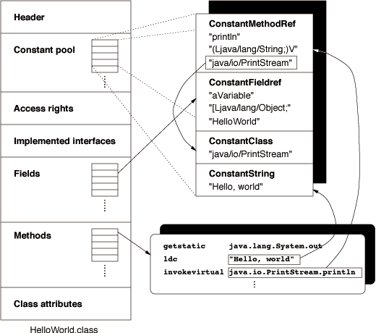
class File

Slide 18
Issues in Compiler Testing
The aim of compiler testing is to verify that the compiler implementation conforms to its specifications, which is to generate an object code that faithfully corresponds to the language semantic and syntax as specified in the language documentation.

Slide 19
Test case:
A test purpose or test case description
A test input consisting of a source program for which the behavior of the compiler under test is verified
An expected output which may include a reference to an output file or error file.

Slide 20
Compiler
test suite
Test programs
Test program generator
Compiler under test
Compiler output
Test result analysis
Grammar
Expected output
Test Report
Test case generation and selection
Dynamic test execution
Test result analysis
Different stages of compiler testing

Slide 21
Criteria to assess test case generation methods:
Data definition coverage
Syntax coverage
Semantic coverage
Extent of automation
Implementation and efficiency

Slide 22
Thank You

