Slide 1
Register allocation
Morgensen, Torben. "Register Allocation." Basics of Compiler Design. pp191-208.
from (http://www.diku.dk/~torbenm/Basics/basics_lulu2.pdf)
Karina Liles
Compiler Construction
Spring 2013

Slide 2
Overview
9.2 Liveness
9.3 Liveness Analysis
9.4 Interference
9.5 Graph Coloring
9.6 Spilling
9.7 Heuristics

Slide 3
Chapter 9: Introduction
Register Allocation: The process of assigning variables to registers.
Only a few registers available
Some registers must be used for a particular purpose

Slide 4
9.1 Liveness
Definition 9.1 A variable is live at some point in the program if the value it contains at that point might conceivably be used in future computations. Conversely, it is dead if there is no way its value can be used in the future.
Q: When can two variables share a register?

Slide 5
A: Two variables may share a register if there is no point in the program where they are both live
We can use rules to determine when a variable is live:
If an instruction uses the contents of a variable, that variable is live at the start of that instruction. (Generated)
If a variable is assigned a value in an instruction, and the same variable is not used as an operand in that instruction, then the variable is dead at the start of the instruction, as the value it has at this time is not used before it is overwritten. (Killed)
If a variable is live at the end of an instruction and that instruction does not assign a value to the variable, then the variable is also live at the start of the instruction. (Propagated)
A variable is live at the end of an instruction if it is live at the start of any of the immediately succeeding instructions. (Propagated)

Slide 6
9.3 Liveness analysis
The instruction numbered j (if any) that is listed just after instruction number i is in succ[i], unless i is a GOTO or IF-THEN-ELSE instruction. If instructions are numbered consecutively, j = i + 1.
If instruction number i is of the form GOTO l, (the number of) the instruction LABEL l is in succ[i]. Note that there in a correct program will be exactly one LABEL instruction with the label used by the GOTO instruction.
If instruction i is IF p THEN lt ELSE lf, (the numbers of) the instructions LABEL lt and LABEL l f are in succ[i].

Slide 7
gen[i]: lists the variables that may be read by instruction i (live at the start of the instruction)
kill[i]: lists the variables that may be assigned a value by the instruction

Slide 9
For each instruction i, we use two sets to hold the actual liveness information:
in[i] – holds the variables that are live at the start of i
out[i] – holds the variables that are live at the end of i

Slide 11
Reverse order
out[13], in[13], out[12], in[12],...,out[1], in[1]

Slide 12
9.4 Interference
Definition 9.2 A variable x interferes with a variable y if x≠y and there is an instruction i such that x ∈ kill[i], y ∈ out[i] and instruction i is not x := y.

Slide 13
After x:=y, x and y may be live simultaneously, but as they contain the same value, they can still share a register.
It may happen that x is not in out[i] even if x is in kill[i], which means that we have assigned to x a value that is definitely not read from x later on. In this case, x is not technically live after instruction i, but it still interferes with any y in out[i]. This interference prevents an assignment to x overwriting a live variable y.

Slide 16
Figure 9.5: Interference graph for the program in figure 9.2

Slide 20
9.5 Register allocation by graph coloring
Graph coloring is the process of assigning colors to nodes, such that nodes connected by an edge have different colors
A graph is n-colorable if it has a coloring with n colors
Nodes = Variables
Colors = Registers

Slide 21
9.5 Register allocation by graph coloring
Two variables can share a register if they are not connected by an edge in the interference graph. Hence, we must assign to each node in the interference graph a register number such that:
Two nodes that share an edge have different register numbers.
The total number of different register numbers is no higher than the number of available registers.

Slide 22
Interference Graph

Slide 23
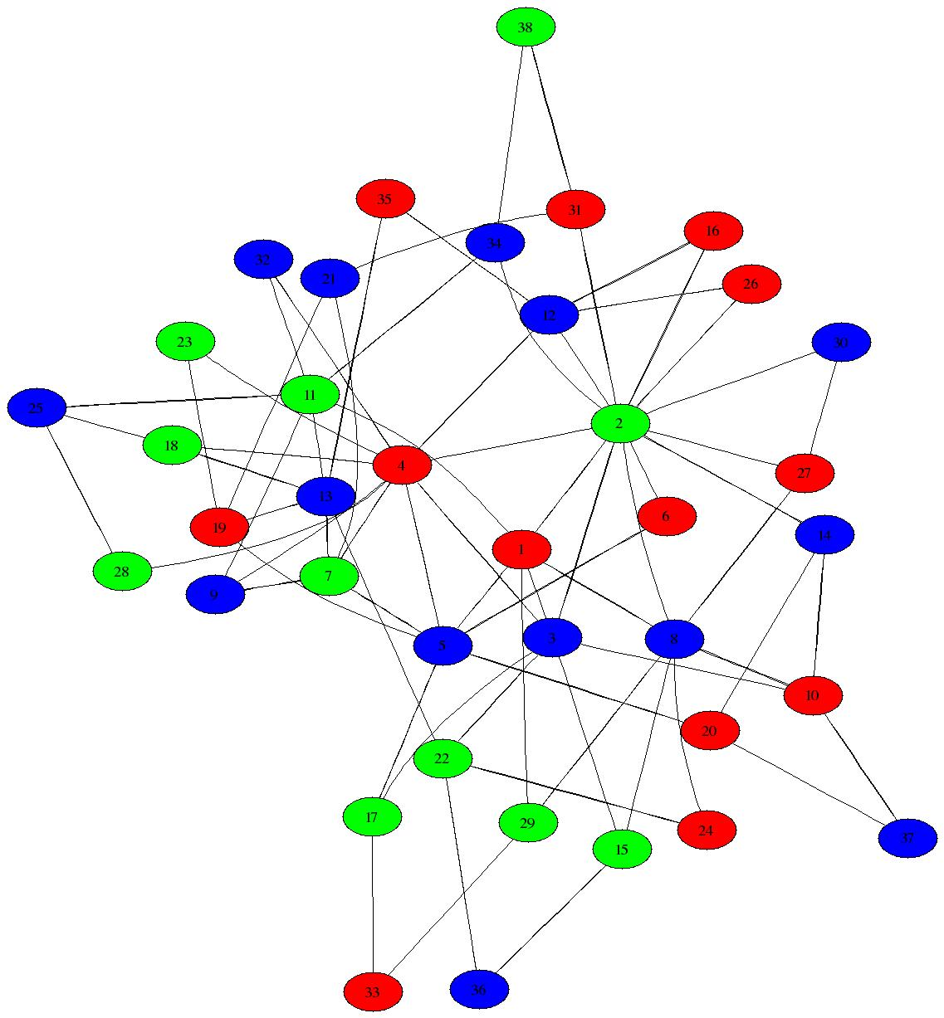
Heuristics for Register Coloring

Slide 24
Heuristics for Register Coloring
Coloring a graph with N colors
If degree < N (degree of a node = # of edges)
Node can always be colored
After coloring the rest of the nodes, you’ll have at least one color left to color the current node
If degree >= N
still may be colorable with N colors

Slide 25
Heuristics for Register Coloring
Remove nodes that have degree < N
Push the removed nodes onto a stack
When all the nodes have degree >= N
Find a node to spill (no color for that node)
Remove that node
When empty, start to color
Pop a node from stack back
Assign it a color that is different from its connected nodes (since degree < N, a color should exist)

Slide 26
Algorithm 9.3
Initialize: Start with an empty stack.
Simplify: If there is a node with less than N edges, put this on the stack along with a list of the nodes it is connected to, and remove it and its edges from the graph.
If there is no node with less than N edges, pick any node and do as above.
If there are more nodes left in the graph, continue with simplify, otherwise go to select.
Select: Take a node and its list of connected nodes from the stack. If possible, give the node a color that is different from the colors of the connected nodes (which are all colored at this point). If this is not possible, coloring fails and we mark the node for spilling (see below).
If there are more nodes on the stack, continue with select.

Slide 27
Graph Coloring Example
s1
s2
s0
s3
s4

Slide 28
Initialize
N = 3
s1
s2
s0
s3
s4

Slide 29
Simplify
N = 3
s1
s2
s0
s4
s3
s4

Slide 30
Simplify
N = 3
s1
s2
s0
s2
s4
s3
s4

Slide 31
Simplify
N = 3
s1
s2
s0
s1
s2
s4
s3
s4

Slide 32
Simplify
N = 3
s1
s2
s3
s0
s1
s2
s4
s3
s4

Slide 33
Simplify
N = 3
s1
s2
s0
s3
s0
s1
s2
s4
s3
s4

Slide 34
Select
N = 3
s1
s2
s0
s3
s0
s1
s2
s4
s3
s4

Slide 35
Select
N = 3
s1
s2
s3
s0
s1
s2
s4
s3
s4

Slide 36
Select
N = 3
s1
s2
s0
s1
s2
s4
s3
s4

Slide 37
Select
N = 3
s1
s2
s0
s1
s2
s4
s3
s4

Slide 38
Select
N = 3
s1
s2
s0
s2
s4
s3
s4

Slide 39
Select
N = 3
s1
s2
s0
s2
s4
s3
s4

Slide 40
Select
N = 3
s1
s2
s0
s4
s3
s4

Slide 41
Select
N = 3
s1
s2
s0
s4
s3
s4

Slide 42
Select
N = 3
s1
s2
s0
s3
s4

Slide 43
Select
N = 3
s1
s2
s0
s3
s4

Slide 44
9.6 Spilling
Initialize: Start with an empty stack.
Simplify: If there is a node with less than N edges, put this on the stack along with a list of the nodes it is connected to, and remove it and its edges from the graph.
If there is no node with less than N edges, pick any node and do as above.
If there are more nodes left in the graph, continue with simplify, otherwise go to select.
Select: Take a node and its list of connected nodes from the stack. If possible, give the node a color that is different from the colors of the connected nodes (which are all colored at this point). If this is not possible, coloring fails and we mark the node for spilling (see below).
If there are more nodes on the stack, continue with select.

Slide 45
9.6 Spilling
Choose a memory address address_{x} where the value of x is stored.
In every instruction i that reads or assigns x, we locally in this instruction rename x to x_{i}.
Before an instruction i that reads x_{i}, insert the instruction x_{i} := M[address_{x}].
After an instruction i that assigns x_{i}, insert the instruction M[address_{x}] := x_{i}.
If x is live at the start of the program, add an instruction M[address_{x}] := x to the start of the program. Note that we use the original name for x here.
If x is live at the end of the program, add an instruction x := M[address_{x}] to the end of the program. Note that we use the original name for x here.

Slide 46
9.6 Spilling
Figure 9.6

Slide 47
9.6 Spilling
Figure 9.7

Slide 48
9.6 Spilling
Figure 9.8

Slide 49
9.6 Spilling
Figure 9.9

Slide 50
9.7 Heuristics
We may choose a node with close to N neighbors, as this is likely to be colorable in the select phase anyway. For example, if a node has exactly N neighbors, it will be colorable if just two of its neighbors get the same color.
We may choose a node with many neighbors that have close to N neighbors of their own, as spilling this node may allow many of these neighbors to be colored.
We may look at the program and select a variable that does not cost so much to spill, e.g., a variable that is not used inside a loop.

Slide 51
9.7 Heuristics
9.7.1 Removing redundant moves
9.7.2 Using explicit register numbers

Slide 52
Conclusion
I welcome all questions and comments via email: lileskr@email.sc.edu
I encourage you to try the exercises at the end of chapter 9 to increase your understanding

