Slide 1
Fast, Effective Code Generation
in a
Just-In-Time Java Compiler
Rejin P. James & Roshan C. Subudhi
CSE Department
USC, Columbia

Slide 2
Introduction
What is JIT compilation?
Java source code -> Byte code -> Native machine code
Static compiler(JVM) -> interpreted (faster)
JIT -> converts (comparatively slower)
Efficient Java JIT compiler through various optimization techniques explained later.
The Java JIT compiler for version 2.5 Intel’s Vtune for Java
Notes:
Static – for C/C++
JIT – at run time
Vtune :- Performance analyzer , JIT profiler, Code optimization

Slide 3
Phases
Prepass
Global Register Allocation
Code Generation
5 major phases of Intel JIT
Code Emission
Code and Patching
Notes:
Explain every phase in short

Slide 4
Pre-Pass phase
Collects following information:
depth of Java operand stack at entry of each basic block
static reference count of each local variable
Java operand stack locations containing references at each point where garbage collection may occur
a list of those variables that alternately hold reference and non-reference values at different points in the method.

Slide 5
Code Generation Phase
Lazy code selection goals:
to keep intermediate values (i.e., Java operand stack values) in scratch registers
to reduce register pressure and take advantage of the IA32 addressing modes by folding loads of immediate operands and accesses to memory operands into the compute instructions that use them.
Auxiliary data structure called Mimic Stack.

Slide 6
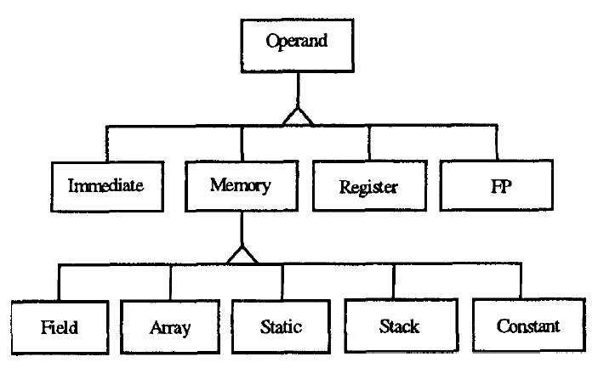
Code Generation Phase
Operand class hierarchy

Slide 7
Code Generation Phase
Lazy code selection optimizations include:
Strength Reduction
Converts compare followed by branch instructions to one compare and branch instruction
Elimination of redundant load after store
Notes:
Stack-based operations

Slide 8
Code Generation Phase
Common Sub-Expression Elimination
by a fast and lightweight algorithm that focuses on extended basic blocks.
expression tag represented by the pair <offset, length>
expressions lengths of 16 bytes are compared, determined empirically
Expressions in R are ‘killed’ when:
Instructions that modify R
Assignments that modify value of R

Slide 9
Code Generation Phase
Common Sub-Expression Elimination limitations:
“x+y” and “y+x” are different,
If “x=w”, “x+y” and “w+y” are different,
Non-contiguous byte code streams not applicable

Slide 10
Code Generation Phase
IA32 Architecture:
Code selector interfaces between code generation and register allocation, and the register manager.
Register manager handles:
7 general-purpose scratch registers
3 caller-saved (eax, ecx, edx) – (local)
4 callee-saved (ebx, ebp, esi, edi) – (global)
Notes:
Spill code is generated if overflow occurs

Slide 11
Code Generation Phase
Local Register Allocation
LRU (circular allocation strategy), based on ‘mimic’ stack
Global Register Allocation
Algorithm 1: highest static reference counts
Algorithm 2: priority-based scheme
Notes:
Spill code is generated if overflow occurs

Slide 12
Code Generation Phase
Benefits of global register allocation (in prepass phase)
less spill code is generated,
callee-saved registers are used as spill locations (reducing stack frame accesses),
more CS are found (registers with live expressions live longer)
Notes:
Spill code is generated if overflow occurs

Slide 13
Code Generation Phase
Array Bounds Check Elimination
Bounds checks can be eliminated if it can be proven that index is always within the correct range
Eg: bounds check for A[7] is computed
=> A[5] bounds check need not be recomputed
Also, this can be applied to the “newarray” bytecode

Slide 14
Code Generation Phase
Array Bounds Check Elimination is limited as follows:
applied only locally and not globally,
only constant operands are used (symbolic information could further reduce bounds checks)

Slide 15
Code Generation Phase
Out-of-Line Exception Throws is similar to the previous technique, but it differs as follows:
subscripts are checked to be within the bounds of the array
This is infrequently used and is referred to as “cold code”

Slide 16
Sample Test Scenario
We will look at a code sequence from the MPEG player program, on the following slide, illustrating the following:
Lazy code selection
Common subexpression elimination
Out-of-Line exception throwing
Register allocation

Slide 17
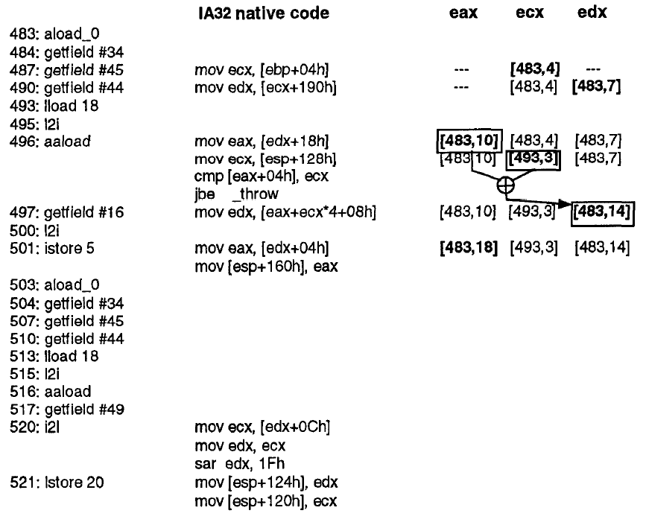
Illustration of optimizations in Intel JIT

Slide 18
Garbage Collection
Freeing up heap space by deallocating memory of unreferenced variables
Live reference analysis done by traversing a graph of reachable nodes from the root set
Root set calculated by JIT because it has access to stack locations and registers

Slide 19
Garbage Collection
Problem is “ambiguous types” which is solved by the JIT being able to precisely enumerate the complete set of variables containing valid references.
This is done through:
Maintaining an extra bit in the stack frame
In general, not possible to analyze all variables and so a dynamic tagging approach is used
Also, analyzing when a variable
a) is initialized
b) is live
c) contains a reference

Slide 20
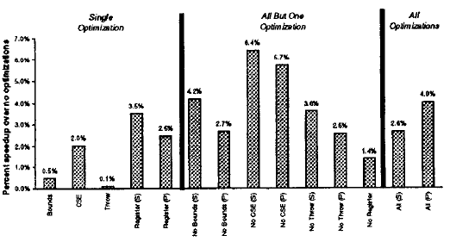
Experimental Analysis
Performance of Lisp

Slide 21
Conclusions
Optimization techniques include:
Lazy code selection
Common subexpression elimination
Global register allocation
Array bounds check elimination
(memory is used sparingly because no explicit intermediate memory representation is used, only byte code is used)

Slide 22
Conclusions
On the whole, the Intel JIT generates code in lesser compilation time and requires smaller memory space, which are the most important criteria to ensure fast performance, and yet high quality of the IA32 code is guaranteed.

Slide 23
References
Adl-Tabatabai, Ali-Reza, Michał Cierniak, Guei-Yuan Lueh, Vishesh M. Parikh, and James M. Stichnoth. "Fast, effective code generation in a just-in-time Java compiler." ACM SIGPlAN Notices 33, no. 5 (1998): 280-290.

