Slide 1

The HipHop Compiler
from Facebook
By
Megha Gupta & Nikhil Kapoor

Slide 2
The HipHop Compiler
from Facebook
By
Megha Gupta & Nikhil Kapoor

Slide 3
Introduction
HipHop for PHP
  HPHPc
  HPHPi
  HPHPd
  HHVM
The Facebook HipHop Compiler @Megha Gupta & Nikhil Kapoor

Slide 4
Chronology of PHP
Became a compiled language with PHP4
Until version3… only Interpreters in vouge
PHP 4 introduced the Zend Engine
  HPHPi
  HHVM
The Facebook HipHop Compiler @Megha Gupta & Nikhil Kapoor

Slide 5
Compiler vs Interpreter
Compiler
  The entire program must be translated before it can start to run and produce result
Interpreter
  The interpreter does not translate the source program into object code prior to execution
The Facebook HipHop Compiler @Megha Gupta & Nikhil Kapoor

Slide 6
Advantages of Compilation
better execution speed
static analysis
improved interoperability with code written in other languages
The Facebook HipHop Compiler @Megha Gupta & Nikhil Kapoor

Slide 7
PHP Compilers of note
Phalanger
Zend Engine
PHP static
PHC
HipHop
The Facebook HipHop Compiler @Megha Gupta & Nikhil Kapoor

Slide 8
compile@Phalanger
Phase 1 - Compiles source code into CIL byte-code
Phase 2 - completed by the JIT compiler component of the.NET Framework.
Does not address:-
  native code generation
  optimization
The Facebook HipHop Compiler @Megha Gupta & Nikhil Kapoor

Slide 9
compile@Zend Engine
splits the processing of PHP code into several phases.
first phase generates Zend opcodes.
second phase execute the opcodes.
opcodes stored in the server shared memory space.
several PHP caching extensions also known as PHP accelerator extensions.
The Facebook HipHop Compiler @Megha Gupta & Nikhil Kapoor

Slide 10
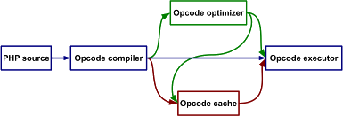
compile@Zend Engine cond…
The Facebook HipHop Compiler @Megha Gupta & Nikhil Kapoor

Slide 11
compile@PHPstatic
(ex. Roadsend PHP)
generates standalone binaries or extensions for the Apache Web server.
Php scripts run as standalone Apache modules
also provides its own Web server
The Facebook HipHop Compiler @Megha Gupta & Nikhil Kapoor

Slide 12
compile@PHC
compiles PHP scripts
generates PHP extension
convert PHP into XML and back
The Facebook HipHop Compiler @Megha Gupta & Nikhil Kapoor

Slide 13
compile@HipHop
Developed on CentOS and Fedora systems.
Initial release 2 February 2010
Increases the speed of PHP applications by factors of 2 to 6 times.
Source code on GitHub
The Facebook HipHop Compiler @Megha Gupta & Nikhil Kapoor

Slide 14
compile@HipHop cond…
HPHPc
  original version of HipHop
  source code transformer
  Was unfriendly to developers
  deprecated on 19 February 2013
The Facebook HipHop Compiler @Megha Gupta & Nikhil Kapoor

Slide 15
compile@HipHop cond…
HPHPi
  developer mode version of HipHop
  much less performant than HPHPc
  But… enabled developers to use the same stack as production code.
The Facebook HipHop Compiler @Megha Gupta & Nikhil Kapoor

Slide 16
compile@HipHop cond…
HPHPd
  HipHop debugger
  keyboard interactive interface
  Provides developers with many tools for running code and setting watches.
The Facebook HipHop Compiler @Megha Gupta & Nikhil Kapoor

Slide 17
compile@HipHop cond…
HHVM
  The HipHop Virtual Machine
  current version of HipHop
  replaced HPHPc and HPHPi
The Facebook HipHop Compiler @Megha Gupta & Nikhil Kapoor

Slide 18
compile@HipHop cond…
HHVM
  compiles PHP source to Bytecode
  Bytecode either:-
    run in a virtual machine environment, or
    compiled at run-time to machine code
  uses a custom JIT
The Facebook HipHop Compiler @Megha Gupta & Nikhil Kapoor

Slide 19
HipHop
Multi-threaded vs Multi-process
Web Servers
compiles the code into an executable program that works as a multi-threaded Web server.
the compiled PHP code
  runs faster, and
  is more memory efficient.
The Facebook HipHop Compiler @Megha Gupta & Nikhil Kapoor

Slide 20
HipHop
Multi-threaded vs Multi-process
Web Servers cond…
Apache uses Multi-process Web Servers.
each request handled by separate OS process.
each process has its own memory pool.
The Facebook HipHop Compiler @Megha Gupta & Nikhil Kapoor

Slide 21
HipHop
Problem with Multi-process Web Servers
When a process uses a large chunk of memory.
memory is not returned to the OS until the process exits.
waste of memory.
The Facebook HipHop Compiler @Megha Gupta & Nikhil Kapoor

Slide 22
HipHop
Problem with Multi-process Web Servers cond…
HipHop compiler generates… multi-threaded Web server programs
New PHP extensions are thread-safe…
this means that… they can run without crashing.
The Facebook HipHop Compiler @Megha Gupta & Nikhil Kapoor

Slide 23
benchmarks@ HipHop
Tests conducted to evaluate performance of compilers
Script named bench.php
  Does not execute any I/O operations, like accessing files, networks or database servers.
  available from the official PHP development repository.
http://svn.php.net/viewvc/php/php-src/trunk/Zend/bench.php?view=markup
The Facebook HipHop Compiler @Megha Gupta & Nikhil Kapoor

Slide 24
benchmarks@ HipHop
bench.php was executed 5 times for each type of PHP compiler environment
Reason:-
  benchmark was performed on a Linux
  Linux is a preemptive multi-tasking environment
  shortest execution time
The Facebook HipHop Compiler @Megha Gupta & Nikhil Kapoor

Slide 25
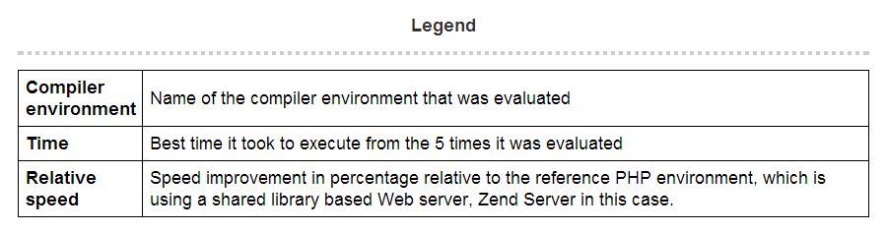
benchmarks@ HipHop
Results for the different PHP compiler environments that were evaluated:-
The Facebook HipHop Compiler @Megha Gupta & Nikhil Kapoor

Slide 26
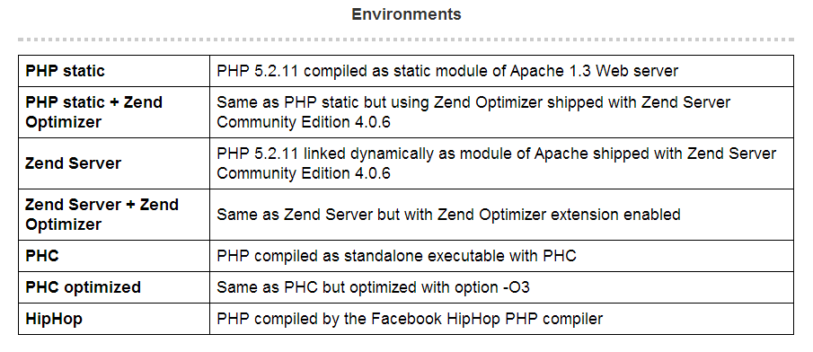
benchmarks@ HipHop
The Facebook HipHop Compiler @Megha Gupta & Nikhil Kapoor

Slide 27
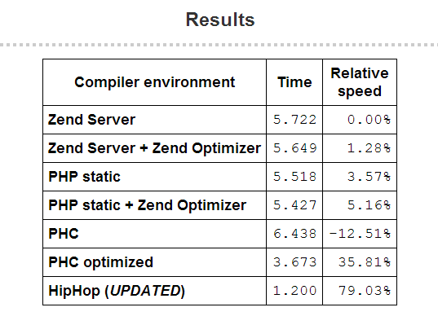
benchmarks@ HipHop
The Facebook HipHop Compiler @Megha Gupta & Nikhil Kapoor

Slide 28
Conclusions@ HipHop
fastest code generated by PHC and HipHop
main difference between these:-
  HipHop generates whole Web server executables
  PHC generates PHP extensions that can be used in a regular PHP installation based on Zend Engine.
  PHC compiled code performs well when enabling optimizer options.
  No big difference when trying different optimizer level values for HipHop.
The Facebook HipHop Compiler @Megha Gupta & Nikhil Kapoor

Slide 29
Which Compiler Best for Who ?
Very busy sites - HipHop
  need many servers to handle all user requests
  memory usage efficiency the best
Not so busy sites - PHC
  provides better speed execution
  memory usage efficiency not so great
The Facebook HipHop Compiler @Megha Gupta & Nikhil Kapoor

Slide 30
Thanks!
The Facebook HipHop Compiler @Megha Gupta & Nikhil Kapoor

