Slide 1

Pokemon Yellow
Total Control Hack
Logan Hood, Justin Baumgartner
CSCE 531 -- 23 April 2013

Slide 2
Overview
The "total control" hack was performed by Robert McIntyre.
By utilizing a buffer overflow bug within the game Pokemon Yellow, he was able to reprogram the game from within by creating a series of "bootstrapping" programs.
http://aurellem.org/vba-clojure/html/total-control.html

Slide 3
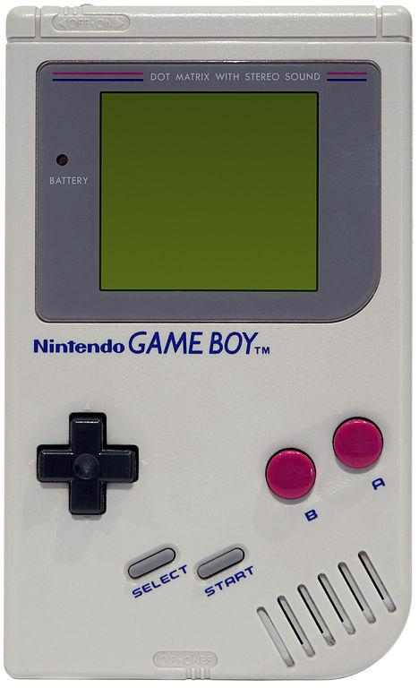
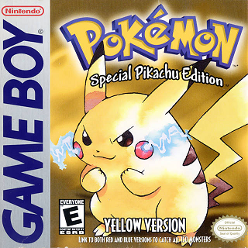
Background
The GameBoy, a portable handheld gaming device was released in 1989.
Pokemon Yellow was released in 1998 by Nintendo for the GameBoy.

Slide 4
GameBoy's Architecture
The GameBoy's machine code is a mix of 8-bit and 16-bit instructions.
Game data is also a series of 8-bit words.
The GameBoy is a Von Neumann machine - i.e. the instructions and the active game data are stored in the same memory unit.
An entire game is stored on a ROM (read-only memory) cartridge.
The GameBoy itself has 8 kB of RAM, plus 8 kB of VRAM.

Slide 5
Why Pokemon Yellow?
A highly popular game with a competitive "speed-running" community.
The fastest legitimate run is ~2.5 hours, but what if we exploit bugs in the game?
Some individuals discovered a buffer overflow bug that could allow a player to skip the majority of the game, bringing the completion time of the game under two minutes.

Slide 6
What Is a Buffer Overflow?
Occurs when a program accesses data outside the normal bounds of an array or data structure with size set at run-time.
// C++ example -- reading past the "buffer"
int array [10];
for (int i=0; i < 10; array[i++]=i);
for (int j=0; j <=10; j++)
cout << array[j] << " ";
0 1 2 3 4 5 6 7 8 9 134514656

Slide 7
What Is a Buffer Overflow?
// writing past the buffer
char* input = new char[5];
int* array = new int[10];
for (int j=0; j < 10; array[j] = j++);
cout << "enter 5 characters:" << endl;
/* if the user enters more than 5 characters,
this will cause a buffer overflow */
cin >> input;
cout << "here is your unaltered list..." << endl;
for (int j=0; j < 10; cout << array[j++] << endl);

Slide 8
What Is a Buffer Overflow?
enter 5 characters...
> hello
here is your unaltered list...
0
1
2
3
4
5 ...

Slide 9
What Is a Buffer Overflow?
enter 5 characters...
> YOU_CAN'T_TELL_ME_WHAT_TO_DO!!
here is your unaltered list...
1213685573
1415533633
1329880911
8481
4
5 ...

Slide 10
What Is a Buffer Overflow?
This can be a significant security issue if the compiler and/or operating system does not perform bounds checking.
Since there is no "operating system" other than Pokemon Yellow running off the ROM cartridge, all bounds-checking is dependent on the programmer.

Slide 11
How Does This Bug Work?
While saving the game, the author kills the game at a very specific time.
If timed correctly, the save file will be corrupted so that the game thinks the player has 255 pokemon (normally, the maximum size of this array is 6).
The player can perform certain operations on this list, such as swapping the order of pokemon.

Slide 12





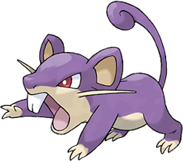
How Does This Bug Work?
This list points to blocks of memory (each Pokemon is stored in 30 bytes), so 30 bytes of memory are swapped whenever pokemons' order are switched.
0 1 2 3 4 5
0-29 30-59 60-89 90-119 120-149 150-179
0-29 30-59 60-89 90-119 120-149 150-179

Slide 13
How Does This Bug Work?
So if the bounds of the list are expanded, and we can swap 30-byte blocks further down the line... accessing memory we shouldn't be able to!
0 1 2 3 4 5 6 7 8

Slide 14
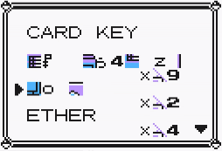
Result of Bug
Now the player can access other memory locations that he shouldn't be able to access.
...including the size of the player's inventory, causing another buffer to overflow.

Slide 15
Item List Overflow
The advantage of overflowing the inventory array is that this is memory that the player can alter (by changing the order of items, buying items, dropping items, etc.).
Every item in the game has a specific 8-bit ID, as well as an 8-bit number for the quantity.
For example, "16 lemonades" would be stored as [62 16]

Slide 16
First Step - Item List
The author writes his first program in the player's inventory by finding items & quantities that correspond to instructions.
A certain function pointer (an address of a subroutine) is also accessible from the overflowed inventory.
By altering the value of this pointer to point to the beginning of the inventory, and causing this subroutine to be called, the first program can be executed.

Slide 17
Items to Instruction
[62 16 37 224 47 240 37 230 15 55]
A "program" that reads the current input state and copies it to Register A.
It corresponds to this sequence of items:
lemonade x16
guard spec. x224
leaf stone x240
guard spec. x230
parlyz heal x55

Slide 18
First Step - Item List
After buying the correct items and quantities, the author deposits them into the item PC to spell out his first program.
Because of the constraints on the number of items available in the game, this program only reads from the A, B, start, and select buttons.
With this program, 4 bits can be generated each frame.

Slide 19
Second Step - 4 Button
This four button program is used to write another program that can take input from each of the 8 buttons on the GameBoy.
This program can write 8 bits each frame so any number of bytes can be written to any location.

Slide 20
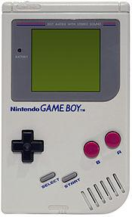
Buttons to Instruction
When writing the programs, the buttons are used to determine if each bit is 0 or 1. So for the 8 button program where B, start, and right are pressed:
0 0 0 1
0 1 1 0
}
0x16

Slide 21
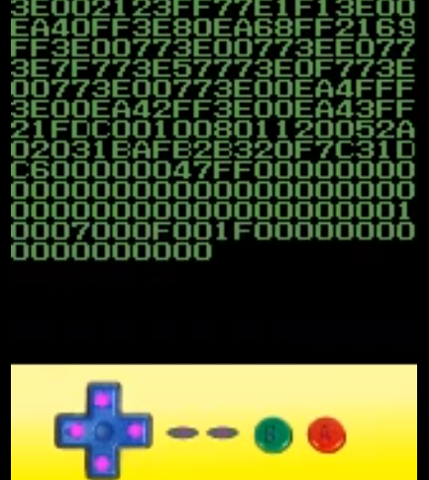
Third Step - 8 Button
Finally, the author uses bootstraps the new 8 button program to create another program that can also display the bytes it is writing on the screen.
The function pointer is swapped with the location of this final program and the program is loaded and run.

Slide 22
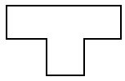

Tombstone Diagrams
8-Button
MC
8-Button
MC
4-Button
MC
4-Button
MC
Items
Items

Slide 23
Tombstone Diagrams
8-Button
w/ Display
MC
8-Button
w/ Display
MC
8-Button
8-Button
MC
MC
MC
MC

Slide 24
Tombstone Diagrams
Target
Program
8-Button
Target
Program
MC
8-Button
w/ Display
MC
MC
MC

Slide 25
Video Demonstration
https://www.youtube.com/watch?feature=player_embedded&v=p5T81yHkHtI

Slide 26
What Else Is Possible
Theoretically any 8-bit program that can fit on the 8kB of memory could be programmed to run in this fashion.
Could have Tetris or Pong programmed to run on Pokemon Yellow cartridge.

