Slide 1
Legal and Ethical Issues in Computer Security
Csilla Farkas
farkas@cec.sc.edu

Slide 2
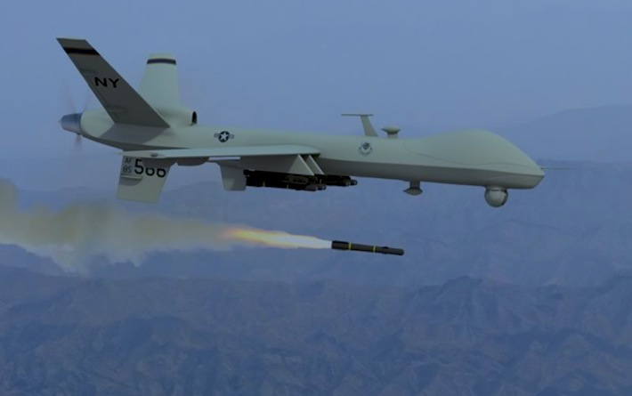
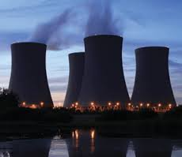
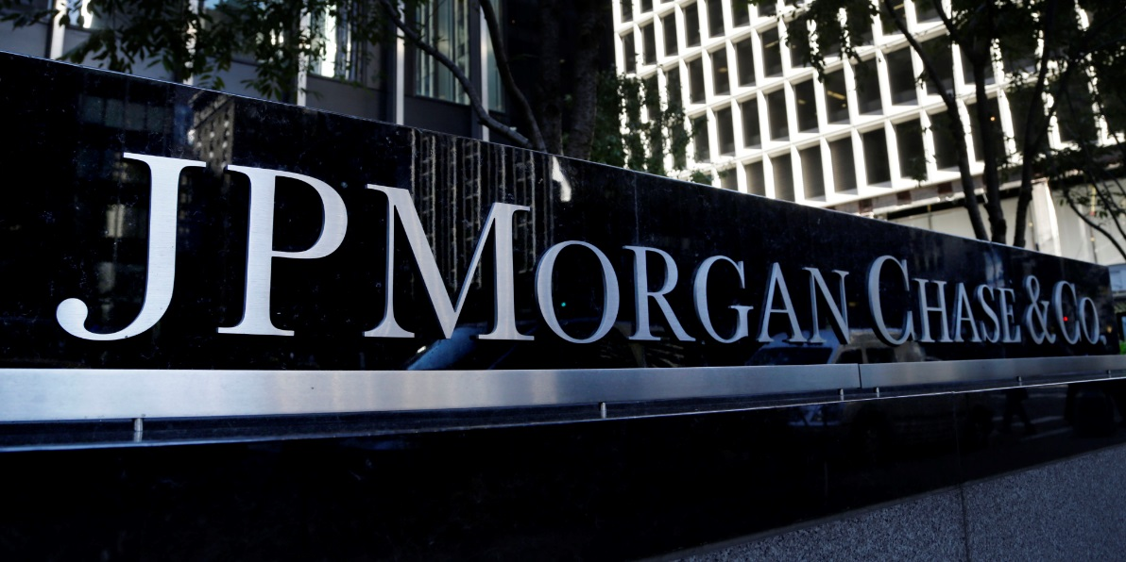
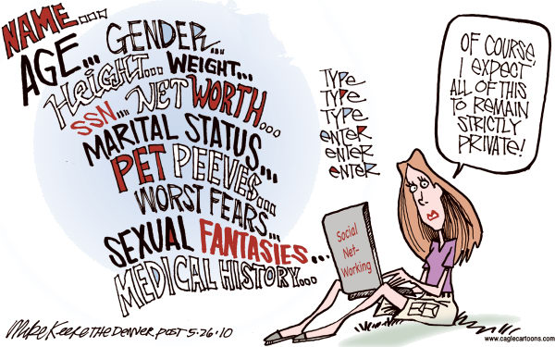
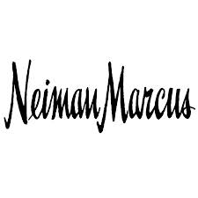
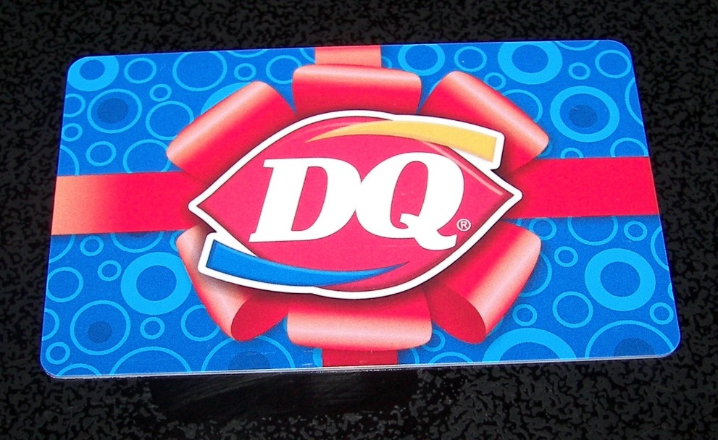
Who is Impacted by Cyber Attacks?
Source: http://www.cagle.com/2010/05/internet-privacy/

Slide 3
The Scary Future!

Slide 4
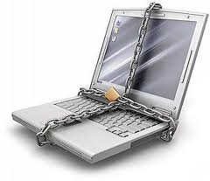
What is Cyber Security?
Highly Technical
People, processes, and technology
Legislation and Regulation
Risk management

Slide 5
Law and Computer Security
International, national, state, and city laws: affect privacy and secrecy
Laws: regulate the use, development, and ownership of data and programs
Laws: affect actions that can be taken to protect the secrecy, integrity, and availability of computing resources

Slide 6
Lack of Legislation
Reactive procedures
Not addressed improper acts
Lack of technical expertise of legal personnel

Slide 7
Protection of Computer Systems
Protecting computing systems against criminals
Protecting code and data
Protecting programmers’ and employers’ rights
Protecting users of programs

Slide 8
Protecting Programs and Data
Copyright
Patents
Trade secrets
Protection for computer objects

Slide 9
Question 1.
If you see someone shoplifting a bicycle what would you do?
Report it
Create diversion to ensure s/he is not detected
Ask if you can borrow it sometime
Turn away

Slide 10
Question 2.
If you see someone making a copy of a computer game what would you do?
Report it
Create diversion to ensure s/he is not detected
Ask if you can borrow it sometime
Turn away

Slide 11
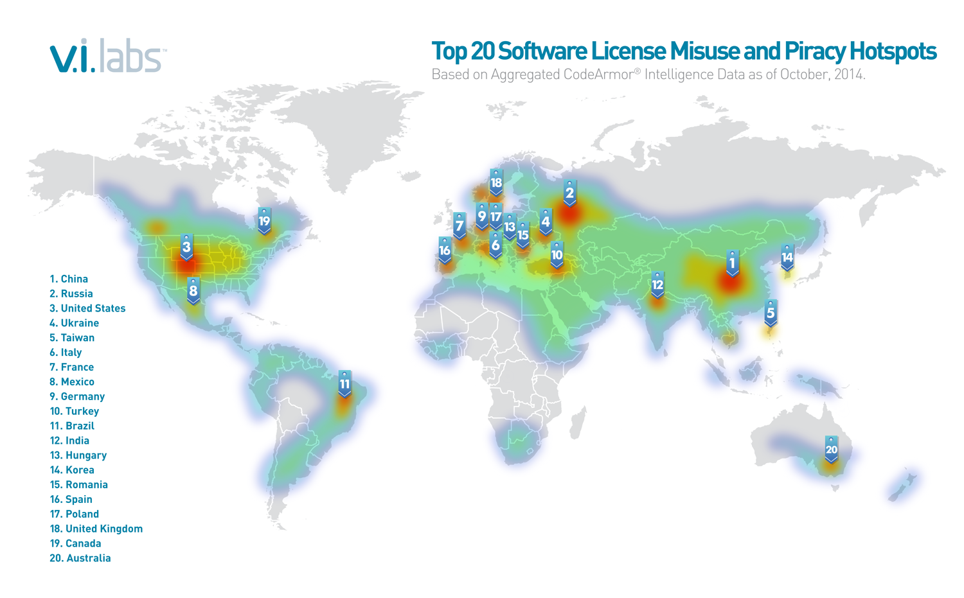
Copyright: http://sdtimes.com/top-20-countries-software-piracy/ Nov. 2014

Slide 12
Copyrights
Protect the expression of ideas
1978: U.S. copyright law
Updated in 1998: Digital Millennium Copyright Act (DMCA) – deals with computers and other electronic media
Give the copyright holder the exclusive right to make copies of the expression and sell them to the public
Simple procedure to register copyright
U.S. copyright expires 70 years beyond the death of last surviving holder

Slide 13
Fair Use
The purchaser has the right to use the product in the manner for which it was intended and in a way that does not interfere with the author’s right.
Piracy
First sale
Copyright infringement

Slide 14
Copyright for Digital Objects
Digital Millennium Copyright Act
Digital objects can be copyrighted
It is a crime to circumvent or disable anti-piracy functionality
It is a crime to manufacture, sell, or distribute devices that disable anti-piracy functionality or that copy digital objects
Exempt: when used for educational and research purposes
It is legal to make a backup to protect against loss
Libraries can make three backups

Slide 15
Patents
Protects inventions – results of science, technology, and engineering
Requirement of novelty
Truly novel and unique → only one patent for a given invention
Non-obvious
U.S. Patent and Trademark Office: register patent
Patent attorney: verifies that the invention has not been patented and identifies similar inventions

Slide 16
Patent Infringement
Copyright: holder can decide which violations prosecute
Patent: all violations must be prosecuted or patent can be lost
Suing for patent infringement may cause the patent owner to loose the paten. Infringer may argue that:
This isn’t infringement (different inventions)
The patent is invalid (a prior infringement was not opposed)
The invention is not novel
The infringer invented the object first

Slide 17
Trade Secret
Information that gives one company a competitive edge over the others
Must always be kept secret
If someone obtains it improperly, the owner can recover
Profits
Damages
Lost revenues
Legal cost
Reverse Engineering!

Slide 18
Protection of Computer Objects
Protecting hardware, firmware, object code software, source code software, documentation, web content, domain names, etc.

Slide 19
Computer Crime
Least clear area of law in computing
Separate category for computer crime
No access to the physical object → Is it a serious crime?
Rules of evidence → How to prove the authenticity?
Threats to integrity and confidentiality → How to measure loss of privacy?
Value of data → How to measure it?

Slide 20
Why Computer Crime is Hard to Prosecute?
Lack of understanding
Lack of physical evidence
Lack of recognition of assets
Lack of political impact
Complexity of case
Age of defendant

Slide 21
Ethical Issues
Ethic: objectively defined standard of right and wrong
Ultimately, each person is responsible for deciding what to do in a specific situation
Ethical positions can and often do come into conflict

Slide 22
Ethics vs. Law
Law | Ethics
Formal, written document | Unwritten principles
Interpreted by courts | Interpreted by each individual
Established by legislatures | Presented by philosophers, religious, professional groups
Applicable to everyone | Personal choice
Priority decided by court | Priority determined by individual
Court makes final decision | No external decision maker
Enforceable by police and courts | Limited enforcement

Slide 23
Questions?

