Slide 1

Condor Cluster
Matt Scofield

Slide 2
What is the Condor Cluster
1,760 Playstation 3s forming a super computer
Designed by the USAF for high resolution satellite images
35th fastest computer in the world
Energy efficient, seventh greenest computer in the world

Slide 3
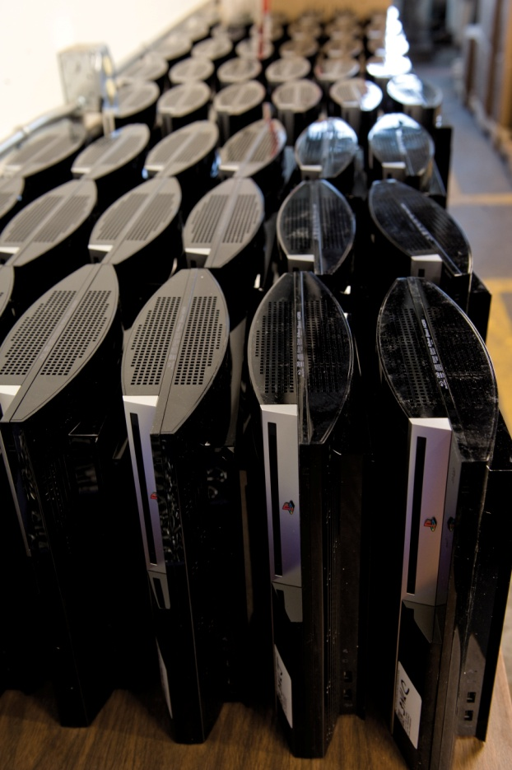
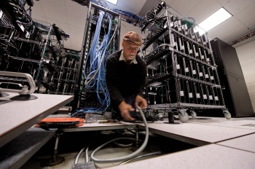
Ethical Issues
Is it ethical for the US Air Force to use PlayStation 3s to enhance target images?

Slide 4
Benefits
Low cost project
Very energy efficient
Can perform 1.5 GigaFLOPS (floating point operations per second)

Slide 5
Other Potential Uses
Neuromorphic computing
Laster, Jill. "1,760 PlayStation 3s Form New Supercomputer - Air Force News | News from Afghanistan & Iraq - Air Force Times." Air Force News, Pay & Benefits, Careers, Entertainment, Photos - Air Force Times HOME. Gannett Government Media Corporation, 24 Dec. 2010. Web. 18 Apr. 2011. <http://www.airforcetimes.com/news/2010/12/air-force-playstation-3-supercomputer-122410w/>.

