Slide 1
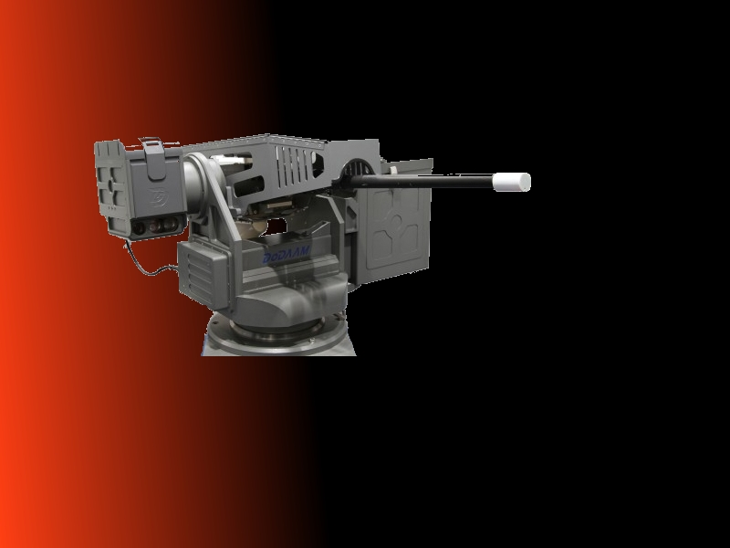
Computer Aided Warfare
A new type of warfare

Slide 2
The conflict with the ACM code of ethics
Section 1.2: Avoid harm to others.
This principle prohibits use of computing technology in ways that result in harm to any of the following: users, the general public, employees, employers.

Slide 3
Information Warfare
Disruption of the enemy’s power and communications grids.
Can lead to loss of civilian life, even though the target is generally the political and military structures.

Slide 4
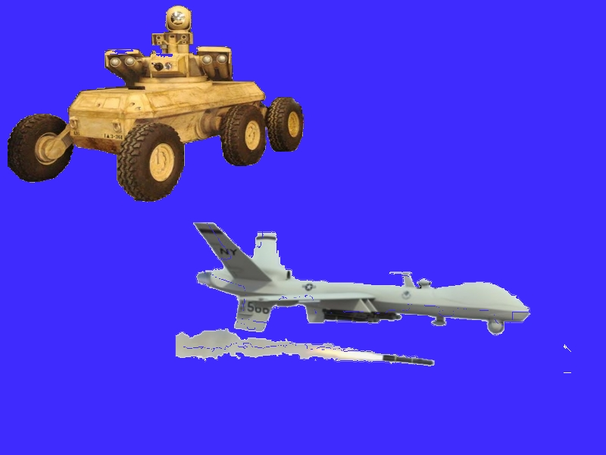
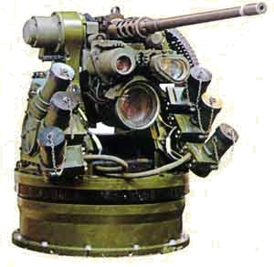
Semi-Autonomous Weapons Systems
UGV, UAV, UUV (Unmanned Ground, Air, Underwater Vehicles)
Remote Weapon stations

Slide 5
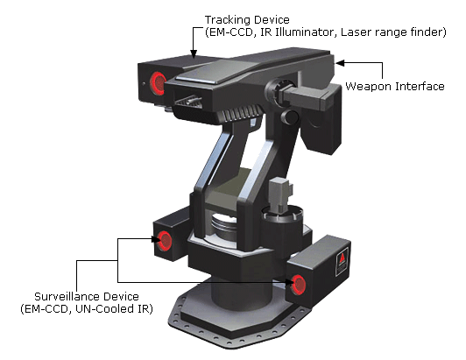
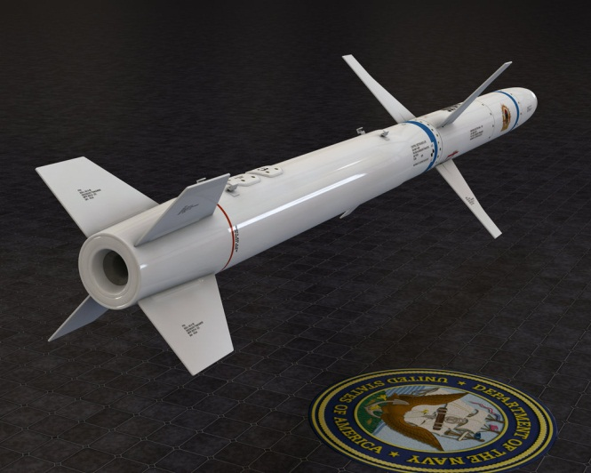
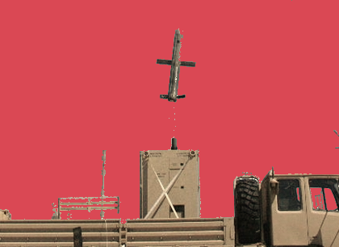
Autonomous Weapons Platforms
Samsung SGR-A1
XM501 Non-Line-of-Sight Launch System
AGM-88E Advanced Anti Radiation Guided Missile

Slide 6
Problem: How can engineers follow the code and develop systems for their countries military?
The functionality of most military systems is to bring harm to their country’s enemies which is in implied conflict with section 1.2.

Slide 7
Solution:
The code of ethics needs to be updated to take in account that computer scientist/engineers are needed to develop weapon systems for their nations military, while assuring they follow the generally accepted rules of warfare.
To not update the code is to make a declaration of pacificity, which is unrealistic and harmful to the organization.

