Slide 1


Facebook Opens Up Its Hardware Secrets
By Martin Nenov
Date: 04/18/11
Source: Technology Review MIT

Slide 2
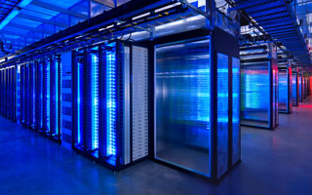
What is the ‘Open Compute Project’?
The Big goal: To build one of the most efficient computing infrastructures at the lowest possible cost.
The result : Data center full of vanity free servers which is 38% more efficient and 24% less expensive to build and run than other state-of-the-art data centers.

Slide 3
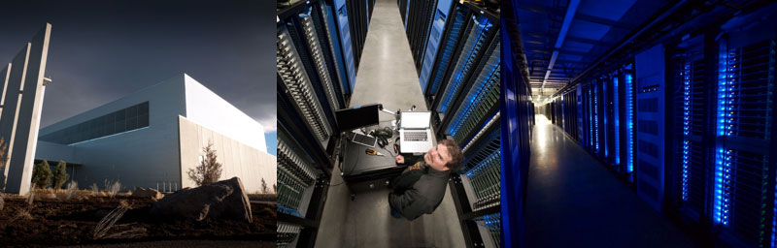
Facebook breaks the Rules
“The company is breaking a long-established unwritten rule for Web companies: don't share the secrets of your server-stuffed data warehouses.”
Technology Review MIT

Slide 4
Ethical Issues:
Company privacy & corporate secrets revealed !
Other major online companies may cherry pick elements from Facebook's designs.
The most energy-efficient data centers ever built will be available for competitors replicate ideas and take advantage of their technology innovations etc.

Slide 5

The motives of
Most of those secret servers rely heavily on open source or free software. Facebook`s Idea is to do the same for the hardware…WHY $?
"Mark [Zuckerberg] was able to start Facebook in his dorm room because PHP and Apache and other free and open-source software existed," says David Recordon, who helps coordinate Facebook's use of, and contribution to, open-source software. "We wanted to encourage that for hardware, and release enough information about our data center and servers that someone else could go and actually build them.“
MIT

Slide 6

The Conclusion is : Openness
The Goal is to develop servers and data centers following the model traditionally associated with open source software projects.
1st Step- releasing the specifications and mechanical drawings
2nd Step- working with the community to improve them.
Let`s Work together to make the world more efficient through technology

