Slide 1
Computer Factories eat way more energy than running the devices they build
By Guangfei Liu

Slide 2
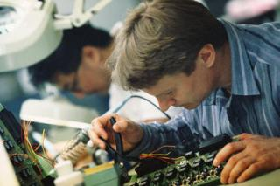
Idea behind saving energy
Buy newer, more energy efficient devices
It is the wrong way to look at the issue
Researchers show that 70% of the energy in a laptop is used in manufacturing

Slide 3
Manufacturing a laptop emit carbon
227 to 270 kilograms per laptop
Close to manufacture of a refrigerator
Requires 3010-4340 MJ of primary energy

Slide 4
Ethical issure?
Influence the environment
Waste of energy
Waste of materials

Slide 5
Solution
To extend lifespan mitigate manufacturing energy use
Questions:
  Is there any other solutions?
  Do you think we should buy newer computers or reuse our computers?
  What do you think computer factories should do?

