Slide 1
THE LANGUAGE OF THE INTERNET
Internationalizing domain names.

Slide 2

The history
The previous generation
Their sacrifice
Their failure
Their success

Slide 3

The article
“Internationalizing Top-Level Domain Names: Another Look”
John Klensin, Oct 18, 2004
Conflict of interest? Or conflict of conscience?

Slide 4
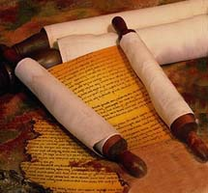
The Code of ethics and professional practice
Step 1.) the case
Step 2.) the stakeholders
Step 3.) the three solutions
Step 4, 5, 6, 7, and 8.) five birds one natural stone.

Slide 5

The verdict
4.06 and 6.07
You decide!

