Slide 1
Defensive Cyber weapon in Japan
ACM Jan 12
Ronessa DaSilva

Slide 2
What is it?
The Defense Ministry (of Japan) is in the process of developing a computer virus that tracks, identifies and disable sources of cyber attacks.
Most distinctive feature of the virus is its ability to trace cyber-attack sources.
Identify immediate source AND “springboard” computers used to transmit the virus
Virus can disable attacking program and collect relevant information
But analysts say that it could violate Japanese law that bans virus production

Slide 3
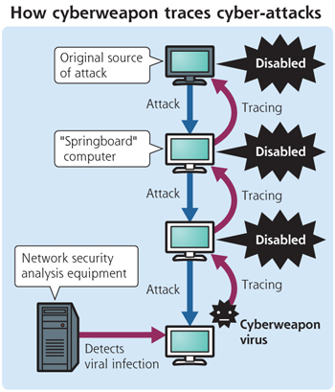
How it works?

Slide 4
Ethical Decision-Making Process
1) Problem is there are cyber attacks going on
2) Stakeholders are the computer owners: companies, businesses, individuals
3) Solution: Cyber weapon mentioned
4) Everyone should be be permitted to use the solution.
5) This solution is natural however, to fight the virus, a virus itself is being developed to stop cybert attacks.
6) There should be a majority agreement that the solution is the most efficient. It is currently being used in the USA and China but not in Japan. And it surely will produce the greatest good for the greatest number of people

Slide 5
Ethical Decision-Making Process (cont.)
7) This solution is the one I personally feel most committed to regardless of whether or not it benefits me personally. The process makes it easier to prosecute the one starting the cyber attacks by tracking them. I choose this solution free from the influence of others.
8) The Philosophy that I feel influences my solution in this case is pragmatism.

Slide 6
ACM Code
This solution applies to first ACM code under General Moral Imperatives: 1.2 Avoid harm to others. “Harm means injury or negative consequences, such as undesirable loss of information, loss of property damage, or unwanted environmental impacts… Harmful actions include intentional destruction or modification of files and programs leading to serious loss of resources.”
This cyber weapon virus will help prevent serious problems that attackers can cause.

