Slide 1

Fat Fingers
A Big Problem With Smartphones
By: Ray Bracey
April 21st, 2011
For: Valtorta’s CSCE 390 Class. Thursdays at 3:30
Technews Archive: http://technews.acm.org/archives.cfm?fo=2009-11-nov/nov-25-2009.html#439249
Article: http://www.newscientist.com/article/dn18190-fat-fingers-can-become-dainty-for-touch-screens.html

Slide 2
What and Who
Touch screens are becoming smaller and smaller
Buttons on screens are becoming smaller and smaller
People with larger fingers can feel left out
People Involved
People with larger fingers
Smartphone Creators
Smartphone App Developers

Slide 3

Possible Solutions
Extremes
A: Increase the size of phones by twice as much
B: Decrease size of fingers by exercising
Compromise
C: Phones that zoom in when you press them

Slide 4
Make Phones Bigger
Best Case
Phones will be more accessable to people
Those with larger fingers don’t have to do anything
Software can draw on a bigger screen
Visibility is dramatically increased
Worst Case
Prices increase substantially
Phones won’t fit in pockets
More than likely will not sell very well

Slide 5
Make Fingers Smaller
Best Case
People will be able to press smaller buttons
Health and lifespan will increase dramatically
Phones could remain the same size
Worst Case
People don’t like being told to lose weight
Some people may not be able to decrease the size of their fingers
Smartphones might get even smaller

Slide 6
Magnifying Feature
Best Case
Can easily detect where user is pressing
Can be helpful for people of all finger sizes
Visibility also dramatically increases.
Sales increase over fantastic feature
Worst Case
Software may be hard to develop
May make users feel bad about themselves
May not even know about feature if not advertised properly

Slide 7
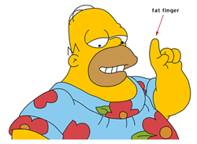
Why Magnifier Works
Gives all people the chance to use phone
Increases the quality of phones
More job opportunities for developers who will create feature
Everybody wins!

Slide 8
Why Magnifyer works
Would allow anybody to use solution
Treats all parties involved humanely and gives the best result for all
Natural: Doesn’t require drastic changes
Good Balance
  Increases the size of the screen
  Decreases the required width of the finger

Slide 9
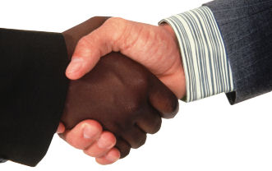
Agreement
Most parties will be in agreement
Smartphone companies will make more money
Software jobs will increase
Phones will become more user-friendly

Slide 10
Personal Beliefs
Without any bias, I believe this is the best solution
It would make the most amount of people happy
Idealistic
  There is room for error, so we compromise
  Nothing is set in stone, so we change
  No one person is right, so we work together

