Slide 2
About Us
The mission of the University of South Carolina Career Center is to empower and educate students in the development of lifelong career management skills.

Slide 3
About Us
  Decide it. Make informed career decisions
  Experience it. Gain career related experience before graduation
  Live it. Prepare for and find employment opportunities after graduation

Slide 4
Career Center Services:
Content Packed Website
  Online tip sheets
  4 year timeline
  Career information & job listings/salary data
OptimalResume
USC JobMate (sponsored by Bosch)
  Job Listings
  Resume Referrals
  On-campus Interviews
Job Fairs & Events
Graduate School Preparation
Alumni Career Services/Reciprocity
Overview of Services
On-Call Counselor Access (1-4, M-F)
Career Counseling by Appointment
Discovery Tools (FOCUS, MBTI, SII, etc.)
Job Shadowing
Workshops
Internships & Co-ops
Mock Interviewing
Comprehensive Career Library
Small groups
Notes:
No one else will be responsible for your career path - you are in the drivers seat!! No one else knows you as well as you…don’t depend on what others think….make informed decisions.
All the services in the world don’t do you any good if you don’t take the initiative to use them – talk about how many seniors comment that they wish they’d come earlier.
Making no decision IS a decision.

Slide 5
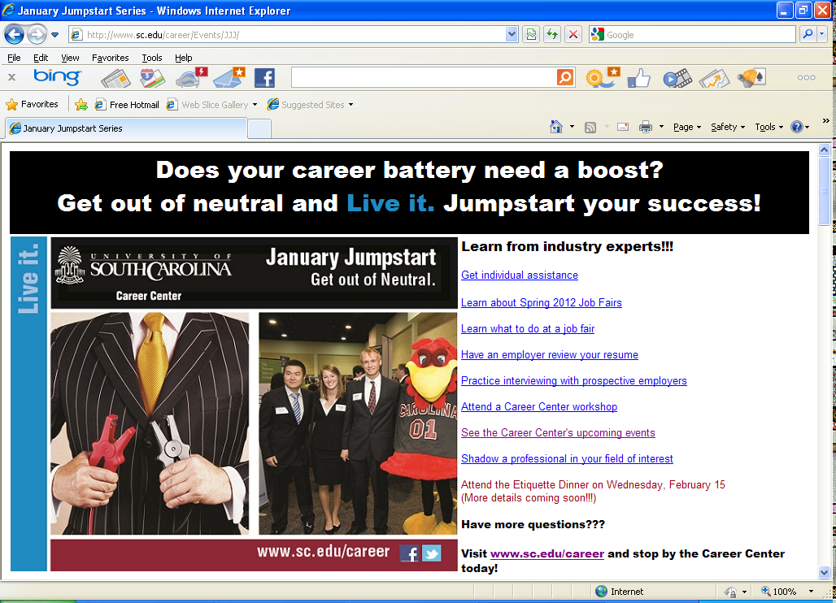

Slide 6

Science, Engineering & Technology Fair

Slide 7
INTEGRATION POINT
Thursday, Jan 26
Integration Point is hosting
an Information Session
Time: 5:30PM
Location: Faculty/Staff Lounge (1A03 Swearingen)
Learn more about Integration Point by visiting www.IntegrationPoint.com

Slide 8

Stay Connected to the Career Center:
Attend Workshops & Events
Become a fan of CEC Career Center on Facebook
Read Email Updates/Newsletters sent to you
Watch the Flat Panel Displays
Visit our Office
Drop-in the Ms. Fields’ Cookie Events (3rd Thurs at 3PM) Follow us on Facebook

Slide 9
Identify Experiential Learning Opportunities

Slide 10

Real Work Before the Real World
Experience it.
Internships
Job Shadowing
Research
Student Organizations
Peer Leadership
Volunteer
Part-Time Work
Study Abroad
Co-ops

Slide 11
GET EXPERIENCE…
It’s really not a choice, it’s a must!
Internship
Cooperative Education (Co-op)
Job Shadowing

Slide 12

Building a Foundation for Your Career
The USC JobMate database allows students to search for jobs, internships, and employers. You can search for CIP internships too!!!
Use Perfect Interview software or do a mock interview with a Career Center staff member to help you prepare for an internship or co-op interview.

Slide 13

Building a Foundation for Your Career
Our Community Internship Program connects students and employers by facilitating internship opportunities.

Slide 14
Cooperative Education Participation
College of Engineering and Computing Students comprise 73% of the total number of students doing co-op at USC
Average co-op salary = $15.57/hr
Last year CEC students averaged approx. $18/hr

Slide 15
PREPARE FOR S.E.T. FAIR

Slide 16
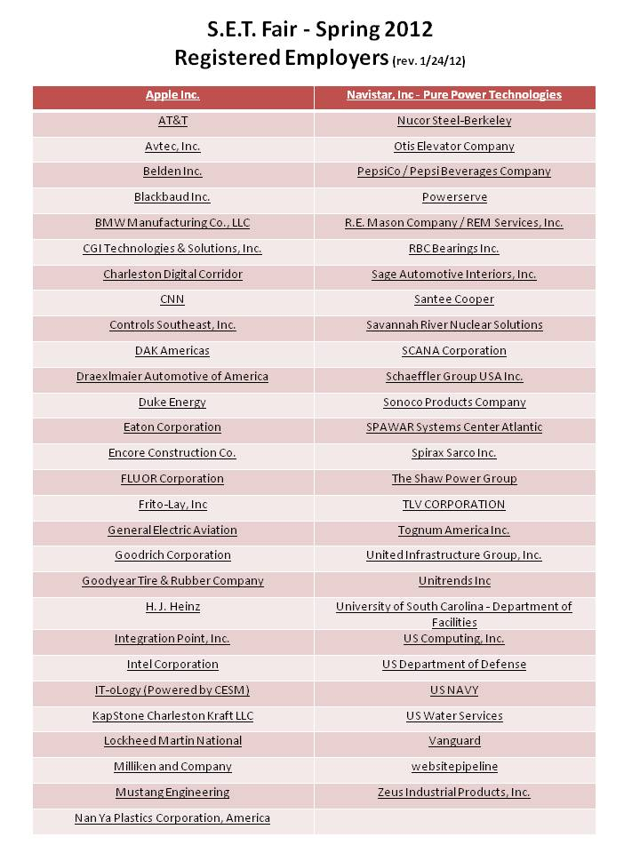

Slide 17
Know your Goal:
Understand your reason for attending
the fair. Are you:
  looking for full-time, part-time,
  internship, co-op?
  exploring career opportunities?
  investigating companies?
  practicing networking skills?

Slide 18
Research Employers Attending the Fair
Review list of employers attending the fair via JobMate (accessible from www.sc.edu/career)
Visit employer web sites and use employer research sites found on the Career Center’s web resources page
Use Company/Organization Information tip sheet to organize your research
Narrow and prioritize number of employers to whom you will focus your attention

Slide 19
Make a Good 1st Impression
Have a well-written, critiqued resume – bring 20+ copies
Develop a list of questions for employers based on research
Prepare to speak a “skills” language
Know how to express your qualifications and goals
Know how to express what you are looking for and what you want
Prepare a Career Fair Employer Log to use for note-taking during the fair

Slide 20
Make a Good 1st Impression
Arrive early and give yourself enough time to not rush through the fair
Dress and act professionally
Establish rapport with the recruiters
Remember your body language
LISTEN to the recruiter
Don’t ramble
Ask at least TWO intelligent questions of each organization

Slide 21
Visit Us in the CEC Career Center:
Location: 1st Floor, Swearingen
(behind Reading Room)
803-777-1949 or 803-777-1974
www.sc.edu/career
On-call or Drop-in Hours:
Mon – Fri, 1:00-4:00PM
Appointments can also be made

