Slide 1
Legal and Ethical Issues in Computer Security
Csilla Farkas
farkas@cec.sc.edu

Slide 2
Question 1.
If you see someone shoplifting a book what would you do?
Report it to the authorities
Create a diversion to ensure s/he is not caught
Ask if you can borrow the book later
Turn away and pretend you didn’t see anything

Slide 3
Question 2.
If you see someone making a unofficial copy of a computer game what would you do?
Report it to the authorities
Create diversion to ensure s/he is not caught
Ask if you can borrow the game later
Turn away and pretend you didn’t see anything

Slide 4
Ethics vs. Law
Law | Ethics
Formal, written document | Unwritten principles
Interpreted by courts | Interpreted by each individual
Established by legislatures | Presented by philosophers, religious, professional groups
Applicable to everyone | Personal choice
Priority decided by court | Priority determined by individual
Court makes final decision | No external decision maker
Enforceable by police and courts | Limited enforcement

Slide 5
Law and Computer Security
Laws: regulate the use, development, and ownership of data and programs
Laws: affect actions that can be taken to protect the secrecy, integrity, and availability of computing resources
International, national, state, and city laws

Slide 6
Cyber Security: Lack of Legislation
Reactive procedures
Do not address improper acts
Lack of technical expertise of legal personnel
What is an appropriate protection?
What is a security breach?
Demand
Technology
Law

Slide 7
Protection of Computer Systems
Protecting computing systems against criminals
Protecting code and data
Protecting programmers’ and employers’ rights
Protecting users of programs

Slide 8
Protecting Programs and Data
Copyright
Patents
Trade secrets
Protection for computer objects

Slide 9
Copyrights
Protect the expression of ideas
1978: U.S. copyright law
Updated in 1998: Digital Millennium Copyright Act (DMCA) – deals with computers and other electronic media
Give the copyright holder the exclusive right to make copies of the expression and sell them to the public
Simple procedure to register copyright
U.S. copyright expires 70 years beyond the death of last surviving holder

Slide 10
Fair Use
The purchaser has the right to use the product in the manner for which it was intended and in a way that does not interfere with the author’s right.
Piracy
First sale
Copyright infringement

Slide 11
Copyright for Digital Objects
Digital Millennium Copyright Act
Digital objects can be copyrighted
It is a crime to circumvent or disable anti-piracy functionality
It is a crime to manufacture, sell, or distribute devices that disable anti-piracy functionality or that copy digital objects
Exempt: when used for educational and research purposes
It is legal to make a backup to protect against loss
Libraries can make three backups

Slide 12
Software Piracy
Which countries are the highest in software piracy?
Armenia: 93%
Azerbaijan: 92%
Moldova: 92%
Bangladesh: 92%
Zimbabwe: 91%
Sri Lanka: 90%
United States: 20%
Cultural indifference toward software piracy

Slide 13
Patents
Protects inventions – results of science, technology, and engineering
Requirement of novelty
Truly novel and unique → only one patent for a given invention
Non-obvious
U.S. Patent and Trademark Office: register patent
Patent attorney: verifies that the invention has not been patented and identifies similar inventions

Slide 14
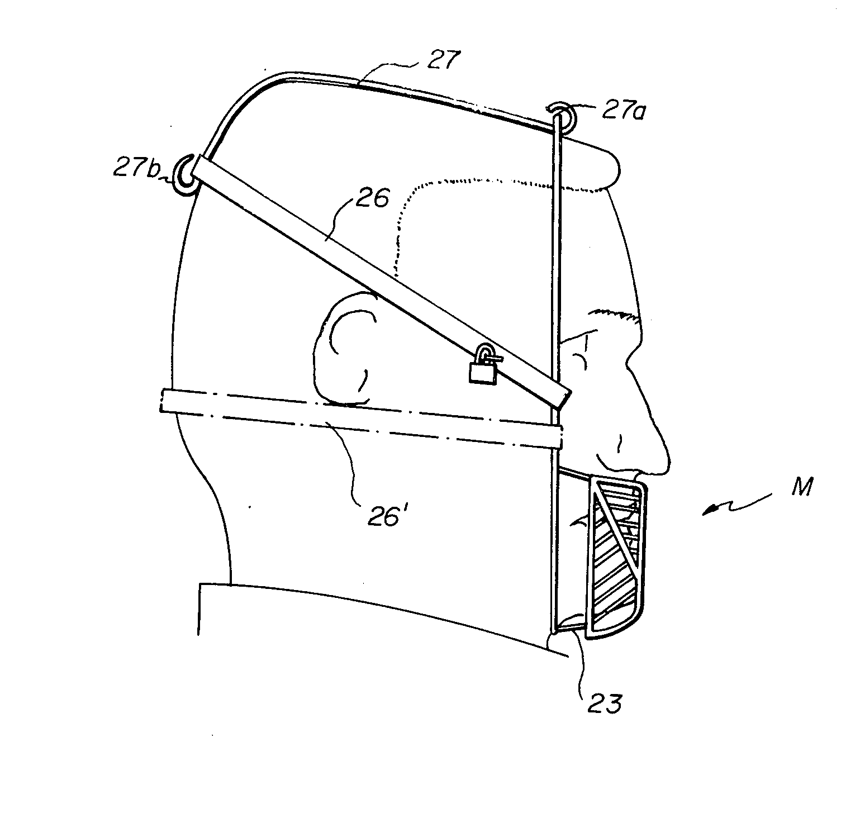
Interesting Patents 1.
August 17,1982 – Anti-eating face mask

Slide 15
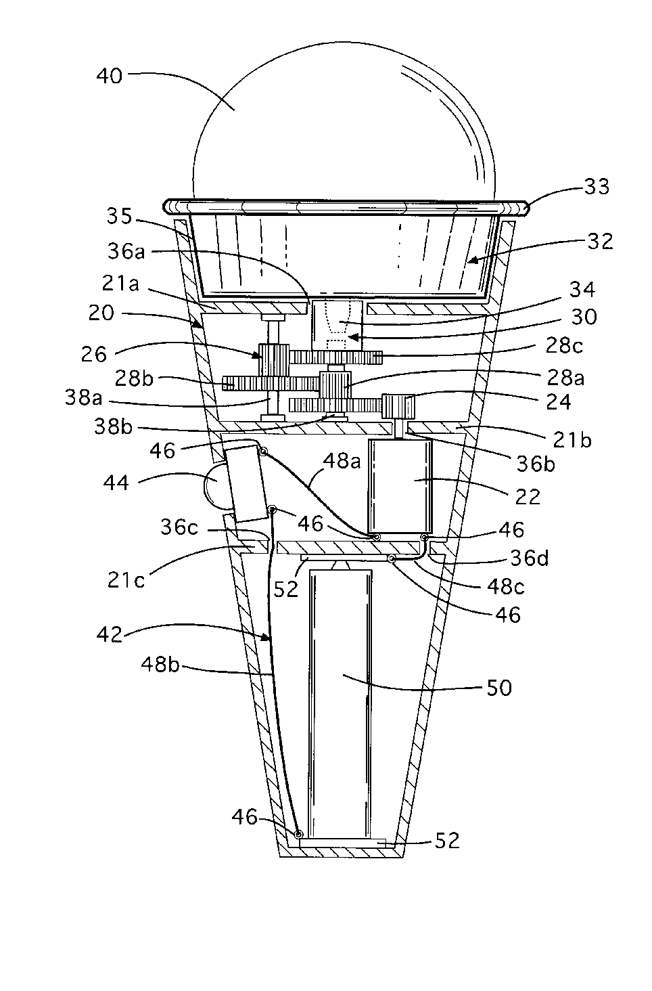
Interesting Patents 2.
October 26, 1999
Motorized ice-cream cone

Slide 16
Patent Infringement
Copyright: holder can decide which violations prosecute
Patent: all violations must be prosecuted or patent can be lost
Suing for patent infringement may cause the patent owner to loose the paten. Infringer may argue that:
This isn’t infringement (different inventions)
The patent is invalid (a prior infringement was not opposed)
The invention is not novel
The infringer invented the object first

Slide 17
Trade Secret
Information that gives one company a competitive edge over the others
Must always be kept secret
If someone obtains it improperly, the owner can recover
Profits
Damages
Lost revenues
Legal cost
Reverse Engineering!

Slide 18
Protection of Computer Objects
Protecting hardware, firmware, object code software, source code software, documentation, web content, domain names, etc.

Slide 19
Computer Crime
Least clear area of law in computing
Separate category for computer crime
No access to the physical object → Is it a serious crime?
Rules of evidence → How to prove the authenticity?
Threats to integrity and confidentiality → How to measure loss of privacy?
Value of data → How to measure it?

Slide 20
Why Computer Crime is Hard to Prosecute?
Lack of understanding
Lack of physical evidence
Lack of recognition of assets
Lack of political impact
Complexity of case
Age of defendant

Slide 21
Ethical Issues
Ethic: objectively defined standard of right and wrong
Ultimately, each person is responsible for deciding what to do in a specific situation
Ethical positions can and often do come into conflict

Slide 22
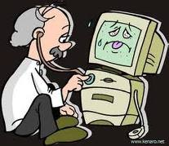
Information Assurance Courses
At
USC

Slide 23
Courses and Faculty
Courses
CSCE 201 – Introduction to Security
CSCE 517 – Computer Crime and Forensics
CSCE 522 – Information Security Principles
CSCE 557 – Introduction to Cryptography
CSCE 548 – Secure Software Construction
Faculty
Csilla Farkas
Chin-Tser Huang
Wenyuan Xu

Slide 24
IA Jobs
Job market
Civil (Join Information Systems Security Association, ISSA, https://www.issa.org/ )
Government (Internship available at USC-UTS, and SC Dept. of Probation, Parole, and Pardon Services)
Military (Internship available at SPAWAR, Charleston)
Education and training requirements (B.S. degree, certification, hands-on experiments)
Salary
FUN

