Slide 1

Career Center Services
+ Resume Writing
+ career fair Prep
Professional Issues in Computer Science & Engineering
CSCE 390

Slide 2
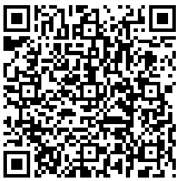
CC services +
Resume writing + career fair prep
Scan QR Code
Presentation Outcomes
Following this presentation, you will be able to:
Learn of one service offered by the university career center,
Create or update resume, and
Identify employer(s) of interest attending the career fair

Slide 3


Raise your hand if . . .
Are looking for a co-op in spring 2025 or a summer 2025 internship or a full-time job?
Asking yourself what companies you can work for upon graduation?
Curious to what jobs you can do with your major and what responsibilities they entail?
What step(s) should you take in the next few semesters to get you to your career goals?

Slide 4
Career center services
The mission of the University of South Carolina Career Center is to empower
and educate students in the development of lifelong career management skills.

Slide 5
About Us! www.sc.edu/career
Hours of Operation = 8:30-5:00pm M-F
Career Studio (Drop-In) Hours = 1:00pm-4:00pm M-F
Locations for Use =
  Molinaroli College of Engineering and Computing in Swearingen, Suite 1A03
  Thomas Cooper Library 5th Floor (one floor down from main floor)
  Grad Hub located in Close-Hipp, 4th floor (pursuing graduate school) and
  Office of Pre-Professional Advising (OPPA) located in Sumwalt Room 208
We are here to help you with:
      Resume preparation → Cover Letters → Internship/Co-Op/Job Search
      Interview Preparation → Job Fair Preparation → Networking →
      Salary Negotiation → Email Etiquette → Discussing your Path Forward!

Slide 6
Purpose
Make informed career decisions
(figure out majors to career path interests)
Decide It
Experience It
Get relevant experience before graduation
(explore work environments related to career interests)
Prepare for the “college to work” transition
(work towards the right post-graduate opportunities)
Live It

Slide 7


Services offered
Decide It
Experience It
Career Assessments
Job Shadowing
Drop-In Hours
Presentations
Career Appointments
Web Resources
Tip Sheets
Part-time Jobs
Internships & Co-ops
Micro-internships
Leadership
Volunteer
Undergraduate Research
Study Abroad
Pathways to Professions
Drop-In Hours &
Career Appointments
Live It
Optimal Resume
Mock Interviews
On-campus Interviews
Grad School Prep
Job Fairs
Information Sessions
Handshake

Slide 8
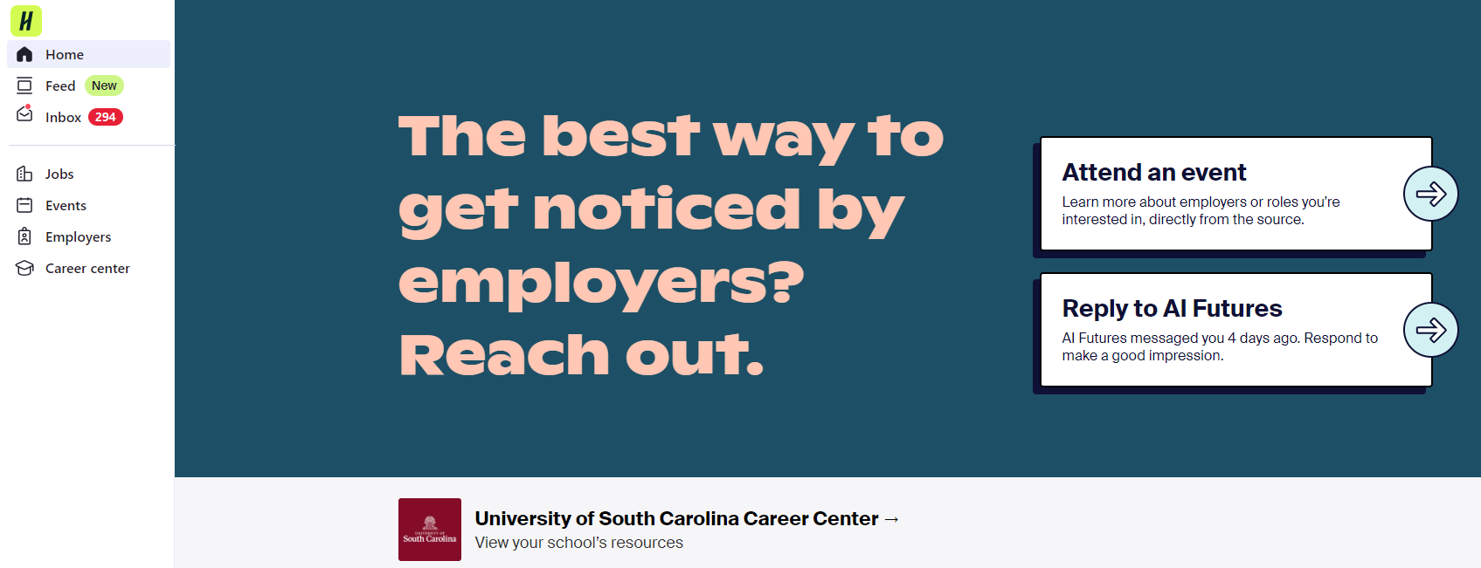
Every job starts with a handshake
PT, Internships, Full-Time Job Postings
Tabling, Career Fairs, Workshops, Info Sessions
NEW – Employer Collections
Schedule a career coaching appointment AND access Experience dashboard (CIP)

Slide 9
Fall 2024 fairs
Part-Time Job Fair (on and off-campus)
Fri., Aug. 23rd from 10a-1p @ RHUU Ballroom
Health Professions Fair
Tues., Sept. 10th from 12-4p @ Coliseum
STEM Career & Internship Fair from 12-4pm @ the Coliseum
Tues., Sept. 17th and Wed., Sept. 18th
All Majors Career & Internship Fair from 10a-2p @ RHUU Ballroom
Tues., Oct. 8th & Wed., Oct. 9th
Law School Fair, Wed., Sept. 25th , 1-4p @ Coliseum
HRSM Experience Expo, Spring 2025 @ Colonial Life Arena
DMSB Expo, Wed., Sept. 25th from 10a-4p @ Columbia Metropolitan Convention Center
We recommend attending BOTH in-person STEM days as employers are unique to each day

Slide 10
Create or update your resume
Tailored Resume ■ Emphasize Projects ■ Highlight Achievements | Formatting Tips ■ Gained Experiences ■ Developed Skills

Slide 11


What is a resume?
}
Education
Why?
Experiences
Skills

Slide 12


Resume to Interview
How long do you think employers tend to spend on their initial review of a candidate’s resume?
Between 6
and 30 seconds!

Slide 13
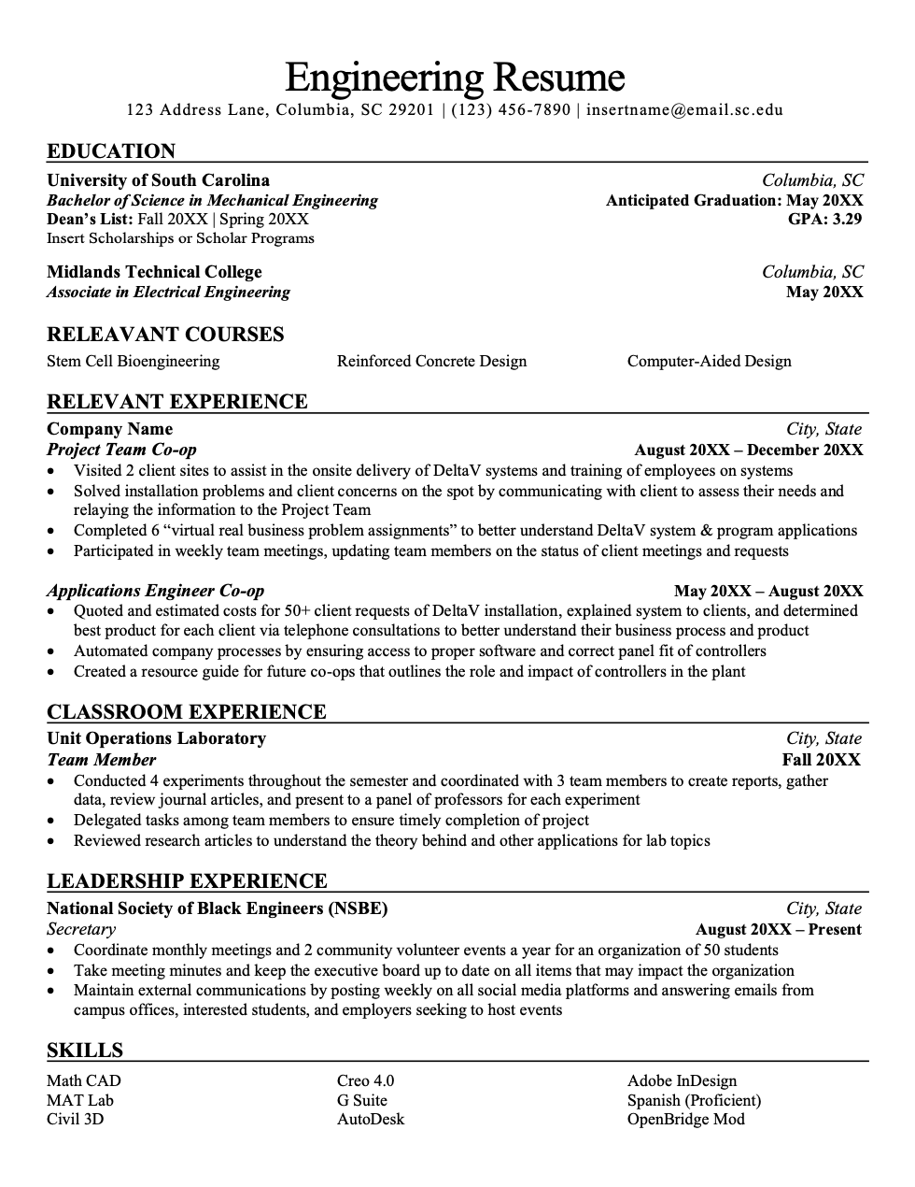
Resume appearance
Page Length 1 page
Margins 0.5” – 1”
Font Style Times New Roman, Arial, Calibri
Font Size 10-12 pt. except your name (14-18 pt.)
Spacing Single-spacing between bullets/content
Double-spacing between sects/headers
Emphasis Bold, italics, UPPER CASE, underline,
& absolutely No COLORS
Your format will assist in impressing potential employers!

Slide 14
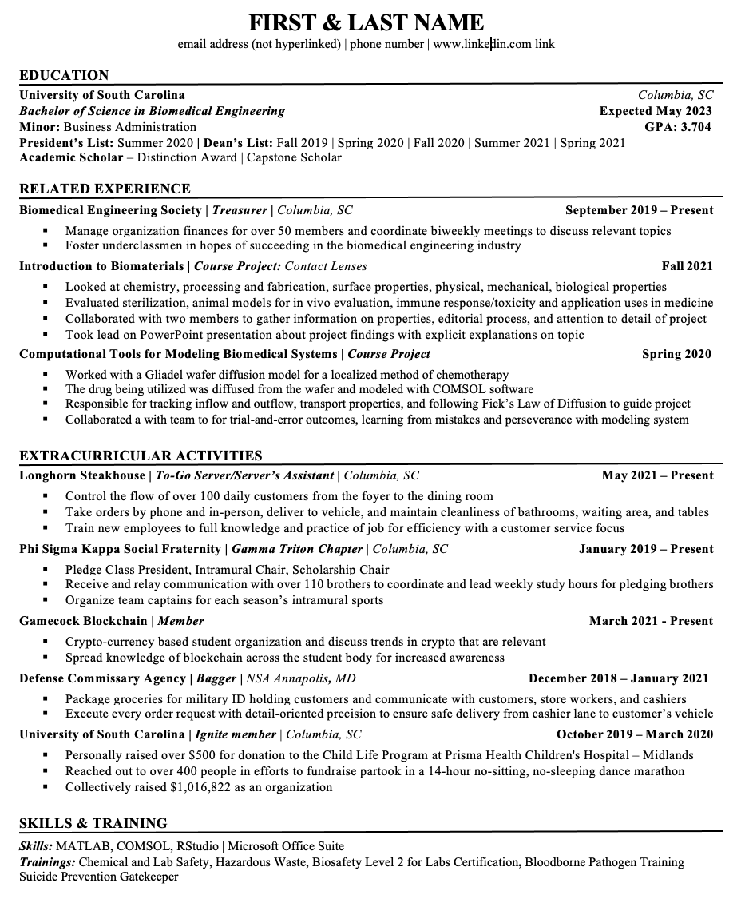
HEADER
EDUCATION
EXPERIENCE
SKILLS

Slide 15

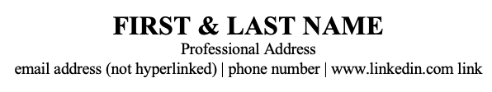
Header
Full Name or First ‘Nickname or Preference’ Last
Phone number
Professional Email Address
Full Address (optional)
  Location (city, state)
  Permanent or local
Personal Website or LinkedIn (optional)
  Remove hyperlink (blue font and underline)
  Personal website could be a GitHub or link to your personal projects for employers to view and grasp an understanding of your technical achievements!
  Now, beware of your second resume for all to see….

Slide 16
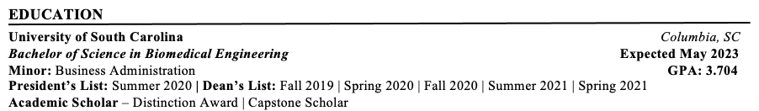
Education
Name of the school or university
Reverse chronological order if more than one school
List only school(s) where degree was earned or currently attending
City and state in which the school is located
Expected graduation date (Month Year)
Always spell out your degree
  Bachelor of Science in Industrial Engineering
Major, minor, concentration or specialization
GPA if above a 3.0 (specify cumulative or major, not both)
Awards/Honors/Scholarships
Consider a separate section if more than 3
Dean’s List, President’s List, Scholarship Programs, Honors College, Capstone Scholars
Study Abroad Experiences
Relevant Coursework
Typically, only specific majors need this

Slide 17

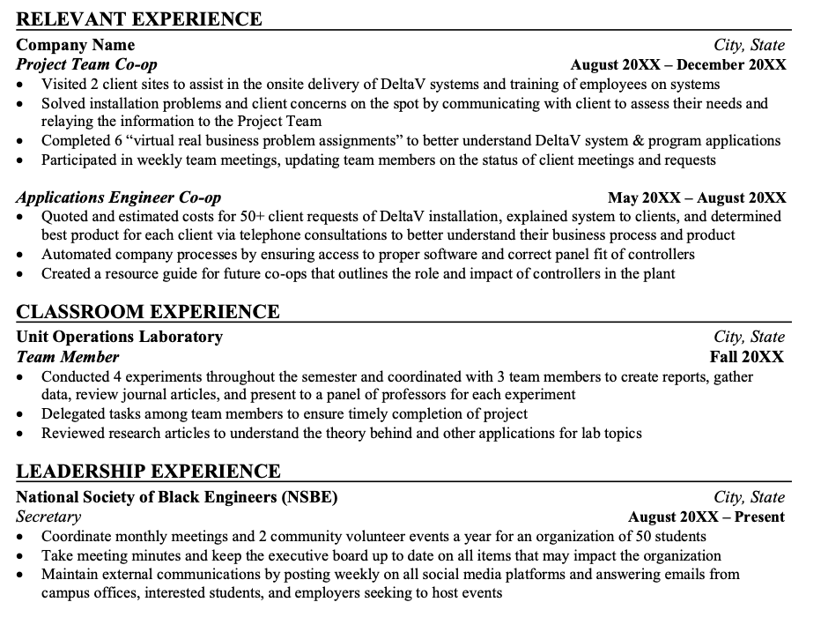
Experience
Start By Asking Yourself…
What experiences in my past support my career goals?
What experiences have I had that are relevant to this position?
Label Options:
Work Experience
Relevant Experience
Project Experience
Research Experience
Leadership Experience
Volunteer Experience
Consistency Is Key!

Slide 18

Experience
Include:
Employer Name
Employer Location (City, State or School)
Your position title
Dates of employment
Bullet Points:
Describe your most essential tasks and biggest accomplishments
Use “formula” Situation+Task+Action+Scope
Use clear, concise bullets (1-2 lines per)
3-6 bullets per experience
Describe “soft” (transferable) skills you utilized (e.g. communication, teamwork)
Use Quantifiers (e.g. #’s, %’s, and $’s)
Past tense for past experience(s), present tense for current experience(s)

Slide 19








NACE 8 career readiness competencies
Career & Self
Development
Communication
Critical Thinking
Equity & Inclusion
Professionalism
Technology
Leadership
Teamwork

Slide 20
Sample Bullet Point Rewrites
“Took care of children” “Managed caretaking duties for 4 children ages 4-8, including planning educational, recreational, and social activities.”
“Worked in food service.” “Delivered exemplary customer service in high volume operations, completing an average of 15 transactions per hour.”
“Tutored students in math courses.” “Planned developmental activities designed to support student learning within 2 SI sessions per week.”
“Trained new employees.” “Onboarded 3 new employees per month, cultivating their skills and abilities to manage sales, create positive customer experiences, and be effective representatives of the company’s brand.”

Slide 21

What is My Skill Set?
Analytical
Computer literacy
Conflict resolution
Conscientiousness
Creativity
Critical thinking
Customer service
Dependability
Diversity-oriented
Enthusiastic
Etiquette
Financial Management
Flexibility
Fund-raising
Honesty/Integrity
Initiative
Independent
Interpersonal
Leadership
Listening skills
Maturity
Multi-tasking
Organizational
Persuasive
Positive attitude
Problem solving
Punctuality
Purposeful
Quick learner
Recruiting
Resourcefulness
Responsibility
Sales
Self confidence
Self discipline
Time management
Team player

Slide 22

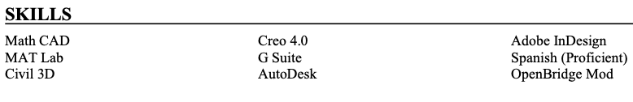
You’ve Got…..Skills
Focus on “hard skills”
Technical proficiencies
Sub-Categories, if needed:
  Programming Languages
  Networking
  Design Software
  Foreign Languages
  Web Systems & Technologies
  Platform Technologies
Avoid listing “soft skills”
Skills developed and honed over time + experience
Skills:
  Career & Self-Development
  Communication
  Critical Thinking
  Equity & Inclusion
  Leadership
  Professionalism
  Teamwork
  Technology

Slide 23


(Optional) Sections
LEADERSHIP & VOLUNTEER EXPERIENCES or ACTIVITIES / INVOLVEMENT Sections
Format like an experience OR include as a list
Demonstrate your involvement in the community/on campus
Including professional associations can display your involvement in the field
Avoid personal interests/activities like knitting or rock climbing – those won’t carry much weight unless you’re applying for very specific industries
HONORS & AWARDS Section or Subsection
>3, include in the Education section at the top
<3, create separate section on its own
PROJECT EXPERIENCE or RELEVANT COURSEWORK Sections
Include if relevant work experience is limited
Demonstrates theory → practice
Even if relevant work experience is not limited, it’s usually good to include a Capstone project!

Slide 24
Non-Traditional (Optional) Sections
Freelance or Contract Projects
As the economy moves more toward contingency workers and temporary contracts, chances are that you may have worked on a freelance basis
Entrepreneurial Spirit
What if you are attempting to pursue work that may not exist or be very niche?
What if you are attempting to re-enter an industry that you left many years ago? An employer may wonder what you were doing throughout those years.
Many create their own business, even if it’s part-time or ‘on the side’/‘side hustle’ while earning money elsewhere
Continuing Education
Have you attended training within your company, at the industry level, or through a national association?
Include the names of the trainings, along with the organization that led the events.

Slide 25

STEM

Slide 26

The Importance of Networking
70% of job vacancies: never advertised
80% of jobs are filled through personal/professional connections
The overall time needed to find a job can
be drastically reduced
4-6 mon. (networking) vs.
6-9 mon. (not networking)
Learn about occupations, employers, and
industries of interest
START EARLY!

Slide 27
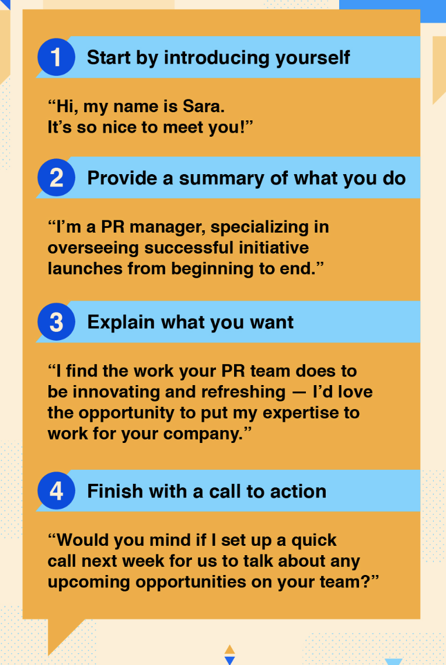
Prepare your Pitch
Elevator Pitch:
Marketing message for your professional self –
Clear, concise, inviting, enthusiastic
Your qualifications + Your interests/goals = Your Pitch
30-60 seconds
Practice, practice, practice!

Slide 28

Elevator Pitch Questions to assist you
What sparked your interest in this field?
What are some supporting experiences that have helped you further develop the skills that would be useful for this job?
What have you already learned about the field and what are you hoping to learn from this opportunity?
What activities or groups are you affiliated with? What experiences or exposure are you gaining from the affiliation?
What about this company do you find particularly exciting?
What questions do you have for the employer?

Slide 29

Do Your Research: Employers
Review the list of employers attending the fair!!!! They are in alphabetical order and will list if they are looking for 1) internship vs. full-time, 2) years of students desired as well as what 3) majors they could employ.
Handshake → Career Center Tab → Events → Career Fair
Use your resources:
Network, company websites, annual reports, social media, LinkedIn, Google News or Wall Street Journal, other websites (Wetfeet, Glassdoor, Vault, Hoover’s)
Narrow your focus & prioritize what is most important!

Slide 30

‘Suit Up’: Dress to impress!
Dress as if the career fair is an interview
Make sure clothes are clean and pressed
Minimal or no overwhelming fragrances – Be Hygienic!
Dress like yourself - Be comfortable & confident!
Remember Carolina Closet (located in Coliseum)
Be prepared for all weather, good and bad
Consider travel time/parking
Allow ample time for delays!
Talk to professors about class conflicts

Slide 31
Now, What Do I Bring?
10-20+ copies of your critiqued resume on nice paper (better to have too many than)
A list of questions based on your employer research
A list of the companies that fit your search
At least 2 pens and a notepad
A folder or padfolio to keep resumes, business cards, notes, brochures, and giveaways organized
Anticipate mishaps:
Umbrella/raincoat
Lint brush
Comb
Mints

Slide 32
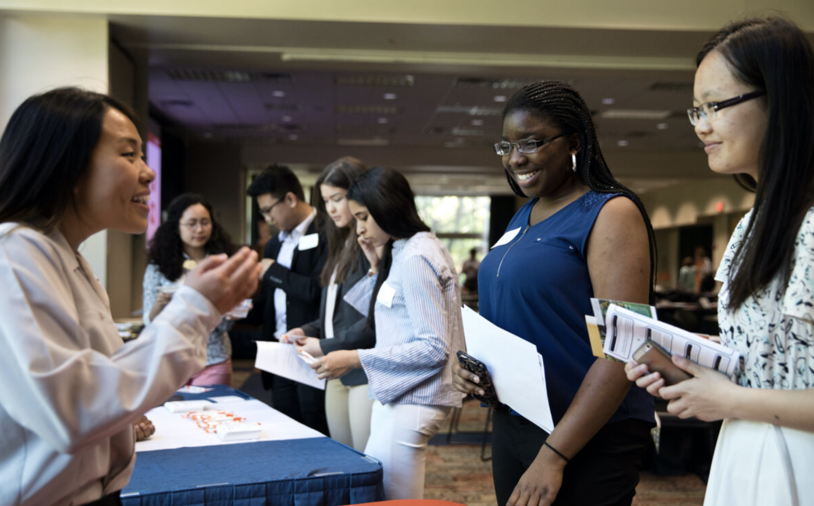
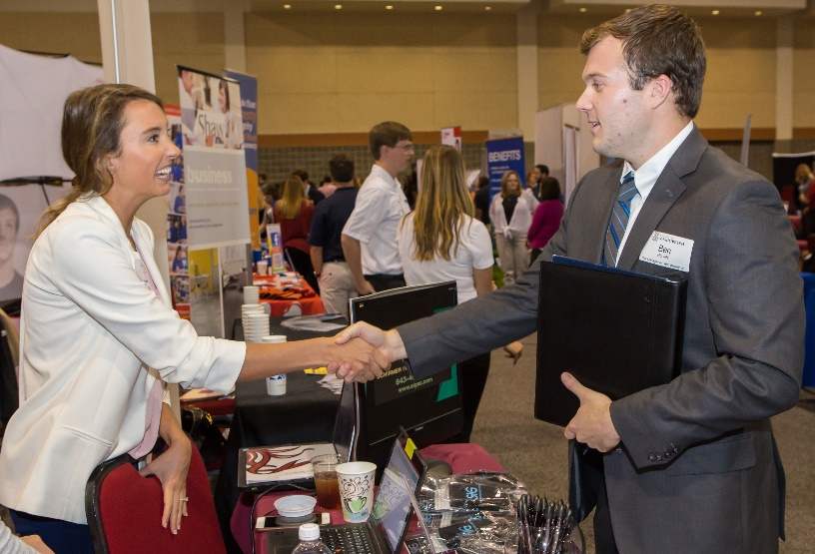
During the FAIR: Make a Good Impression
Arrive within the window of event time
Behave professionally
Establish rapport with the recruiters
Remember your body language
Listen to the recruiter
Don’t ramble
Ask at least 2 intelligent questions of each organization

Slide 33

during the fair: Tips & Tricks
Wear comfortable, appropriate shoes
Take the literature/freebies from the employers you’ve spoken to
  But DON’T take freebies from employers you don’t talk to
Request business cards and take good notes to send a follow up email!
  Step to the side to take notes before moving to the next employer
Be cognizant of your non-verbal communication
Network with the other students

Slide 34

After the fair: Always Follow Up
More important than ever before
If conducting Day-After Interviews,
submit your application materials
well before the deadline!
Email Thank-You note (and resume) to selected employers as soon as possible (within 24 hours)

Slide 35

What’s next? Create a plan with goals
Secure an internship
Earn 2-4 internship offers
Interview with 8 companies
Apply to ~20 jobs
Connect with 25 employers
Research 40 employers attending STEM Fair or beyond
Create candidate documents
  Resumes, Cover Letters, LinkedIn Profile

Slide 36
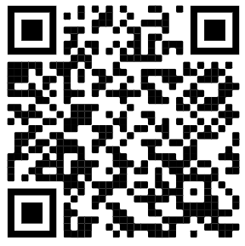
Helpful Knowledge & Links
Career Center Trello Student Toolbox
Handshake = sc.joinhandshake.com
What does the Career Center do?
More than just the resume place…
  Here to assist you with anything regarding the topics to the left & utilize Handshake to promote success!
Located in Swearingen 1A03 next to Wired Cafe

Slide 37
Carolina Internship & co-op program (CIP)
Student eligibility requirements:
Be in good academic standing (have at least a cumulative GPA of 2.5 @ USC) and have completed at least 15 college-level credit hours prior to experience
Report your internship or co-op on Handshake and submit necessary documents before the drop/add deadline
Successfully complete all CIP/co-op program requirements in conjunction with Career Center
For International Students: Must be approved by the USC Office of International Student and Scholar Support and complete a Curricular Practical Training Application
Benefits to students include:
Earn 15 academic credit hours
Being placed in “placeholder class” and keep ALL scholarships/financial aid (student status)
Not paying tuition that semester
Gain new skills and knowledge to build out resume and gain a new reference!
Students need to complete the following:
Experiential Education form with experience info which MUST be signed by a Career Center Coach to be approved
Create an experience on Handshake and upload that form and their signed offer letter from the company

Slide 38
South Carolina Internship Program (SCIP)
South Carolina Internship Program
The University of South Carolina is able to offer financial supplements to students who obtain internships and co-ops that support high-demand industries within the state of South Carolina. Supplements of $3000 are distributed on a first-come, first-served basis for Fall 2023. Application submission does not guarantee award.
How to Apply:
Students wishing to apply for the SCIP Award must complete the following steps. Supplements are awarded on a first-come, first-served basis. Application does not guarantee award. Application for Fall 2024 closes October 14, 2024.
Handshake → Experiences → Submit → Experience → Select SCIP
Eligibility:
Open to current degree seeking students at the University of South Carolina-Columbia throughout the internship/co-op. Preference given to undergraduate students.
Preference given to award recipients who will not require sponsorship for US work authorization post-graduation.
Criteria for this award focuses on internship/co-op opportunities with South Carolina companies in the areas of Manufacturing, Aerospace, Automotive, Energy, Health and Life sciences, and Financial Services, as well as company information submitted through Handshake.
Internship/co-op is in-person and located in South Carolina during 2024-2025.

Slide 39
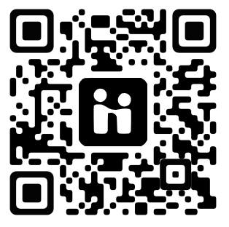

utilize your Handshake account
Schedule a career center appointment
Search for events & career fairs
Search for Jobs
Go to:
Career Center
Appointments
Request an Appointment
Here you can find/schedule with your correct Career Coach or Career Studio appointment
Go to:
Events
Search based on your major
Select Career Fairs or what is happening by week or month
Full time
Part-Time
On-Campus
Internships
Co-ops

Slide 40

STEM

Slide 41

Mock Interview

Slide 42
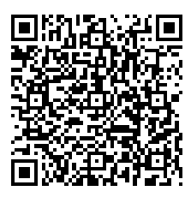
Upcoming MCEC Career Center Event
"Mingle and Master:
Networking Dinner with an Etiquette Twist“ (STEM Dining Etiquette)
Monday, September 16
5:30-8:30p
Russell House Ballroom
Headshots for STEM Students
2 Upcoming Dates:
  Tues., Sept. 3rd 11:30a-12:30p (confirmed)
  Thurs. Sept. 5th 10:30a-12p
  (confirmed)
  Tuesday, Sept. 12th 10a-12p
  (confirmed)
  Tuesday, Sept. 24th 11:30a-12:30p (confirmed)
  More to Come….

Slide 43
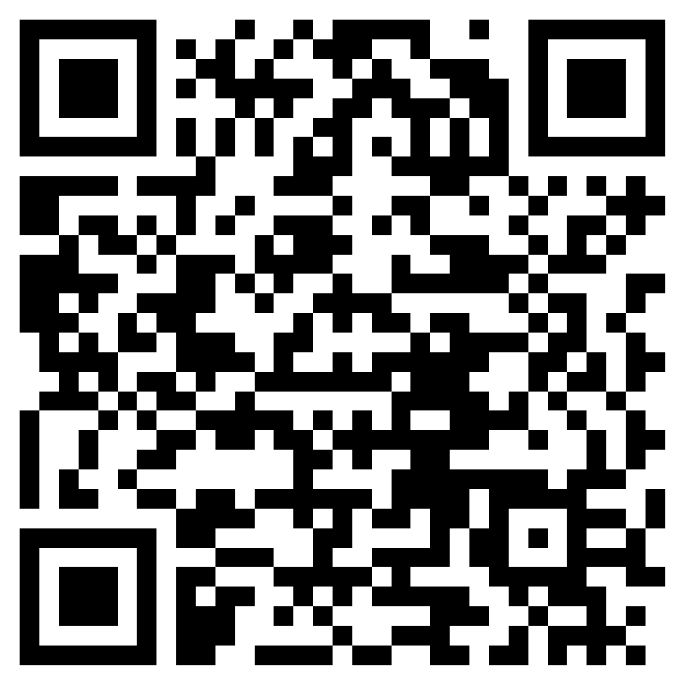
Thanks!
Please complete survey
Nicholas Paschvoss, M.Ed., GCDF
Career Development Coach
paschvoss@sc.edu
www.linkedin.com/in/nicholaspaschvoss

