Slide 1
CSCE 390
Professional Issues in Computer Science and Engineering
What is Computer Ethics?
Fall 2024
Marco Valtorta
mgv@cse.sc.edu
Notes:
The slides are based on textbooks and papers (see Syllabus).

Slide 2
Two Papers
James H. Moor. "What is Computer Ethics?" Metaphilosophy, 16, 4 (October 1985), 266-275
James, H. Moor. "Reason, Relativity, and Responsibility in Computer Ethics." In: Terrell Ward Bynum and Simon Rogerson (eds.). Computer Ethics and Professional Responsibility. ISBN 1-85554-844-5. Blackwell Publishing, 2004
The definitions of Computer Ethics by Maner, Johnson, Moor, Bynum, and Gotterbaum come verbatim from the Editor’s Introduction to the book above.
Notes:
These slides supplement ch.1 [B].

Slide 3

Walter Maner
Computer Ethics studies “ethical problems aggravated, transformed or created by computer technology.”
Traditional ethical theories should be applied to these new problems.
Notes:
http://www.cs.bgsu.edu/maner/ (Bowling Green State U., CS Dept, Emeritus) [Biographical data was researched in August 2014; this is true for all slides in this presentation.]

Slide 4
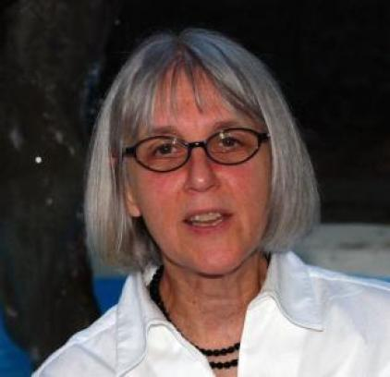
Deborah Johnson
Computer ethics studies the way in which computers “pose new versions of standard moral problems and moral dilemmas, exacerbating the old problems, and forcing us to apply ordinary moral norms in uncharted realms.” Traditional ethical theories should be applied to these new problems.
Computers do not create wholly new moral problems. They just give a “new twist” to ethical questions that were already well known.
Notes:
http://www.batten.virginia.edu/content/faculty-research/faculty/deborah-nodefieldfacultymiddlename-johnson Batten School (Engr. and Applied Science, U. Virginia)

Slide 5
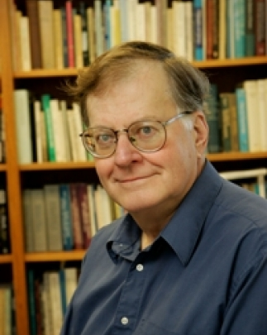
James Moor
A typical problem in Computer Ethics arises
because there is a policy vacuum about how
computer technology should be used. Computers provide us with new capabilities and these in turn give us new choices for action. Often, either no policies for conduct in these situations exist or existing policies seem inadequate. A central task of Computer Ethics is to determine what we
should do in such cases, that is, formulate policies to guide our actions. . . . (Moor 1985, p. 266)
Notes:
dartmouth.edu. Daniel P. Stone Professor of Intellectual and Moral Philosophy, Department of Philosophy, Dartmouth College.

Slide 6
James Moor
One difficulty is that along with a policy vacuum there is often a conceptual vacuum. Although a problem in Computer Ethics may seem clear initially, a little reflection reveals a conceptual muddle. What is needed in such cases is an analysis that provides a coherent conceptual framework within which to formulate a policy for action. (Ibid.)
Notes:
dartmouth.edu. Daniel P. Stone Professor of Intellectual and Moral Philosophy, Department of Philosophy, Dartmouth College.

Slide 7
James Moor
Computers are logically malleable in that they can be shaped and molded to do any activity that can be characterized in terms of inputs, outputs and connecting logical operations. . . . Because logic applies everywhere, the potential applications of computer technology appear limitless. The computer is the nearest thing we have to a universal tool. Indeed, the limits of computers are largely the limits of our own creativity. (Ibid.)
Notes:
dartmouth.edu. Daniel P. Stone Professor of Intellectual and Moral Philosophy, Department of Philosophy, Dartmouth College.

Slide 8
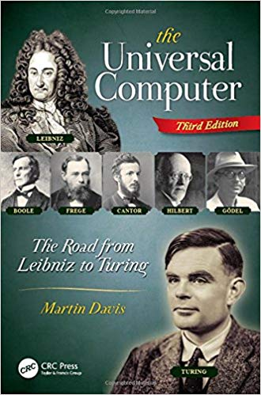
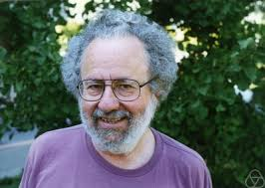
The Universal Computer
Martin Davis, 1928 - 2023
Notes:
Also: Fields of Logic and Computation III. Lecture Notes in Computer Science, vol 12180. Springer, Cham Article or chapter title: Seventy Years of Computer Science
Author: Davis, M. Pages: 105-117

Slide 9
James Moor
According to Moor, the computer revolution
will occur in two stages. The first stage is that
of “technological introduction” in which computer technology is developed and refined. This already occurred during the first 40 years after the Second World War. The second stage – one that the industrialized world has only recently entered [in 1985] – is that of “technological permeation” in which technology gets integrated into everyday human activities and into social institutions, changing the very meaning of fundamental concepts, such as “money,” “education,” “work,” and “fair elections.”
Notes:
dartmouth.edu. Daniel P. Stone Professor of Intellectual and Moral Philosophy, Department of Philosophy, Dartmouth College.

Slide 10
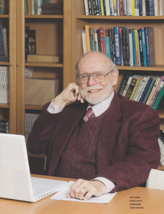
Terrell Ward Bynum
Computer ethics identifies and analyzes the
impacts of information technology on such social
and human values as health, wealth, work, opportunity, freedom, democracy, knowledge, privacy, security, self-fulfillment, etc. This very broad view of computer ethics employs applied ethics, sociology of computing, technology assessment, computer law, and related fields. It employs concepts, theories, and methodologies from these and other relevant disciplines. This conception of computer ethics is motivated by the belief that – eventually – information technology will profoundly affect everything that human beings hold dear.
Notes:
http://en.wikipedia.org/wiki/Terrell_Ward_Bynum. Bynum is currently Director of the Research Center on Computing and Society at Southern Connecticut State University, where he is also a Professor of Philosophy, and Visiting Professor in the Centre for Computing and Social Responsibility in De Montfort University, Leicester, England.
He also was a biographer of the philosopher/ mathematician Gottlob Frege, as well as a translator of (Gottlob) Frege's early works in logic.[6] Bynum's most recent research and publications concern the ultimate nature of the universe and the impact of the information revolution upon philosophy.[7]

Slide 11
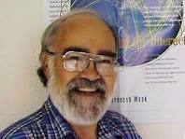
Donald Gotterbarn
Computer ethics should be viewed as a branch
of professional ethics, concerned primarily with standards of good practice and codes of conduct for computing professionals: “There is little attention paid to the domain of professional ethics – the values that guide the day-to-day activities of computing professionals in their role as professionals. By computing professional I mean anyone involved in the design and development of computer artifacts. . . . The ethical decisions made during the development of these artifacts have a direct relationship to many of the issues discussed under the broader concept of computer ethics.” (Gotterbarn 1991, p. 26)
Notes:
Photo from http://www.google.com/imgres?imgurl=http://www.sigcas.org/awards-1/awards-winners/images/gotterbarnaward1.jpg&imgrefurl=http://www.sigcas.org/awards-1/awards-winners/gotterbarn&h=192&w=256&tbnid=N79wq53gjydU0M:&zoom=1&tbnh=90&tbnw=119&usg=__SJIkRFrCyL5Cc0c98VNFle-uv7s=&docid=b_6aiYiRKA1U6M&itg=1&client=firefox-a&sa=X&ei=L6D_U4mIOcnLggTRrYK4Dw&ved=0CK4BEPwdMAo
http://csciwww.etsu.edu/gotterbarn/. Computer and Information Science Department, East Tennessee State University

Slide 12
Donald Gotterbarn
Gotterbarn co-authored the 1992 version of the ACM Code of Ethics and Professional Conduct and led a team of scholars in the development of the 1999 ACM/IEEE Software Engineering Code of Ethics and Professional Practice.
He is the recipient of the 2018 ACM Presidential Award.
Notes:
Photo from http://www.google.com/imgres?imgurl=http://www.sigcas.org/awards-1/awards-winners/images/gotterbarnaward1.jpg&imgrefurl=http://www.sigcas.org/awards-1/awards-winners/gotterbarn&h=192&w=256&tbnid=N79wq53gjydU0M:&zoom=1&tbnh=90&tbnw=119&usg=__SJIkRFrCyL5Cc0c98VNFle-uv7s=&docid=b_6aiYiRKA1U6M&itg=1&client=firefox-a&sa=X&ei=L6D_U4mIOcnLggTRrYK4Dw&ved=0CK4BEPwdMAo
http://csciwww.etsu.edu/gotterbarn/. Computer and Information Science Department, East Tennessee State University

Slide 13
Donald Gotterbarn
Donald Gotterbarn, recognized for 25 years of outstanding service as chief architect of ACM’s Code of Professional Ethics, a living document adopted by the computing community worldwide as the blueprint for professional conduct in the field. Gotterbarn has helped to define what it means, ethically, to be a computing professional. He was a forerunner in recognizing the critical importance of professional ethics and has worked tirelessly—as both an educator and a practitioner—to advance this message to a global audience by developing a computer ethics curriculum, leading workshops, and serving as Chair of ACM’s Committee on Professional Ethics. Throughout the creation of the original code, and now the Code 2018 revision that will be released this summer [summer 2018], Gotterbarn has insisted on engaging the computing community, seeking guidance and feedback in the code’s design and direction, and always appreciating that the cause—and the code—is only as strong as its supporters.
Notes:
Text from https://awards.acm.org/president.
Bio from the same site: Gotterbarn is a Professor Emeritus at East Tennessee State University and a founder of the Software Engineering Ethics Research Institute. He received a Master’s of Divinity from the Colgate Rochester Divinity School, as well as an MA and PhD in Philosophy from the University of Rochester. His honors include receiving the ACM Special Interest Group for Computers and Society (SIGCAS) Making a Difference Award and the International Society for Ethics and Information Technology (INSEIT) Weizenbaum Award.
Photo from http://www.google.com/imgres?imgurl=http://www.sigcas.org/awards-1/awards-winners/images/gotterbarnaward1.jpg&imgrefurl=http://www.sigcas.org/awards-1/awards-winners/gotterbarn&h=192&w=256&tbnid=N79wq53gjydU0M:&zoom=1&tbnh=90&tbnw=119&usg=__SJIkRFrCyL5Cc0c98VNFle-uv7s=&docid=b_6aiYiRKA1U6M&itg=1&client=firefox-a&sa=X&ei=L6D_U4mIOcnLggTRrYK4Dw&ved=0CK4BEPwdMAo
http://csciwww.etsu.edu/gotterbarn/. Computer and Information Science Department, East Tennessee State University

Slide 14
James Moor
In a later (2004) paper, Moor notes how
the ubiquity of connected computers lead to
new ethical problems. He also gives four examples of “Informational Enrichment,” i.e., situations in which the processing of information becomes a crucial ingredient in performing and understanding the activities themselves (Moor, 2004):
Money
Warfare
Privacy
Copyright
Notes:
dartmouth.edu. Daniel P. Stone Professor of Intellectual and Moral Philosophy, Department of Philosophy, Dartmouth College. [Aug. 2014].
Electronic money transfers can reduce corruption, as exemplified by police corruption cases in
Kenia (BBC _The Inquiry_, 20160920 (who wins in a cashless economy), minute 1055 - 1530).

