Slide 1
CSCE 390 Professional Issues in Computer Science and Engineering Ch.3: Philosophic Belief Systems, part I: Idealism and Realism
Fall 2022
Marco Valtorta
mgv@cse.sc.edu
Notes:
The slides are based on [B], [B93], [M99], [M04], and other sources.

Slide 2
Why?
We accept that we need ethical standards
What are the sources of such standards?
Our ethical standards are affected, or even determined, by our worldview (weltanschauung, in German)
In philosophy, the study of the basic meaning of reality is called metaphysics
Metaphysics means “after” or “beyond” physics

Slide 3
Philosophic Belief Systems
Belief: unproven assumption
Contrast: in AI, posterior probability, as in “belief update”
Philosophic: about truth
Philia = love
Sophia = truth
System: consists of related parts
Metaphysics
Epistemology
The study of how we know things
Episteme = knowledge
Logos
Axiology
Axia = value
Ethics
Aesthetics

Slide 4
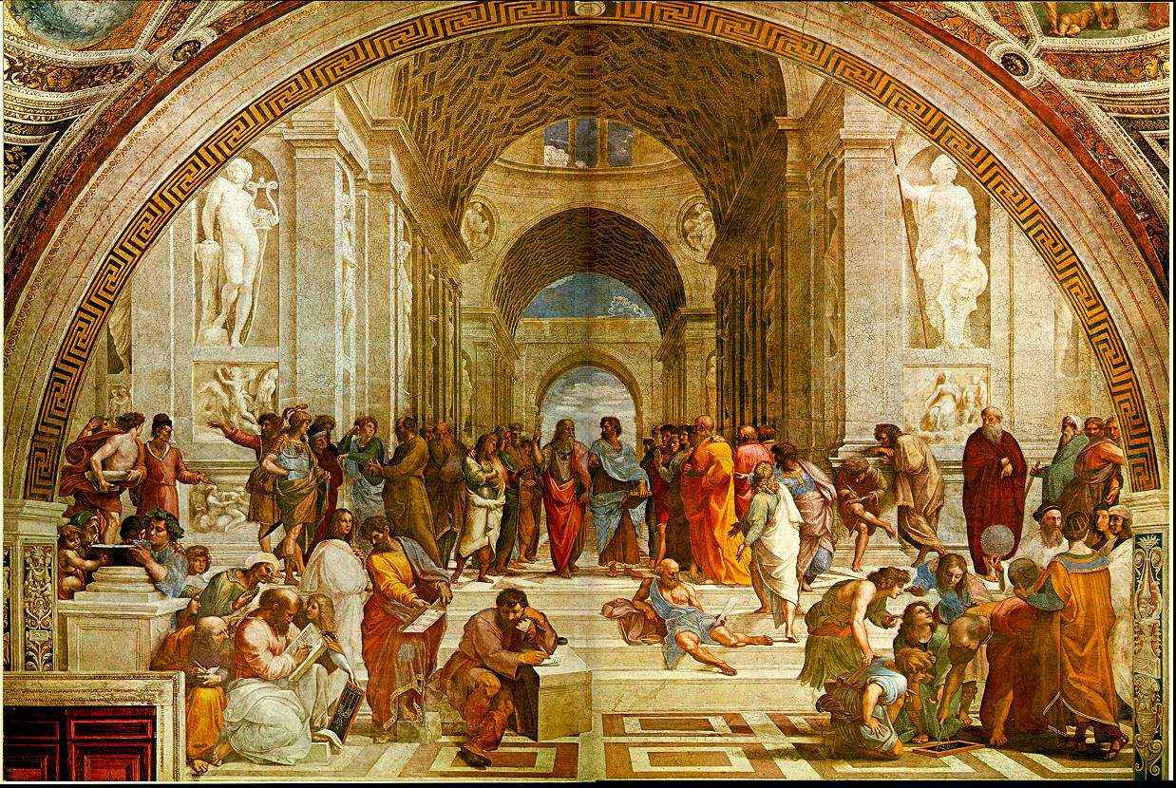
The School of Athens, Raphael, 1511

Slide 5
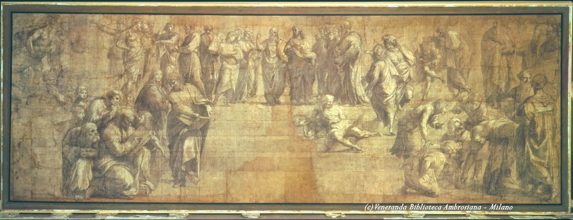
Preliminary Sketch (Cartone) by Raphael
http://www.leonardo-ambrosiana.it/la-pinacoteca-ambrosiana/
Notes:
804 x 285cm. Il grande cartone preparatorio per la Scuola di Atene , affrescata da Raffaello nelle Stanze Vaticane nel 1510, aveva suscitato l’interesse di Federico Borromeo già nel 1610, ma venne definitivamente ceduto dalla vedova del proprietario, Fabio Borromeo Visconti, solo nel 1626 per una somma di seicento lire imperiali. Pertanto, già nel 1625, il grande disegno è descritto nel Musaeum. Si tratta dell’unico grande cartone rinascimentale pervenuto quasi integro. Rispetto al dipinto manca l’architettura classica che accoglie e sovrasta il consesso di filosofi e la figura di Eraclito, aggiunta da Raffaello ad affresco ormai concluso, usando le sembianze di Michelangelo. Per il resto il cartone comunica grande equilibrio compositivo e la chiarezza di contenuto che Raffaello aveva raggiunto in questo trionfo della saggezza antica, radunata attorno alle figure cardini di Platone e Aristotele.

Slide 6
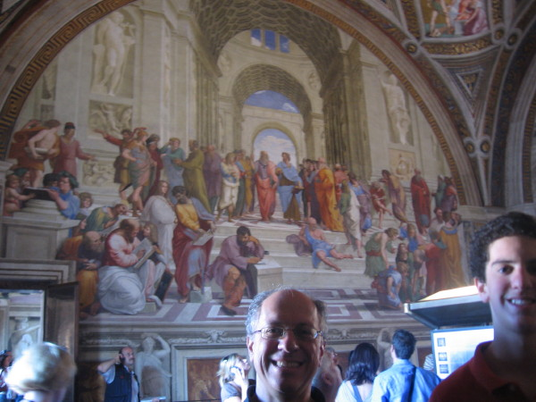
Notes:
Rome (Vatican City), June 8, 2011

Slide 7
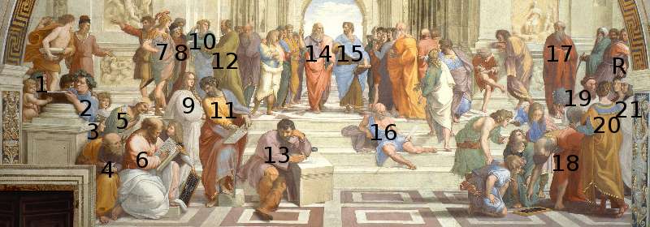
1: Zeno of Citium 2: Epicurus 3: unknown[13] 4: Boethius or Anaximander or
Empedocles? 5: Averroes 6: Pythagoras 7: Alcibiades or Alexander the Great?
8: Antisthenes or Xenophon? 9: unknown [14][13] or the Fornarina as a
personification of Love [15] or (Francesco Maria della Rovere?) or Ipazia 10: Aeschines or Xenophon? 11: Parmenides? 12: Socrates 13: Heraclitus (Michelangelo) 14: Plato (Leonardo da Vinci) 15: Aristotle 16: Diogenes 17: Plotinus (Donatello?) 18: Euclid or Archimedes with students (Bramante?) 19: Zoroaster 20: Ptolemy? R: Apelles (Raphael) 21: Protogenes (Il Sodoma, Perugino, or Timoteo Viti)[16]
Notes:
I added Ipazia (Hypatia) on 2019-09-05. The story of Hypatia, an astronomer from Alexandria of Egypt (c.370-415AD) is told in the 2010 movie Agora, directed by Alejandro Amenabar.

Slide 8
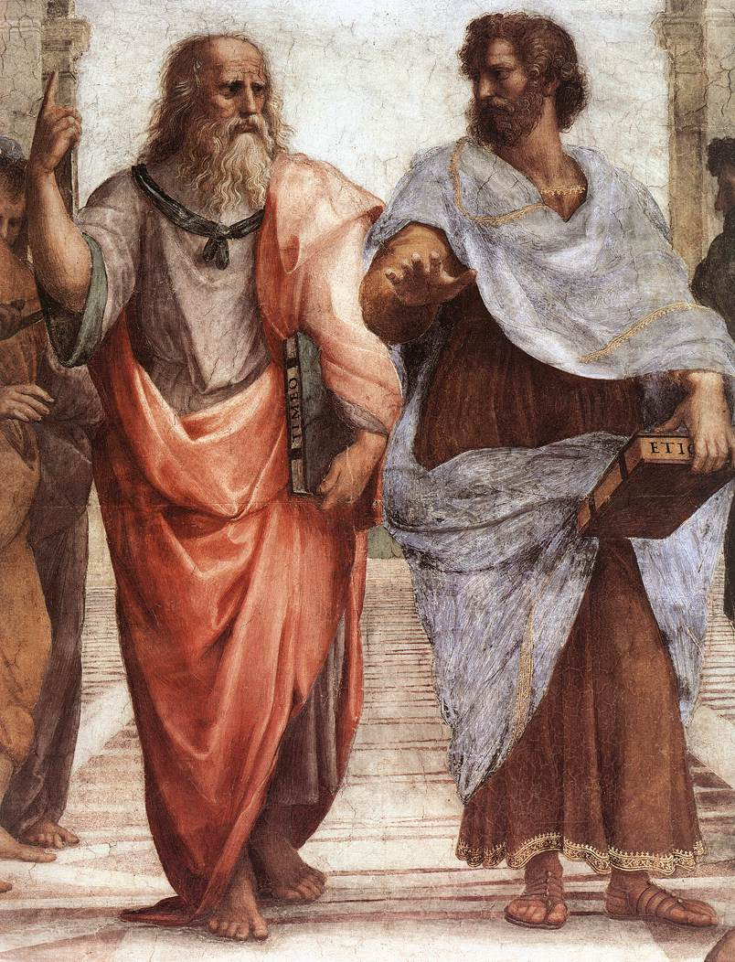
Idealism vs. Realism
Plato (in the
likeness of Leonardo da Vinci)
Aristotle
Notes:
http://en.wikipedia.org/wiki/The_School_of_Athens

Slide 9
Idealist Metaphysics
Socrates (470-399BC) and Plato (427-327)
The parable of the cave
Ultimate reality can not be found in the world of sensory experience, but only in the world of ideas, which only our minds can experience

Slide 10
Idealist Epistemology
The process of knowing is abstract
We use reason to help our mind grasp the ideas that underlie the reality experienced by our senses

Slide 11
Idealist Ethics
Goodness is found in the ideal, i.e., in perfection
Perfection is not found in material things
Goodness is conformance to the unchanging, ever-perfect, incorruptible ideal
Moral imperatives
No exceptions
But… the lesser of two evils

Slide 12
Immanuel Kant (German, 1724-1804)
A non-religious idealist
Moral imperatives
“Act only according to that maxim by which you can at the same time will that it should become a universal law”
“Act as to treat humanity, whether in your own person or in that of another, always as an end and not as a means only”
Do something simply because it is good, not because of what may come of it

Slide 13
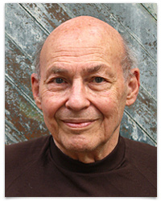
Realist Metaphysics
Aristotle, 384BC-322BC
Things are more real than ideas
Whatever exists, exists independently from any mind and is governed by the laws of nature
John Searle (1932-)
Marvin Minsky (1927-2016)
Minsky

Slide 14
Realist Epistemology
Knowledge is acquired through the senses
Science is more important than reason

Slide 15
Realist Ethics
The criterion of goodness is conformity with reality
What is natural is good
Evil is the departure from the natural norm either by excess or defect
Evil is a breaking of the natural law
Goodness is found in living a life of virtue in harmony with nature
Virtue is identified with happiness
The golden middle: virtue is a mean between two vices: one involving excess, the other deficiency

