Slide 1


Prepare for the Fair:
Science, Engineering, and Technology Fair Fall 2016

Slide 2
Our Mission
The mission of the University of South Carolina Career Center is to educate and empower students in their development of lifelong career management skills.

Slide 3
Location
The College of Engineering & Computing has its own Career Center located in 1A01E Swearingen!
Stop by & see us during drop-in hours:
Monday – Friday: 1-4pm
NO appointment needed!

Slide 4
How does the Career Center help?
Resume Reviews
Handshake Accessibility
Internship and Co-op Search
Mock Interviews
Company Research
Salary Negotiations
Professional Development

Slide 5

Quiz!

Slide 6
Today’s college students will have 12 to 15 jobs over the span of their career.

Slide 7
FACT

Slide 8
Employers don’t expect students to have any career-related experience before they graduate.

Slide 9
CRAP

Slide 10
Computing majors who graduated in 2015 reported starting salaries that averaged
$63K.

Slide 11
FACT

Slide 12
Students who participated in an internship/co-op had starting salaries that were $8K higher than their peers.

Slide 13
FACT

Slide 14


xperiential
Education
Any type of hands-on experience in which you can apply ideas and theory from classroom knowledge to real world situations. Additionally, experiential education engages students in deliberate reflection through learning objectives.

Slide 15

Get Experiential Education
Experience it.
Internships
Job Shadowing
Research
Student Organizations
Peer Leadership
Volunteerism
Part-Time Work
Study Abroad
Co-ops
Externships

Slide 16
Community Internship Program (CIP)
Usually one semester- summer, fall, or spring
Part-time (20 hours per week) or full-time (40 hours per week)
Always paid
Receive professional development before, during, and after your internship from the Career Center
Receive a notation on your Academic Transcript

Slide 17
Cooperative Education (Co-Op)
Multiple work terms for the same employer
  2-3 semesters, full-time alternating work and school, OR
  2-3 semesters, part-time, consecutively
Always paid (average $28 per hour for CEC Majors)
Receive professional development before, during, and after your internship from the Career Center
Receive a notation on your Academic Transcript
Maintain full-time student status

Slide 18

Quiz #2!
What is the initial amount of time an employer takes to review an applicant’s resume?
  Answer:
    15 seconds minimum
    45 seconds maximum

Slide 19

Summary of your qualifications:
Resume
Education
Experience
Skills
Notes:
LIVING DOCUMENT THAT WILL GROW AND CHANGE BUT A GOOD FORMAT WILL STAY

Slide 20

Resume Appearance
Use light colored resume paper
Keep font size between 10 and 12 pt
Use common fonts (Times New Roman, Calibri, Cambria, etc.)
May use simple graphics such as lines to create a border
Maintain reasonable margins. ( .5 - 1 inch margins are preferable)

Slide 21

“Parts” of a Resume
Identifying Information/Heading
Objective
Education
Honors
Experience
Related Coursework
Volunteer/Community Service
Skills
Activities
Professional Organizations

Slide 22
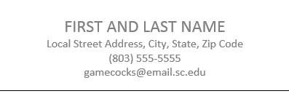
Identifying Information/Heading:
Cap the top of your resume with:
  Full name
  Complete address
  Phone numbers
  E-mail address
  Personal website (if appropriate)`

Slide 23
Objective
Optional category that specifies profession you are seeking
Be specific and concise
Omit category if you don’t know the exact position you’re pursuing
Good Example
Poor Example
An internship at SEFA group.
An engineering position where I can learn and have hands on opportunities.

Slide 24
Education
Degrees/certificates listed in reverse chronological order
Names and locations of schools or programs where you earned a degree
Expected graduation date
Major, minor or cognate
Grade point average (if 3.0 or above)
Awards/Honors/Scholarships (consider a separate section if more than 3)
Study abroad experiences

Slide 25
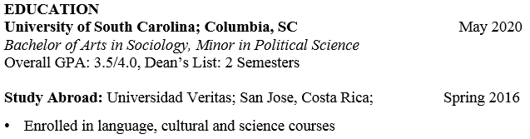
Example of Education Section

Slide 26
Related Coursework
Optional and can also be incorporated into the “EDUCATION” section
Mainly used when you are lacking related experience but want to demonstrate specific knowledge
List the titles of courses you’ve taken that relate to the position for which you are applying
Notes:
General Chemistry
Organic Chemistry
Physics
Calculus
Statistics
Biology

Slide 27
Skills Section
Optional, but valuable
Some Categories include: computer, technology, language
List product names and version numbers if possible
Students seeking positions in technology should break this list down (programming languages, hardware, software, operating systems, databases, peripherals)

Slide 28
Skills Example
SKILLS
  Computer
  Languages: C++, java, HTML, CSS
  Applications: Eclipse, Microsoft Office, Putty, MATHLAB
  Machines: Unix, Linux, Solaris
  Languages
  Fluent in French and Spanish, Basic knowledge of German

Slide 29
Experience
Can be labeled as/broken-up into:
  Experience, Work Experience, Relevant Experience, Research Experience
Always include in this section:
  Employer Name & Location
  Dates of Employment
  Your position/title
  A bulleted list of accomplishments/contributions beginning with an ACTION VERB

Slide 30
Experience
When developing the action bullet points:
  Describe the tasks and projects that you did
  Describe the soft or transferrable skills you utilized
    communication, teamwork, handling difficult customers
  Describe the meaning & takeaway you exited the experience with
  Be descriptive using numbers, percentages, or dollar amounts

Slide 31
Additional Categories
HONORS, ACTIVITIES, RESEARCH, PROFESSIONAL AFFILIATIONS
  You may specifically want to include:
    Activities or leadership positions that demonstrate job related skills
    Honors or awards (Scholarships may or may not be relevant)

Slide 32
Review: Do’s and Don’ts
DO | DO NOT
Use action verbs | Use pronouns (I, me, my, etc.)
Include specific accomplishments | Include references
Keep resume easy to read | Include personal information (age, height, weight, gender identity)
Keep resume about one page | Clutter your resume with nonessential information

Slide 33

What is
?
Every job starts with a handshake.
The USC Handshake database allows students to search for jobs, internships, co-ops.
Notes:
Stand up sit down

Slide 34
Approved
vs.
Not Approved
Can apply for ANY position posted
Upload resume, cover letters, and other documents
Employers can search for YOU
Can upload resumes and cover letters
Able to look at posted positions
Can NOT apply for ANYTHING
*To obtain Approved access to Handshake,
your resume will need to be reviewed by a
Career Center staff member during drop-in hours.

Slide 35


Slide 36


Slide 37
KNOW YOUR GOAL
Understand your reason for attending
the fair. Are you:
  looking for full-time, part-time,
  internship, co-op?
  exploring career opportunities?
  investigating companies?
  practicing networking skills?

Slide 38
RESEARCH EMPLOYERS
ATTENDING THE FAIR
Review list of employers attending the fair
  Look at Handshake Fairs via the Handshake website
  sc.joinhandshake.com
Visit employer web sites and use employer research sites found on the Career Center’s web resources page
Narrow your focus and prioritize number of employers

Slide 39
PREPARE TO MAKE A
GOOD IMPRESSION
Have a well-written, critiqued resume – bring 20+ copies
Develop a list of questions for employers based on research
Prepare to speak a “skills” language
Articulate your qualifications and goals
Know how to express what you are looking for and what you want
Prepare a “Career Fair Employer Log” to use for note-taking during the fair
Notes:
Know how to relate your past work, academic and out-of-class experiences, to the career field.
Prepare a career log in advance to document career fair information (i.e., To whom have you given a resume?, Are they scheduled to return to USC ?, etc.)

Slide 40
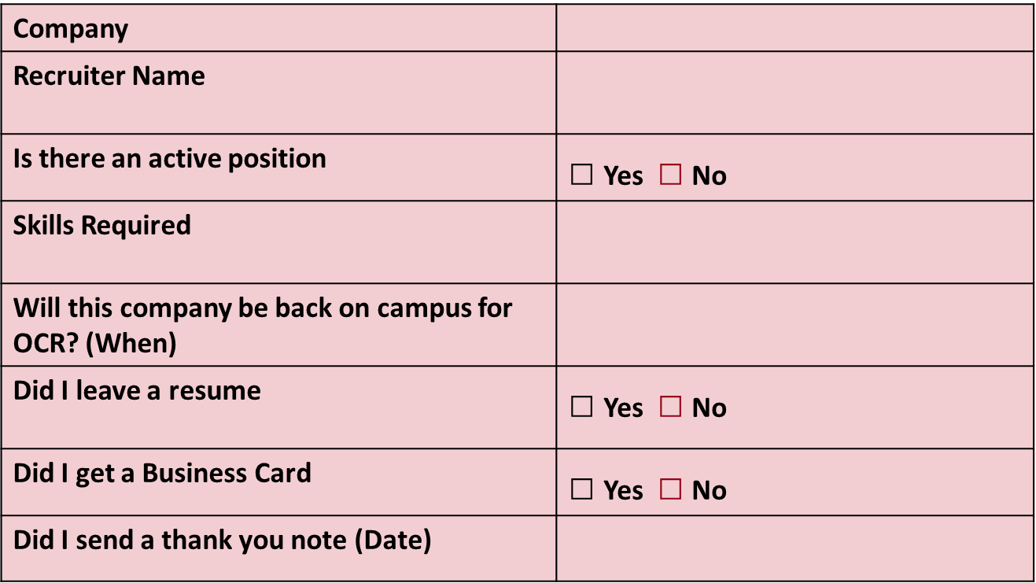
PREPARE TO MAKE A
GOOD IMPRESSION
Notes:
Know how to relate your past work, academic and out-of-class experiences, to the career field.
Prepare a career log in advance to document career fair information (i.e., To whom have you given a resume?, Are they scheduled to return to USC ?, etc.)

Slide 41

THINK AHEAD
Be prepared for potential bad weather
Consider travel time/parking and allow ample time for delays
Talk to professors about class conflicts
Bring paper to take notes and a portfolio to stay organized
Notes:
Smile, make eye contact, and shake hands confidently and firmly. Introduce yourself with your full name, major, and graduation date.
Remember your body language…don’t fidget or look around. Act interested, focused, and enthusiastic. Be friendly, assertive, mature, and sincere.
Ask at least 2 intelligent questions of each organization, about such topics as: organizational statistics, company mission, client base, internship or co-op opportunities, summer or part-time employment, full-time career paths, trainee programs, benefits, hiring procedures, etc.

Slide 42

MAKE A GOOD
IMPRESSION
Arrive early
Dress and act professionally
Establish rapport with the recruiters
Remember your body language
LISTEN to the recruiter
Don’t ramble
Ask at least TWO intelligent questions of each organization
Notes:
Smile, make eye contact, and shake hands confidently and firmly. Introduce yourself with your full name, major, and graduation date.
Remember your body language…don’t fidget or look around. Act interested, focused, and enthusiastic. Be friendly, assertive, mature, and sincere.
Ask at least 2 intelligent questions of each organization, about such topics as: organizational statistics, company mission, client base, internship or co-op opportunities, summer or part-time employment, full-time career paths, trainee programs, benefits, hiring procedures, etc.

Slide 43
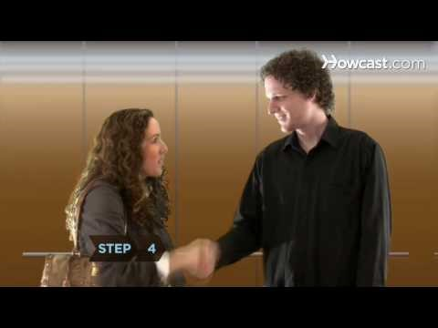
Network with Confidence!
Personal Introduction
30 Second Commercial or Elevator Pitch
  In 30 seconds or less….
    Who you are…
    What you want to do…
    What you can offer…
Notes:
SAMPLE –
Personal Introduction + "I became interested in the human resources field last summer when I interned at The Greater Houston YMCA and I got to know the Human Resources Director there. I had always planned on following the traditional route to graduate school but her job really fascinated me. I liked the variety of her job and the fact that she was a very positive influence in the YMCA. When I returned to school this fall, I decided to add a business class and I also joined the Human Resources Management Association. I have enjoyed my business class and it's a good complement to my psychology classes. Next semester I will begin taking courses as a management major and I hope to obtain an internship in human resources next summer."

Slide 44

The Importance of Networking
80% of job vacancies are never advertised.
Most employers would prefer to hire a person referred by a colleague, peer or friend and believe they will be exposed to a higher quality candidate in this manner.
The overall time needed to find a job can be drastically reduced.
  4-6 months if networking
  6-9 months without networking
You can learn more about your field of interest and occupations within it, as well as specific organizations
Notes:
FOLLOW UP APPROPRIATELY!!!

Slide 45

Suit Up!
A suit is always safe, or button-down shirt with dress pants or skirt
Avoid excessive jewelry, makeup, perfume, or cologne
Make sure clothes are clean and wrinkle free
Dress as if the fair was an interview!
Notes:
Stand up/sit down

Slide 46
Sample Questions To Ask Employers
What unique factors set this organization apart from others?
What type of entry level positions exist in this field?
How did you personally get interested in this field?
What attracted you to this organization?
What is the typical career path of someone in this organization/field?

Slide 47
ALWAYS FOLLOW UP
Search Handshake database to determine which employers will be interviewing on campus following the fair
Review Career Center online materials on writing thank you and follow-up letters – also about speaking with employers on the phone
Mail thank you cover letter and resume to selected employers as soon as possible
Follow-up with a phone call approximately 2 weeks later

Slide 48

WHAT’S YOUR PLAN?
Visit US!!
College of Engineering & Computing (Satellite)
1st Floor
Swearingen Engineering Center
Hours
  8:30am-5:00pm M-F
  Drop-in Hours
  1:00pm-4:00pm M-F
Email: career@sc.edu | Web: www.sc.edu/career

