Slide 1

Career Fair prep & the internship search
Vicki Hamby
Senior Associate Director

Slide 2
AgENDA & Expectations for today
EXPECTATIONS
Stay on camera please!
Send me some encouraging non-verbals!
  Friendly eye contact, nodding, & SMILING are all welcome! ☺
  Audience participation is even better!
If at any point you have a question, don't hesitate to raise your hand or simply un-mute and pipe up with a “Ms. Hamby, I have a question”
AGENDA
CC Services
Internship Search
Upcoming STEM Job Fairs (2 days!!)

Slide 3
Fall 2021 Career Center Services
The CEC Career Center Office in Swearingen 1A03 is open!
  Meet with a career studio peer educator for an up-to 20-minute session during Career Studio hours – great for resume reviews!
  OR
  Meet with a Career Coach for a 15-60 minute topic specific appointment – best for in depth career decision making and internship/job search assistance
  For the safety of our students and staff every appointment and career studio session - whether in-person or virtual - will have to be pre-scheduled through Handshake.

Slide 4
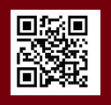

WHAT THE CAREER CENTER DOES
sc.joinhandshake.com
Notes:
What does the Career Center do anyway? We are often known as the “resume place” which is not inaccurate – we certainly can and do review resumes, but that’s definitely not all we do! On the screen are a few other topics we often discuss with students as well.
Our mission is to empower students for lifelong career management. So, I am to help you find internships and full-time positions now, yes, but also help you figure out how to use that knowledge and process for the rest of your life, as you will likely have many, many job transitions throughout your lifetime.

Slide 5

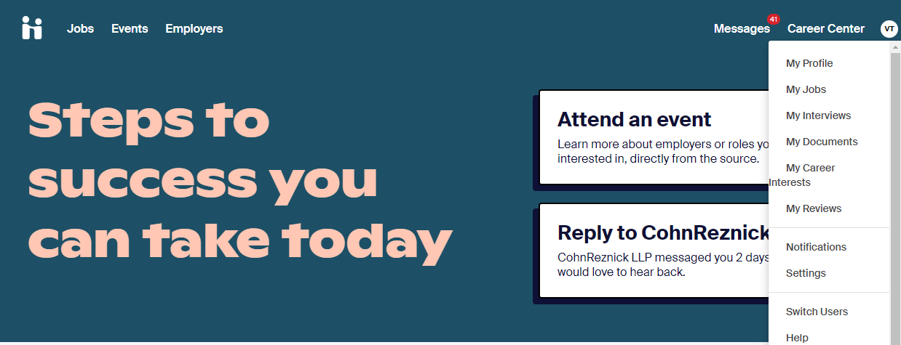
https://sc.joinhandshake.com/
Notes:
Who has heard of Handshake. Who has an account? Under career center you’ll find resources and you’ll be able to request appointments.

Slide 6
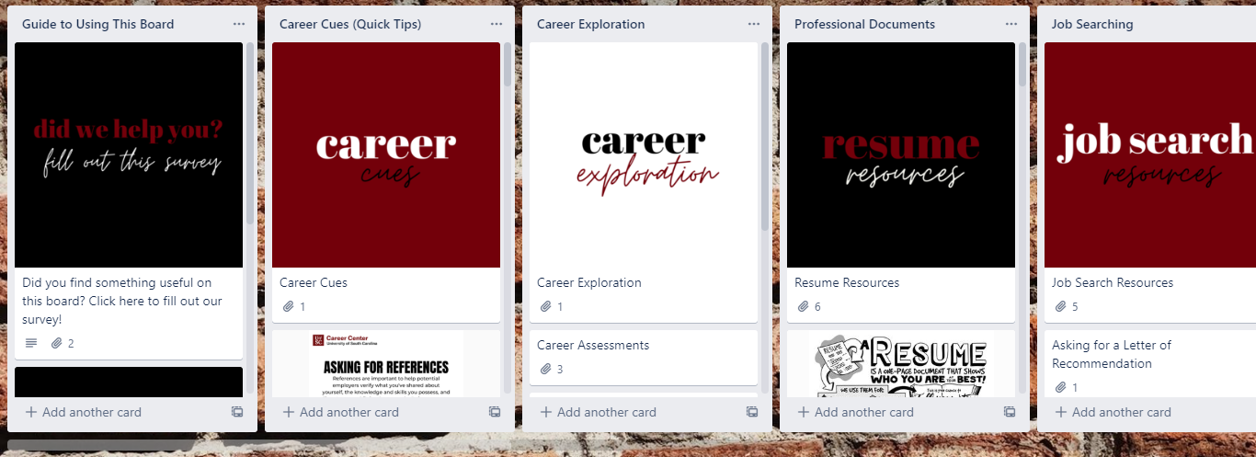
Student toolbox on Trello
Student Toolbox Link

Slide 7

Raise your haNd if you . . .
Are looking for a summer 2022 internship or co-op
Are curious about what companies you can work for upon graduation
Are wondering what jobs you can do with your major and what responsibilities they entail
Are asking yourself what you steps you should take in the next few semesters to get you to your career goals
Notes:
All of these are reasons to attend the upcoming career fair.
If you are seeking an internship, companies at the fair may be hiring and interviewing.
If you aren’t seeking an internship, you can still attend group sessions to better understand what companies are in your field of interest, what entry level positions and projects are, and what skills they suggest developing during college to make you stand out during the job search.

Slide 8
Career fairs Are happening!
STEM Job Fair
  Virtual: Tu. Sept. 14, 12-4:30pm – IN Handshake
  In-Person Th. Sept. 16, 1-5pm - @ the Carolina Coliseum
Graduate & Professional School Fair
  Virtual: W. Oct. 20, 2-6pm – IN Handshake
Health & Wellness Professions Job Fair
  Virtual: W. Oct. 27, 1-5pm – IN Handshake
  In-Person: W. Oct. 28, 1-5pm – @ the Carolina Coliseum
  INFO IN HANDSHAKE!!
Notes:
Check Handshake for details (times, employers, etc.). Employers are still registering (invites to the fair were just recently sent out).
Check out the employers for each of these fairs! You may be surprised to see that an employer of interest may not be attending one of the STEM labeled fairs.

Slide 9
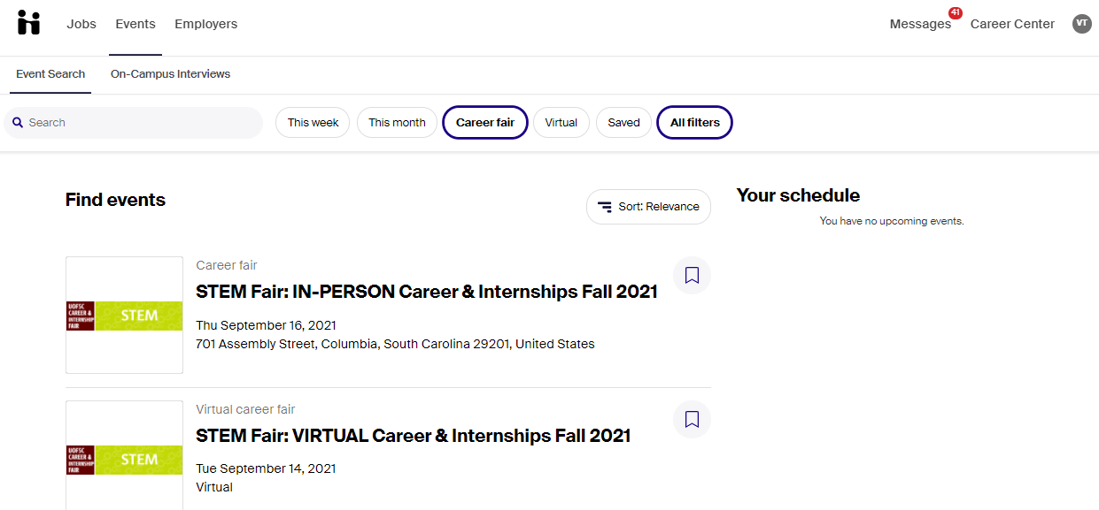
JOB FAIRS

Slide 10
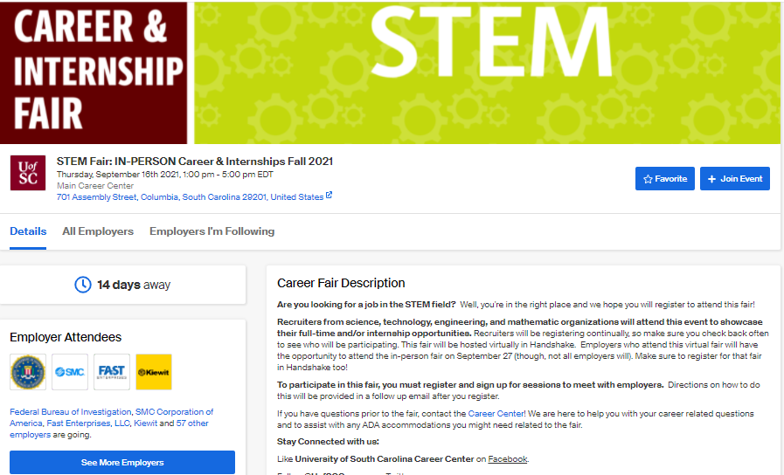

Job FAIRS
Virtual Fair

Slide 11
Virtual Career Fair process
70+ employers registered
Using Handshake’s virtual platform
Must register for the fair on Handshake
Employers will host up to 3 large group information sessions (max of 50 students per session)
Employers will host 10-minute 1:1 conversations
In order to attend, you must sign up in advance for both group and 1:1 sessions. There are a limited number of slots.
Updating your Handshake profile and uploading your resume is more important now than ever, as it will be incredibly accessible to employers.
Notes:
If you are like me, your first thought is: how is this going to work. Here’s a quick overview.
Everything is through Handshake.
Group sessions: if interested, but not totally sure.
- 1:1 – super interested in the company
Good news: because the fairs are virtual, you no longer have to commit so much time to attending for only a few employers that may be of interest!
First come, first served. So, register early for companies you are interested in and check back often.
Flexible scheduling: You can cancel up until a few minutes before your session or one-on-one.

Slide 12
In-person Career Fair process
60+ employers registered
No need to register via Handshake, just register on-site
Mask requested
NEW Venue - Carolina Coliseum (NOT the Convention Center – no buses outside for campus buses)

Slide 13
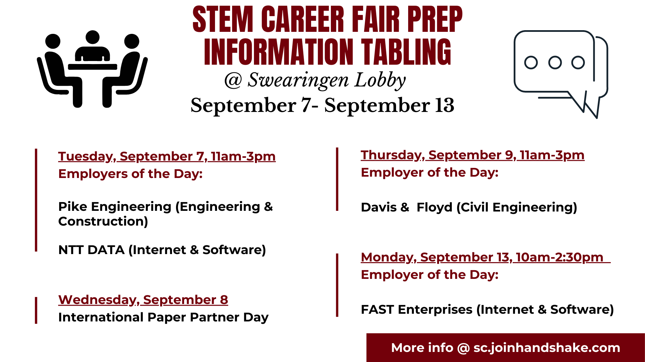
CEC Career Fair Prep workshops
Notes:
That’s a lot of new information, and the process is very different than in years past. So, the CEC Career Center will host several workshops to help prepare you in the weeks leading up to the fair. While these workshops are focused on topics that are necessary for preparing for the career fairs, they are also important concepts to understand in the job search in general and with all interactions with employers! So, don’t feel like you must plan to attend the fair to attend any of these sessions.
Will be via Blackboard Collaborate. More details to come for these! Look on Handshake for them soon!

Slide 14




PRePARE FOR A JOB FAIR OR INTERNSHIP SEARCH
Craft Your Professional Documents
Research & Develop a Plan
Practice Elevator Pitch
Prepare for the Day of
Notes:
In order to make the most of any career fair, there are 4 key success factors that we encourage every student to complete. The first one is to craft a resume that highlights all the relevant experiences and skills you can bring to the table. The second one is to research employers so you know more about what they can do and can answer questions professionally during a one-on-one interaction. The third key success factor is to practice and polish your elevator pitch. By a show of hands, how many of you have heard of an elevator pitch before? Can anyone explain it for me? An elevator pitch is a brief synopsis of your background and experience and is something you would use to sell yourself if you only had 30 seconds with the CEO of your favorite company. The last key success factor is to prepare for the day of by planning what you’re going to wear, what you’re going to bring and how you going to communicate with employers. Today we’re going to go through each of these key success factors in detail and provide you with sample materials to help you make the most of the career fairs we have coming up this semester.

Slide 15
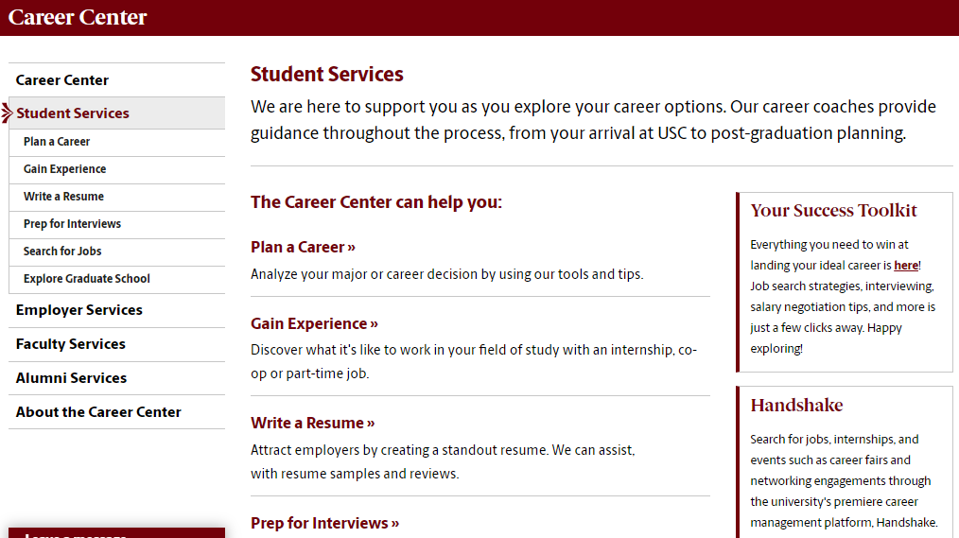
RESUME RESOURCES

Slide 16
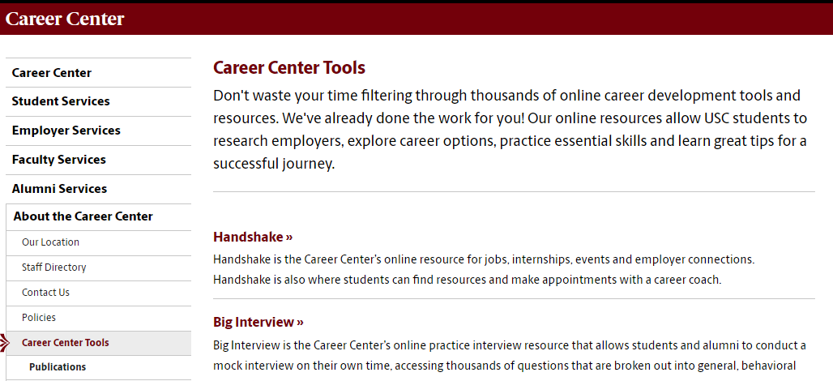
ResUME RESOURCES

Slide 17

Researching employers
Why is this important? How do you research?
Pipe up if you have an answer
Notes:
Prior to attending the fair, it is crucial that you do extensive research on the employers that are attending using Handshake or the Career Fair Plus App. We’ll show you how to identify the employers attending the fair in just a moment. Once you’ve identified those employers, USE YOUR RESOURCES to learn more about them. Ask a family friend that works for your dream company to tell you about what a typical day is like. Scour the company website for their mission statement, and for evidence of how they live out their mission statement daily. If they’re available, look at annual reports to learn about the health of the company. Check out their social media presence on Facebook, Instagram, Twitter, and LinkedIn – that’ll give you some good insight into what’s happening there and what the culture of the company is like. There are a ton of resources you can utilize to learn more about the companies you’re interested in – dig in and learn what you can! Finally, from all of that research, narrow your focus to prioritize the companies you’d like to speak with. We usually have over 150 employers signed up for the fair, so it would be impossible to talk to every employer. Instead, narrow your list to you top 5 and then have a back up 5 that you will talk to if your top 5 are busy and have small lines of students waiting. By creating two lists, you’ll have a lot of options and a great number of people to connect with, but you won’t be talking to so many people that you forget what each of them said.

Slide 18

What does it mean to research?
Mission
Vision
Core Values
History
Leadership
Culture
Community Interaction
Employee Value
Earning Reports
Market Competitors
Recent Initiatives
Position Description
Notes:
When we say research, what does that mean, exactly? Well, it could mean a lot of different things! We encourage you to take a look at the mission, vision, and values of the organization to see how well they line up with your philosophy on the work you’d like to do. Learn about the company’s history – where have they been, and how did they get to where they are today? Who’s in charge of the company, and what does that mean for the direction in which the company’s moving? What about the culture of the organization? Is the workplace environment something you could get on board with? How does the organization interact with the community? (Or do they interact with the community at all?) How would you be valued as an employee in this organization? And of course, look at their business to learn about the health of the company – check out recent earnings reports, learn about their market competitors and what distinguishes them from the bunch, and any recent initiatives they’ve undertaken. Are those initiatives something you’re excited to be a part of?
Doing all this research will not only help you decide which companies to apply to and which to avoid, but it will also be tremendously helpful in writing your cover letters, tailoring your resume, and acing your interview.

Slide 19

Do your research
Company website and social media
Handshake
Career Shift (on USC website)
Glassdoor
Vault
The Muse Company Profiles
Forbes
Bloomberg Company Research
Your personal network!
Notes:
But you’re probably wondering…where on earth am I supposed to find all this information?! Fortunately, the internet is a fabulous research tool, and there are a number of resources that will be of tremendous assistance to you.
Always, always start with the company website – see what they have to say about themselves! Usually, this is where you’ll be able to find information about mission, vision, values, initiatives, and leadership.
Review sites like GlassDoor and Vault are good research resources too, both for facts and figures, as well reviews from former and current employees. (As you would with Amazon.Com reviews, take these with a grain of salt!) These websites can give you a bit more information about how these companies live out their mission, vision, and values.
One of my favorite places to look is the organization’s social media presence – what kind of information are they putting out into the world? How do they interact with the public? What kind of “vibe” do they give off? Not a technical term, but still important!
Also check out company profiles on websites like The Muse, Forbes, the Bloomberg and CNBC Company Searches, and Hoover’s Online.
And finally, go beyond the internet and use your personal network!

Slide 20
How to Research employers:
SC.JOINHANDSHAKE.COM
Search the employer directory
Read employer profiles and hyperlink to website
Read student reviews and interviewing reports & network with peers
Notes:
One of the best resources available to you to conduct this research is Handshake. How many of you are familiar with Handshake? Good! If you are new to Handshake, make sure to pay attention and take note on how to get to the employers tab so you can research!

Slide 21
Develop a plan with smart goals
Secure an internship
Earn 2-4 internship offers
Interview with 8 companies
Apply to 20 jobs
Connect with 25 employers
Research 40 employers attending STEM Fair or beyond
Create candidate documents
  Resumes, Cover Letters, LinkedIn Profile
Notes:
Start with the end in mind and walk it back

Slide 22
Monitor your progress
Save & clearly label your application materials
  Last name, First name – Resume – Employer Name.pdf
  Last name, First name – Cover Letter – Employer Name.pdf
Take notes on interview questions, responses, communication, etc.
Reflect on your observations & gut instincts
Remember, the job/internship search is a process.
Notes:
Be sure to monitor your progress and reflect regularly.
As I mentioned before, keep track of your applications in an Excel document or something similar. Also be sure to save a PDF of the position description and the cover letter and resume you used for the position – keep these materials in a folder labeled by the position and organization.
Be sure to take good notes before, during, and after the interview process. If questions came up that stumped you, jot them down! If you thought of a question afterward that you might like to ask in a future interview, make a note of it! Taking notes will help you improve your job search skills – whether for this search or the next one!
And finally, take some time to thoughtfully reflect on your application and interviewing experience. Did you get any “gut feelings” during the interview? Pay attention to those! Your instincts are trying to tell you something important. But don’t let gut instincts make the decision for you, because nerves could, of course, be a factor!
Remember, the job search is a process. It takes time, it takes energy, and it will look different for every single person. Do not compare your job search to others, be kind to yourself, and be patient. Keep at it and something good will come.

Slide 23
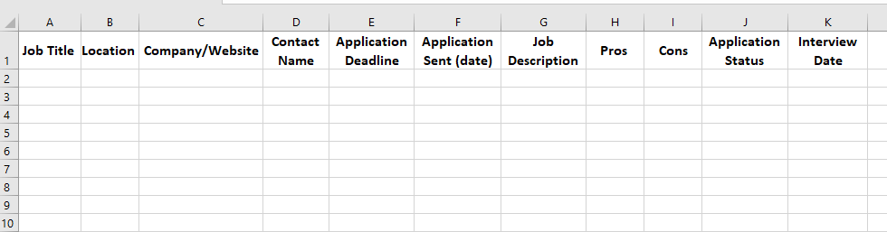
Internship search organizational document

Slide 24


Elevator pitch
Raise your hand if you have an answer
Wait. Do you still need an elevator pitch for career fairs and for interviews?

Slide 25
Yes! You still need to . . .
Introduce yourself
Provide a “marketing message” for your professional self
Share your
  Qualifications
  Knowledge
  Interests
  Skills
  Goals
  Purpose for your conversation
Notes:
This introduction will help you determine which companies to talk to and guide your 10-minute conversation with an employer.
If you did not take time to think about your qualifications and goals, the conversation could be scattered. If you take the time prior to the session to articulate these topics, you will know what you want to get out of the conversation, what questions to ask, and how to explain that you are a good fit for the company.
Not all of this information has to be shared in the first minute of your conversation, but odds are you will talk about all of this information at some point in your conversation.

Slide 26
Elevator pitch ideas
What sparked your interest in this field?
What are some supporting experiences that have helped you further develop the skills that would be useful for this job?
What have you already learned about the field and what are you hoping to learn from this opportunity?
What activities or groups are you affiliated with? What experiences or exposure are you gaining from the affiliation?
What about this company do you find particularly exciting?
What questions do you have for the employer?
Notes:
Here are a few questions to consider that you can use to create an elevator pitch if you don’t have one already. This built-out formula is a great place to start to brainstorm ideas of topics to discuss, but an iteration of this would be fine to utilize when approaching an employer at a career fair. You don’t want to answer each of these questions in full because then your elevator pitch would become a monologue as opposed to the introduction to a two-way conversation. Keep in mind the most important parts of yourself and your experience that you feel you should convey.
One last pointer before I give you a moment to craft your elevator pitch: it’s great to end with a question! That keeps the conversation going but also demonstrates that you’ve taken the initiative to research the company – that you really care about who they are and what they stand for.
Ideas for questions to ask employers:
What unique factors set this organization apart from others?
What type of entry level positions exist in this field?
How did you get personally interested in this field?
What attracted you to this organization?
What is the typical career path of someone in this organization/field?
I’ve heard that you’ve already practiced your elevator pitches in this class. I will give you a minute or so to think about what you might say in an elevator pitch using these prompts, then we will practice them along with handshakes.

Slide 27
Elevator pitch activity
You’re in a 10-minute individual video session with an employer.
1. How do you introduce yourself during the first 30 seconds?
2. What 2 questions from the previous slide do you want to answer? Draft your answers.
3. What are 1-2 general (not company specific) questions you have for the employer?
Notes:
Take the next minute to think about your elevator pitch and write a few ideas down. I will ask 2 people to share.

Slide 28
What should you do and/or think about on the day of the fair?
Raise your hand if you have an answer

Slide 29
Day of fair tips Virtual
Find a quiet, well-lit location
Keep the background simple & professional with no distractions
Test your technology in advance (audio, video, wifi)
Be mindful of your body language: sit up straight, make eye contact, and smile
Professional dress
  Business professional - dress as if the career fair is an interview
  Avoid excessive jewelry or makeup
Notes:
The first thing you can do to prepare for the day of the fair is to make sure you dress for success. First impressions are very important, so it is crucial that you dress as if the career fair was an interview. It is also important to make sure that your suit or professional dress is cleaned and pressed. If you haven’t invested in an iron yet, now may be the best time to do so. When choosing what to wear the day of the Career Fair, make sure to avoid clothing that is too shot, revealing or ill-fitting. Psychologists say that when meeting someone for the first time, you only have about 7 seconds to make a powerful first impression. If you are buying a new suit or a jacket, please make sure you cut the vent stich in the back. Most people aren’t aware that the vent stitch is only used to keep suits and jackets nicely pressed and structured during shipping. In addition to dressing professionally, you should wear little to no perfume or cologne and avoid wearing excessive jewelry and make up the day of. Some individuals have sensitivity issues to various smells and odors, so it is best to proceed with caution when preparing the day of for a Career Fair. We fully support individuals wearing deodorant though!
You want to look good, but “professional dress” type good; not “going out” type good.
If you are not comfortable in heels, you don’t need to wear them! If you prefer not to wear makeup, you don’t have to!

Slide 30
Day of fair tips In-person
Professional dress
  Business professional - dress as if the career fair is an interview
  Avoid excessive jewelry or makeup
Be mindful of your body language: walk confidently, make eye contact, and smile, safe distancing
Have copies of your resume on hand
Know ahead of time what companies you want to talk to
Notes:
The first thing you can do to prepare for the day of the fair is to make sure you dress for success. First impressions are very important, so it is crucial that you dress as if the career fair was an interview. It is also important to make sure that your suit or professional dress is cleaned and pressed. If you haven’t invested in an iron yet, now may be the best time to do so. When choosing what to wear the day of the Career Fair, make sure to avoid clothing that is too shot, revealing or ill-fitting. Psychologists say that when meeting someone for the first time, you only have about 7 seconds to make a powerful first impression. If you are buying a new suit or a jacket, please make sure you cut the vent stich in the back. Most people aren’t aware that the vent stitch is only used to keep suits and jackets nicely pressed and structured during shipping. In addition to dressing professionally, you should wear little to no perfume or cologne and avoid wearing excessive jewelry and make up the day of. Some individuals have sensitivity issues to various smells and odors, so it is best to proceed with caution when preparing the day of for a Career Fair. We fully support individuals wearing deodorant though!
You want to look good, but “professional dress” type good; not “going out” type good.
If you are not comfortable in heels, you don’t need to wear them! If you prefer not to wear makeup, you don’t have to!

Slide 31
Prepare: what to have with you
Your resume
Your Employer Research form with a few questions for each employers based on your research (if needed)
Copy of your Elevator Pitch form (if needed)
A notepad and writing utensil
Notes:
In preparing for the day of the Career Fair, its important you plan ahead and pack a variety of items to bring with you. The first thing that we encourage students to come with are copies of the resume they have crafted. We encourage students to print about 15 to 20 copies to bring with them, but this number may change depending on how many employers a student is planning on talking to. If a student has utilized the Employer Research Form, we encourage students to print those and bring those along with them so they can review them during their time at the fair. In addition to the research they have completed on the employer, we encourage students to brainstorm a few questions they can ask each employer to show the company their sincere interest and the research they have done. If a student feels more comfortable with bringing a copy of the Elevator Pitch form, we highly encourage a student to bring it BUT not to read directly from it when introducing themselves to an employer. The Elevator Pitch form should only be used as a crutch for the day of when many students get nervous. In addition to these printed documents, we encourage students to bring at least 2 pens, a notepad to take notes on and a folder or padfolio to keep resumes, business cards, notes, brochures, and giveaways organized. Organization will be key during the Career Fair to help you in impression each and every employer you talk to at the fair.

Slide 32
After the fair: to do list
Organize your notes
Excel spreadsheet to keep everything in one place
Always follow up, but don’t expect an immediate response
If conducting Day-After Interviews, submit your application materials well before the deadline!
Mail or email thank-you note (and resume) ASAP
Follow up with a phone call approximately 2 weeks later
Notes:
Now that you have mastered your interactions with employers at the Career Fair, it’s time to organize your notes, literature and business cards to keep everything organized. We encourage students to create an excel spreadsheet that lists the companies they talked to, the recruiters name, and their rank or initial gut reaction notes on the employer. While making that list, use Handshake or the Career Fair Plus App to note of the companies that are conducting on campus interviews and make sure to check your phone or email for notifications regularly for messages from employer. While attending a Career Fair can be very exciting and a wonderful opportunity to talk with many different companies all in the same day, it is important to understand the realities that come with working a career fair. First, we’ll point out that many of the individuals you talk to at the Career Fair are HR recruiters whose main job is to attend career fairs and similar events to recruit students to join their company. Many of these HR individuals travel a lot for their jobs so it is normal not to receive an immediate response if you are to follow up with them. Unfortunately there is a reality that you may never hear back from a company, but it is still extremely crucial that you do all you can.

Slide 33

Other job search resources
Handshake
Engineer Jobs
Career Shift
Linked In
Professional Associations - ACM
USA Jobs
COVINTERN
Finding a Computer Science Job
DICE
Notes:
What constitutes a “reputable website,” you ask?
First, if you have target companies you’re interested in, check the company’s “Careers” or “Jobs” page at least once per week.
LinkedIn also has a reputable job search feature that you can use in conjunction with your networking.
Professional associations like AiCHE, ASME, AITP, SWE, etc. tend to have associated job boards than can be a great place to check out.
And finally, search engine website can also be helpful resources. Of course, check out Handshake FIRST – we have thousands of jobs posted on Handshake, and every single employer there has indicated that they’re looking specifically for UofSC students. The candidate pool is significantly smaller through Handshake than it is on company websites or Handshake. We also provide access through Handshake to a website called Career Shift, which is one of the most comprehensive job search tools available.
SCBIO: A statewide, not-for-profit, public/private life sciences industry association formed to promote, and expand South Carolina's life sciences industry. Events for students: SCBIO is hosting a virtual networking event to give students the opportunity to connect and engage with local industry professionals. Join us Sept. 1st from 2PM – 3PM online

Slide 34
Questions?

Slide 35





Connect with us!
(803) 777 - 7280
@CareerCenterCEC
career@sc.edu
http://cec.sc.edu/
careercenter
@uofsc_cec
Swearingen, 1A01
http://sc.edu/career

