Slide 1
CSCE 390
Professional Issues in Computer Science and Engineering
Ch.8: The Computing Field as a Profession
Fall 2020
Marco Valtorta
mgv@cse.sc.edu
Notes:
The slides are based on Barger’s textbook and other sources
A major source for this chapter is: Peter Denning. “The Computing Field: Structure.” http://www.cs.gmu.edu/cne/pjd/PUBS/ENC/cs08.pdf, retrieved 2011-02-24. http://www.cs.gmu.edu/cne/pjd/PUBS/ENC/cs08.pdf

Slide 2
Expert Knowledge
Technical knowledge that is certified by some authority and is not possessed by the layperson
Experts solve problems in their field in a different way than novices
There are good information processing models of expertise, e.g. see Chi and Glaser’s work http://www.public.asu.edu/~mtchi/papers/ChiGlaserRees.pdf
Expert systems are programs that capture expertise

Slide 3
Autonomy
Independence in conducting one’s professional practice
  Diagnosis
  Treatment
  Follow-up

Slide 4
Internal Governance
A professional discipline is controlled by its members, rather than by some external authority
Entrance requirements
Discipline of colleagues who break the rules
Example: Law bar

Slide 5
Service to Society
Humanitarian service
  Pro bono work
  Emergency medical help
  Religious ministry

Slide 6

History of the Professions
Guilds (corporations) in the Middle Ages
Specialized knowledge
  Latin (q.i.d., O.D.)
Autonomy
Self-governance
  state and local government control becomes more common
Public service
Traditional wrough-iron
guild sign of a glazier in
Germany. Those signs
can be found in many
European old towns where
guild members had to mark
their places of business.
Notes:
http://en.wikipedia.org/wiki/Guild

Slide 7
Guilds in Syria
Title: Craft Organization, Work Ethics, and the Strains of Change in Ottoman Syria, Abdul-Karim Rafeq, Journal of the American Oriental Society, Vol. 111, No. 3 (Jul. - Sep., 1991), pp. 495-51, http://www.jstor.org/stable/604267
Abstract: Craft organizations (guilds), whose origins in the Arab-Islamic countries are controversial, developed in a highly sophisticated way in these countries under Ottoman rule. Known as ṭawāʾif (sing. ṭāʾifa) in Ottoman Syria and in other Ottoman provinces, these organizations were autonomous. They regulated the affairs of their members, distributed collective taxes among them, controlled the quality of their products, and fixed the prices of their commodities. The stability of the economic and social life in Syria owes much to these organizations. Religio-ethnic tolerance was a major characteristic of these organizations which included Muslims, Christians and Jews within their ranks. Through work ethics, merit was the primary consideration for admission into, and promotion within, the craft.

Slide 8
Computing as a Profession
Specialized knowledge?
Autonomy?
Internal governance?
Public service?

Slide 9
Computing as a Profession: My Vote
Specialized knowledge?
  Yes
Autonomy?
  Yes, but some see computing as auxiliary to other specialized fields and therefore unable to evaluate its successes and failure autonomously
Internal governance?
  Partly: codes of ethics, but no strongly accepted certification; most states do not certify information technology professionals
Public service?
  Yes, e.g. open source projects and the web

Slide 10
What is a Profession? Another View
Initial professional education
Accreditation
Skill development
Certification
Licensing
Professional development
Code of ethics
Professional Society
Michael J. Quinn. Ethics for the Information Age. Addison-Wesley, 2005, p.366 (after a Software Engineering Institute report by Ford and Gibbs, ref. [1] there).
Notes:
Michael J. Quinn. Ethics for the Information Age. Addison-Wesley, 2005, p.366 (after Ford and Gibbs, ref. [1] there)..

Slide 11

Andrew A. Chien’s View
Andrew A. Chien is the Editor-in-Chief of Communications
of the ACM. This article appeared in October 2017.

Slide 12
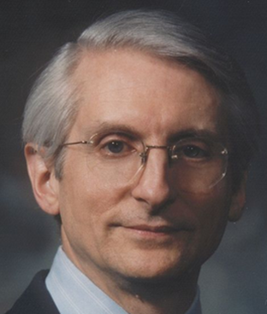
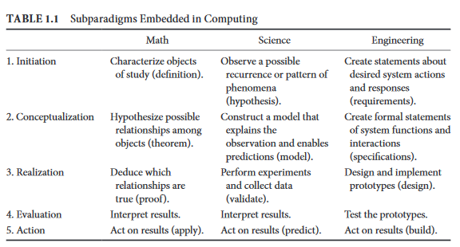
What is Computing?
Peter Denning, http://denninginstitute.com/pjd/PUBS/ENC/CRC-csstructure-2013.pdf

Slide 13
The ACM’s Position
The ACM is against licensing software engineers
The ACM is in favor of software engineering being view as a profession
The ACM sees a difference between licensing and certification
The ACM will continue its efforts to improve the quality of software, which is “the most important problem facing the IT profession”
Source: John White and Barbara Simons. “ACM’s Position on the Licensing of Software Engineers.” CACM, 45, 11 (Nov. 2002), p.91.

Slide 14
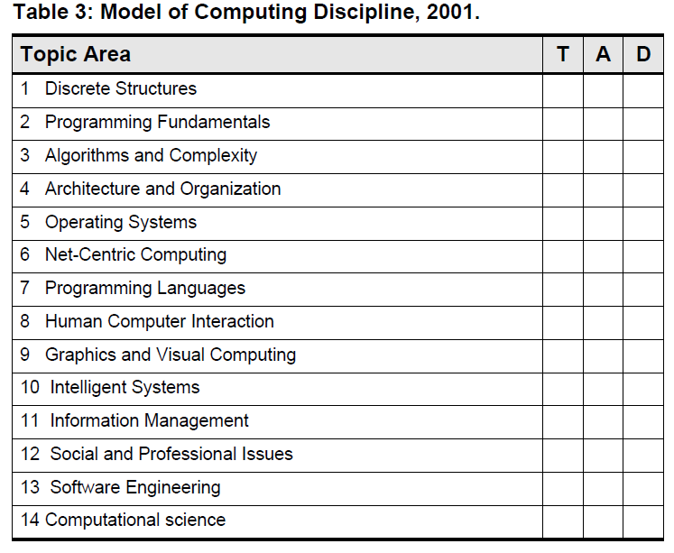
What is Computing?
ACM/IEEE-CS Curriculum 2001 Update
Notes:
http://www.cs.gmu.edu/cne/pjd/PUBS/ENC/cs08.pdf

Slide 15
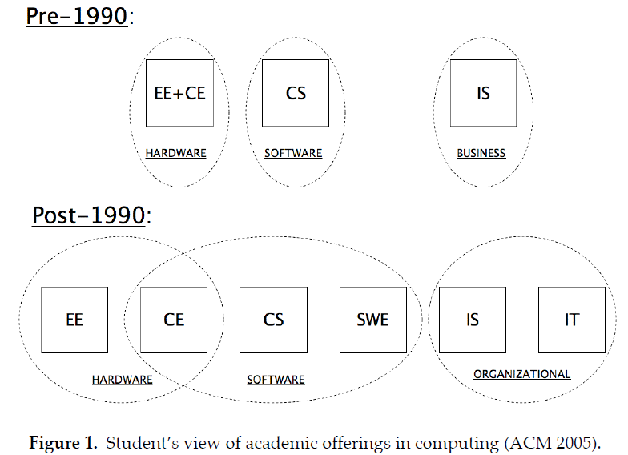
Academic Specialties
Academic disciplines (professional subfields?) in Computing (“Informatics” outside the US) (ACM/IEEE-CS, 2001)
EE -- Electrical Engineering
CE -- Computer Engineering
CS -- Computer Science
SWE -- Software Engineering
IS -- Information Systems
IT -- Information Technology
Notes:
ACM/IEEE-CS, 2001; http://www.cs.gmu.edu/cne/pjd/PUBS/ENC/cs08.pdf

Slide 16

ACM “IT Profession” Initiative (1998)
The initiative responded to the growing interest in the industry for professional standards (especially in safety critical systems), organized professional
bodies representing various specialties, and the university movement to establish degree programs
in information technology. The ACM concluded that computing met the following four criteria for a profession:
1. A durable domain of human concerns.
2. A codified body of principles (conceptual knowledge).
3. A codified body of practices (embodied knowledge including competence).
4. Standards for competence, ethics, and practice.
Peter Denning
(born 1942)
Notes:
Source: Peter Denning. “The Computing Field: Structure.” http://www.cs.gmu.edu/cne/pjd/PUBS/ENC/cs08.pdf, retrieved 2011-02-24. http://www.cs.gmu.edu/cne/pjd/PUBS/ENC/cs08.pdf

Slide 17
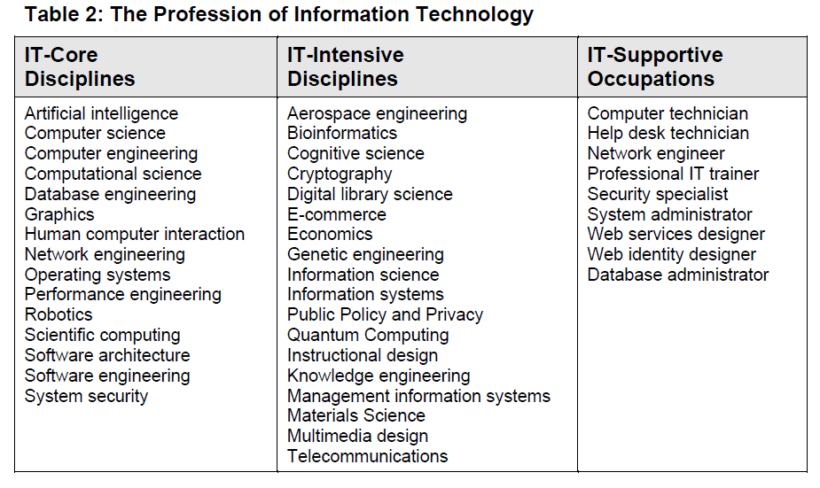
ACM “IT Profession” Initiative (1998)
Core: Major technical areas of IT and spans the intellectual core of the field.
Intensive: Other well-established fields that are intensive users of IT, draw heavily on IT and often make novel contributions to computing.
Supportive: Areas of skill and practice necessary to support the IT infrastructures that everyone uses.
Notes:
Source: Peter Denning. “The Computing Field: Structure.” http://www.cs.gmu.edu/cne/pjd/PUBS/ENC/cs08.pdf, retrieved 2011-02-24. http://www.cs.gmu.edu/cne/pjd/PUBS/ENC/cs08.pdf

Slide 18
ACM “IT Profession” Initiative (1998)
Conclusions:
(1) The IT profession has broad scope, which includes subfields from science, engineering, and business;
(2) the players share a common base of science and technology but have distinctive professional practices;
(3) many players are willing to identify with the IT field but not with the computer science discipline;
(4) Strong leadership from the professional societies is needed to keep these players united under the common IT identity.
The ability of the IT field to resolve broad,
systemic problems such as software quality, basic research, and professional
lifelong education requires extensive cooperation among the players. Several
universities established IT departments and schools to address the needs of the
profession directly
Notes:
Source: Peter Denning. “The Computing Field: Structure.” http://www.cs.gmu.edu/cne/pjd/PUBS/ENC/cs08.pdf, retrieved 2011-02-24. http://www.cs.gmu.edu/cne/pjd/PUBS/ENC/cs08.pdf

Slide 19
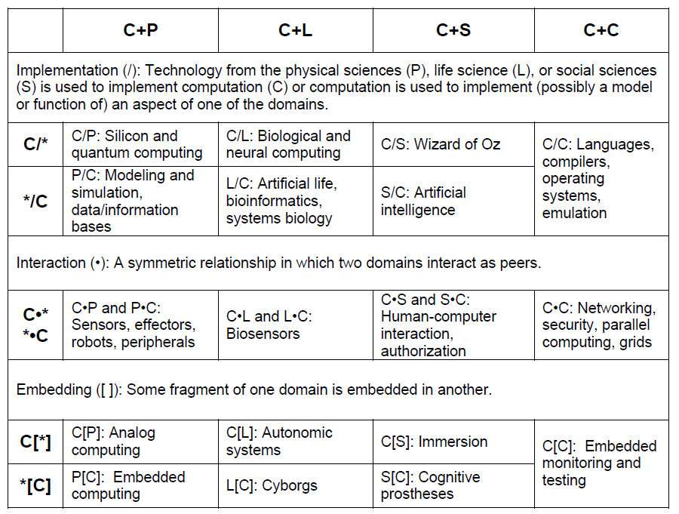
Interactions with Other Fields
Notes:
Source: Paul Rosenbloom, quoted in: Peter Denning. “The Computing Field: Structure.” http://www.cs.gmu.edu/cne/pjd/PUBS/ENC/cs08.pdf, retrieved 2011-02-24. http://www.cs.gmu.edu/cne/pjd/PUBS/ENC/cs08.pdf

