Slide 1
CSCE 390
Fall 2016
Four Cases by Robert N. Barger
Direct Link: http://www.cambridge.org/us/academic/subjects/computer-science/computing-and-society/computer-ethics-case-based-approach?format=PB&isbn=9780521709149 and click on “Resources”

Slide 2
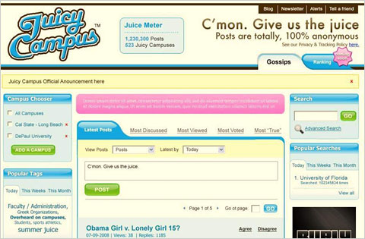
Juicy Campus
Case 5991
NYT: http://nyti.ms/1mtvT3Y
NYT: http://bits.blogs.nytimes.com/2009/02/05/juicycampus-collegiate-tabloid-goes-offline/?_r=0
Some relevant ACM code imperatives:
  1.7, 1.8, 2.5
Some relevant ACM/IEEE-CS code principles:
  1.03, 1.04, 2.07, 3.03, 3.12, 3.13 (data provenance)

Slide 3
TEXAS REGULATION OF COMPUTER REPAIR
Case 6152
A “publicity stunt?”
No NYT article found
https://consumerist.com/2008/07/09/texas-law-probably-does-not-require-pi-license-to-fix-spyware-infested-computers/ includes quotes from Texas representatives
“Sometimes you get a spouse coming in wanting to know what the other spouse is doing on the computer. And you have companies who might want to investigate because they’re worried someone within their organization is sending information to their competitors.”
Law vs. ethics
Some relevant ACM code imperatives: 1.7, 1.8, 2.3, 2.8
Some relevant ACM/IEEE-CS code principles: 2.5, 3.13, 6.06,

Slide 4
E-MAIL PRIVACY CASE
Case 6153
The general rule concerning use of e-mail in the workplace is that employees should have no expectation of privacy.
But, in this case…
The ACM and ACM/IEEE-CS codes may not to be relevant, since no professional expertise is needed to read emails in the context of the specific case. Still, see the second paragraph of the guidelines in ACM 1.7.
Questions:
  1. Was it ethical for Sidell’s employers to access his personal Yahoo! e-mail account without his permission while it was open on his desktop computer? Give reasons for your answer.
  2. Regardless of how you answered Question 1 above, do you think it was ethical for Sidell’s employers to consult Sidell’s e-mails to his attorneys in his personal Yahoo! Mail account regarding strategies in his arbitration claim against SSI? Give reasons for your answer.
Notes:
Read the NYT article! The case as written by Barger uses much of the same language. Barger’s questions are interesting.

Slide 5
THE “GREEN DAM - YOUTH ESCORT” CASE
Case 7494
NYT: http://nyti.ms/2eGarUT
Neither the ACM Code of Ethics and Professional Conduct nor the ACM/IEEE-CS Code on Software Engineering Ethics and Professional Practice include the work “censor” and related words.
There are side issues involving the quality of the software and its impact on computer performance.
Censorship is an ethical issue. Article 12 of the Universal Declaration of Human Rights states: “Everyone has the right to freedom of opinion and expression; this right includes freedom to hold opinions without interference and to seek, receive and impart information and ideas through any media and regardless of frontiers.”

