Slide 1
CSCE 390
Professional Issues in Computer Science and Engineering
Ch.6: The Ethical Decision-Making Process
Fall 2021
Marco Valtorta
mgv@cse.sc.edu
Notes:
The slides are based on Barger’s textbook [B] and other sources

Slide 2
Why a Process?
To document how you decided
To help obtain a better decision

Slide 3
Steps 1-3
Briefly describe the ethical issues in this case
Identify the stakeholders in this case and tell what you think each of them would like to see as an outcome
(A) Propose three possible solutions to the case (two extremes and a compromise). Mark them a), b), and c). (B) Give a best-case and worst-case outcome for each solution and, for each solution, indicate whether you could tolerate the worst-case outcome. (C) Which of the three solutions would you choose?

Slide 4
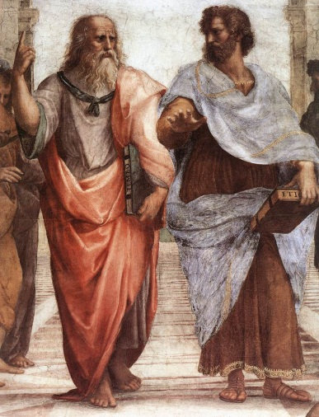
Steps 4-5
(A) Would you be willing for everyone to be permitted to use the solution you chose? Explain. (B) Does this solution treat people as ends rather than as means only? Explain.
(A) Is this solution in accord with what is natural (e.g., in accord with human nature, the environment, or the inherent purpose of anything else involved in the case)? Explain. (B) Is this solution balanced between an approach that might be excessive on one end and deficient on the other? Explain.

Slide 5
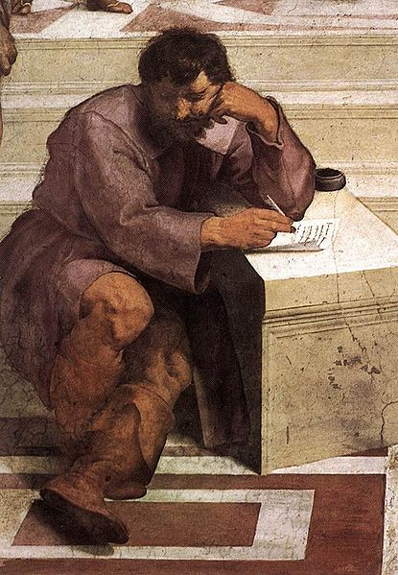
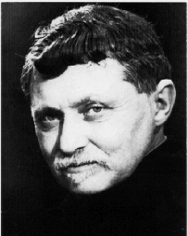
Steps 6-7
6. (A) Would there be majority agreement that this solution is the most efficient means to the end? Explain. (B) Will it produce the greatest good for the greatest number of people? Explain.
7. (A) Is this solution the one you feel most committed to in your conscience regardless or whether or not it benefits you personally? Explain. (B) Do you choose this solution in an autonomous manner, free from the influence of others? Explain.

Slide 6
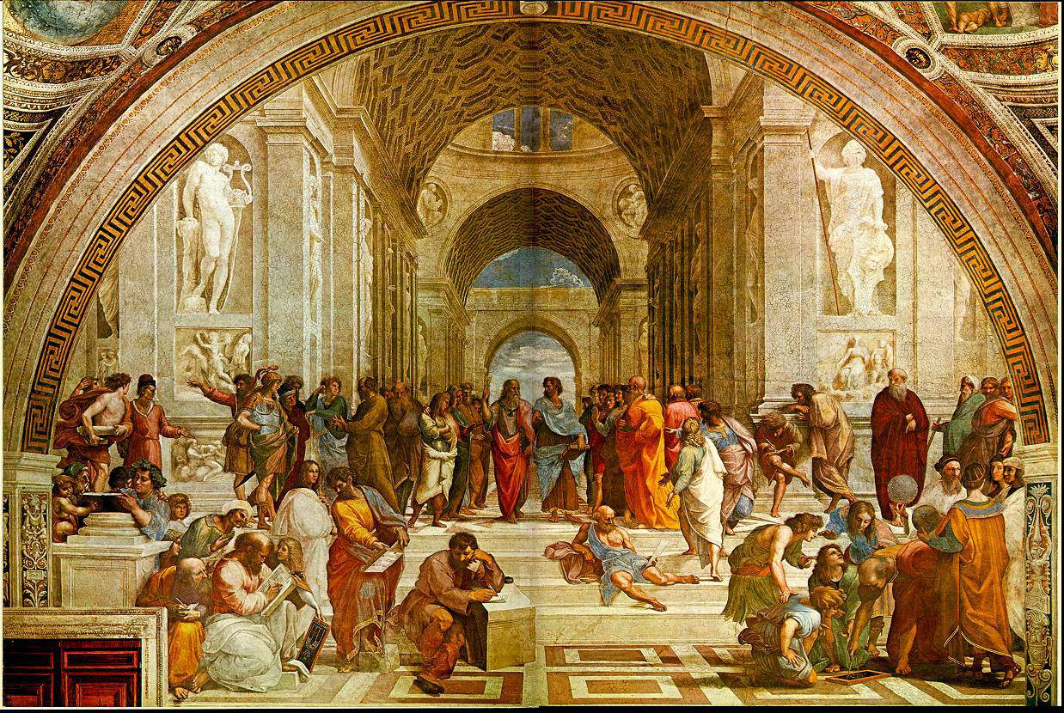
Step 8
Which philosophical belief system do you feel was most influential in your solution to this case? Why?

Slide 7
The Culture Clash on the Net Case
http://home.utah.edu/~nahaj/ethics/culture.clash.html, accessed 2014-10-02, written 1996, updated 2000
Local copy: https://cse.sc.edu/~mgv/csce390f20/cultureClashOnNet_NoTypos.pdf
Notes:
https://cse.sc.edu/~mgv/csce390f20/cultureClashOnNet_NoTypos.pdf

Slide 8
IRAC
A methodology for legal analysis
Issue
Rule
Application
Conclusion
Notes:
Source: (after mention by Prof. Kuo) Wikipedia

Slide 9
A Framework for Ethical Decision Making in Journalism
Start with an open mind
Get all the facts you can
Listen to what your gut is saying
Identify what duties are at stake
Find out what kind of conflict you’re facing
Brainstorm and analyze
Reach a conclusion---and try to reach consensus with co-workers too
Try to minimize whatever harm your decision might cause
Look toward the future
Notes:
Stephanie Craft and Charles N. Davis. _Principles of American Journalism: An Introduction_. Routledge, 2013.
This method is based on one proposed by Michael J. Meyer.

Slide 10
The Markkula Framework for Ethical Decision Making
Recognize an Ethical Issue
Could this decision or situation be damaging to someone or to some group? Does this decision involve a choice between a good and bad alternative, or perhaps between two "goods" or between two "bads"?
Is this issue about more than what is legal or what is most efficient? If so, how?
Notes:
Santa Clara University’s Markkula Center for Applied Ethics, https://www.scu.edu/ethics/ethics-resources/ethical-decision-making/a-framework-for-ethical-decision-making/, retrieved 2016-09-29. See https://cse.sc.edu/~mgv/csce390f20/MarkkulaFramework.pdf for a detailed description.

Slide 11
The Markkula Framework for Ethical Decision Making
Get the Facts
  What are the relevant facts of the case? What facts are not known? Can I learn more about the situation? Do I know enough to make a decision?
  What individuals and groups have an important stake in the outcome? Are some concerns more important? Why?
  What are the options for acting? Have all the relevant persons and groups been consulted? Have I identified creative options?
Notes:
Santa Clara University’s Markkula Center for Applied Ethics, https://www.scu.edu/ethics/ethics-resources/ethical-decision-making/a-framework-for-ethical-decision-making/, retrieved 2016-09-29. See https://cse.sc.edu/~mgv/csce390f20/MarkkulaFramework.pdf for a detailed description.

Slide 12
The Markkula Center Framework for Ethical Decision Making
Evaluate Alternative Actions
  Evaluate the options by asking the following questions:
  Which option will produce the most good and do the least harm? (The Utilitarian Approach)
  Which option best respects the rights of all who have a stake? (The Rights Approach)
  Which option treats people equally or proportionately? (The Justice Approach)
  Which option best serves the community as a whole, not just some members? (The Common Good Approach)
  Which option leads me to act as the sort of person I want to be? (The Virtue Approach)
Notes:
Santa Clara University’s Markkula Center for Applied Ethics, https://www.scu.edu/ethics/ethics-resources/ethical-decision-making/a-framework-for-ethical-decision-making/, retrieved 2016-09-29. See https://cse.sc.edu/~mgv/csce390f20/MarkkulaFramework.pdf for a detailed description.

Slide 13
The Markkula Center Framework for Ethical Decision Making
Act and Reflect on the Outcome
  How can my decision be implemented with the greatest care and attention to the concerns of all stakeholders?
  How did my decision turn out and what have I learned from this specific situation?
Notes:
Santa Clara University’s Markkula Center for Applied Ethics, https://www.scu.edu/ethics/ethics-resources/ethical-decision-making/a-framework-for-ethical-decision-making/, retrieved 2016-09-29. See https://cse.sc.edu/~mgv/csce390f20/MarkkulaFramework.pdf for a detailed description.

Slide 14
False Images in Broadcasts Case (1)
This case involves the use of digital alteration of news programs on network television. Here is a summary from [B], pp.78-79:
CBS Television wanted to cover the New Year’s celebration in Times Square on New Year’s Eve – December 31, 1999. There was only one problem. NBC happened to have a sign in Times Square that would have shown up in CBS’ coverage. CBS decided to solve the problem by superimposing a digitally created CBS logo over the NBC sign, thereby blocking it out.
Notes:
Summary from [B], pp.78-79.
Original source: Bill Carter. New York Times, 13 January 2000, Section C, p.1, col.5. Available to digital subscribers of The New York Times at https://www.nytimes.com/2000/01/13/business/cbs-is-divided-over-the-use-of-false-images-in-broadcasts.html?smid=url-share
and through the New York Times TimesMachine (p.43). Note the major advertisement bought by ABC News on p.51 (for ABC News Coverage of the new millennium celebrations).

Slide 15
False Images in Broadcasts Case (2)
CBS had used such electronic technology before, making it appear in their morning “Early Show” telecasts that CBS promotional signs existed at locations in downtown Manhattan when, in fact, they did not. The difference was that the superimposition of the CBS logo over the NBC sign was being done on a news program. Dan Rather, the CBS news anchor, was not in agreement with the use of the digital logo. He said, “There is no excuse for it. I did not grasp the possible ethical implications of this and that was wrong on my part. At the very least we should have pointed out to viewers that we were doing it.”
Notes:
Summary from [B], pp.78-79.
Original source: Bill Carter. New York Times, 13 January 2000, Section C, p.1, col.5. Available to digital subscribers of The New York Times at https://www.nytimes.com/2000/01/13/business/cbs-is-divided-over-the-use-of-false-images-in-broadcasts.html?smid=url-share
and through the New York Times TimesMachine (p.43). Note the major advertisement bought by ABC News on p.51 (for ABC News Coverage of the new millennium celebrations).

Slide 16
False Images in Broadcasts Case (3)
Andrew Heyward, President of CBS News, admitted that using the logo on the evening news was “a closer call” than using it during the Early Show to promote CBS, but said that he did not see the ethical problem that Rather did. He mentioned that Rather had not been part of the discussion about using this technique and said that “reasonable people could disagree on whether this was an appropriate use of digital technology.”
Notes:
Summary from [B], pp.78-79.
Original source: Bill Carter. New York Times, 13 January 2000, Section C, p.1, col.5. Available to digital subscribers of The New York Times at https://www.nytimes.com/2000/01/13/business/cbs-is-divided-over-the-use-of-false-images-in-broadcasts.html?smid=url-share
and through the New York Times TimesMachine (p.43). Note the major advertisement bought by ABC News on p.51 (for ABC News Coverage of the new millennium celebrations).

Slide 17
False Images in Broadcasts Case (4)
The President of CBS Television was more direct, saying: “Anytime there’s an NBC logo up on our network we’ll block it again.” ABC and NBC have not used this technology. A spokesman for ABC said: “It’s been discussed at length. We wouldn’t use it here.” The executive producer of NBC’s Today show said: “We were offered the same technology and we passed because we didn’t think it was appropriate.”
Notes:
Summary from [B], pp.78-79.
Original source: Bill Carter. New York Times, 13 January 2000, Section C, p.1, col.5. Available to digital subscribers of The New York Times at https://www.nytimes.com/2000/01/13/business/cbs-is-divided-over-the-use-of-false-images-in-broadcasts.html?smid=url-share
and through the New York Times TimesMachine (p.43). Note the major advertisement bought by ABC News on p.51 (for ABC News Coverage of the new millennium celebrations).

