Slide 1
CSCE 390 Professional Issues in Computer Science and Engineering Ch.3: Philosophic Belief Systems, part II: Pragmatism and Existentialism
Fall 2021
Marco Valtorta
mgv@cse.sc.edu
Notes:
The slides are based on [B], [B93], [M99], [M04], and other sources.

Slide 2
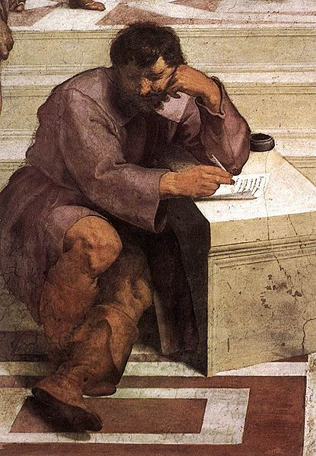
Pragmatist Metaphysics
Reality is not the (hidden) ideal; it is not physical matter; it is a process
Is chewing gum a food?
Heraclitus (ca. 535—475 BC): panta rei: everything flows
“You cannot step into the same river twice”
For the pragmatist, everything is essentially relative---the only constant is change; there are no absolutes
Pragmatism is also called consequentialism and utilitarianism, especially in its modern, Anglo-Saxon forms

Slide 3
Pragmatist Epistemology
Reason cannot be trusted
Senses cannot be trusted
Knowledge is achieved by open testing
Reality is the experience of the group
Truth is reached by consensus
Truth is not permanent: it may be revised
Truth is not absolute: it is true as long as it is useful

Slide 4
Pragmatist Ethics
The pragmatist turns “Is it good?”into “Is it good for what?”
A pragmatist may believe that killing is always bad, but only because that pragmatist believes that killing always leads to worse consequences than an alternative action, not because it is intrinsically wrong
The end justifies the means, or, positively,
A means is good if it achieves an end more efficiently
Evil is that which is counterproductive
A pragmatist attempts to achieve the greatest good for the most people

Slide 5
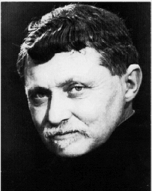
Existentialist Metaphysics
Reality is not fixed and static
Reality is not obtained by consensus
Reality must be achieved individually
Jean-Paul Sartre (1905-1980): the world is absurd (without meaning); what meaning there is only holds for the individual
Gabriel Marcel (1889-1973): the world is recognized by each individual in a unique way, by action of the will
Reality is different for each individual
Notes:
Jean-Paul Sartre speaks to students at the Sorbonne main lecture hall on 21 May 1968.

Slide 6
Existentialist Epistemology
The individual produces his or her own truth
There can be multiple, incompatible truths
Communication is very difficult; you cannot fully understand each other
Science is very difficult
We may agree on something being true, but we reach this consensus independently

Slide 7
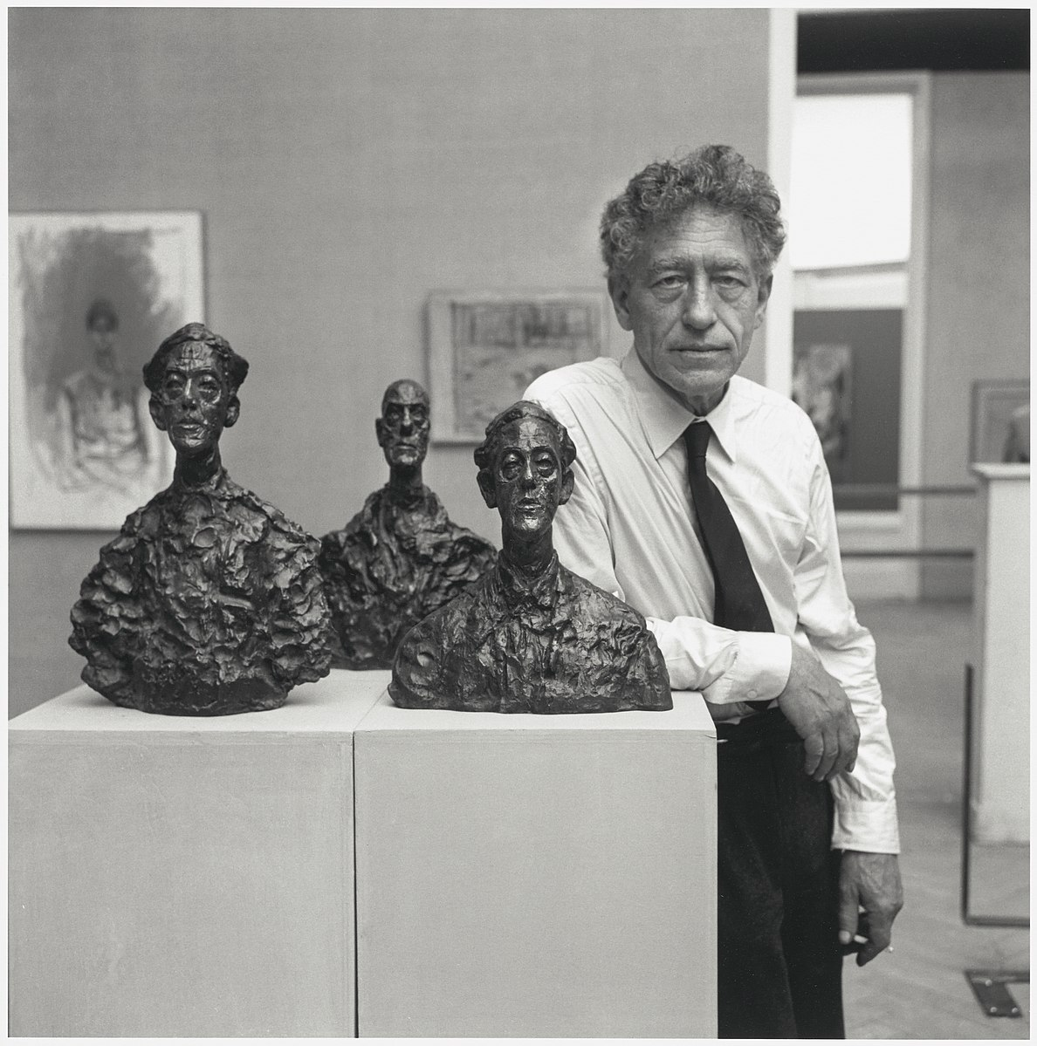
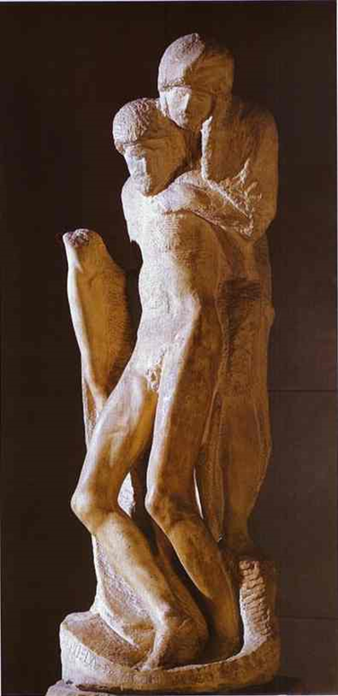
Existentialist Ethics
The individual must create his or her own value
One cannot escape the need to decide
The individual is fully responsible for his or her choices
Individual choice and responsibility are paramount
Existentialism is tough! The only guide to one’s actions is one’s conscience: no ideals as a guide, no nature to follow, no group consensus to accept
Swiss Sculptor
Alberto Giacometti (top);
Michelangelo’s “Pietà Rondanini”
(right)
Notes:
https://commons.wikimedia.org/wiki/File:2012-0035-Tribun20130130.jpg (Giacometti Photo)

Slide 8
Joseph Pieper (1904-1997)
Pieper (a religious idealist) contrasts idealism and realism with existentialism in the quoted passages below (ref. in pptx notes)
First and foremost, a presupposition must be clarified and then accepted, namely, the belief that a man “ought to.” In other words, not everything in his action and behavior is well and good just as it is. … “Fire does by necessity what is true and right according to its being, not so man, when he is doing the good.” This is a sentence from Anselm of Canterbury’s Dialogue on Truth. …
It is precisely this [belief]… that … existentialism resists …; this is … what Jean-Paul Sartre's famous sentence means: “There is no such thing as human nature!” …[To Sartre] it would be understandably meaningless to speak at all of an "ought to" and it would make no sense to give instructions or obligations, be it in the form of a teaching on virtue or otherwise.
Notes:
Originally published in "Die Aktualitat der Kardinaltugenden", BUCHSTABIER-UBUNGEN (Munich: Kosel-Verlag, 1980). Translated by Margareta Svjagintsev. Retrieved from http://www.pc.maricopa.edu/ss/phi101/supplementary/more/OUGHT_TO-PIEPER.htm on 2011-01-12.
Also see: http://bearspace.baylor.edu/Scott_Moore/www/Pieper_info.html

Slide 9
Moor’s Proposal [M99]
Based on
Bernard Gert’s “blindfold of justice”
John Rawls’ “veil of ignorance:” “Parties subject to the veil of ignorance will make choices based upon moral considerations, since they will not be able to make choices based on their own self- or class-interest.”
A unified ethics:
Pare down possible courses of action using universal imperatives
Choose among remaining courses of action using their usefulness
So: idealism plus pragmatism
Notes:
Quote from a wikepedia article: https://en.wikipedia.org/wiki/Veil_of_ignorance
James H. Moor. “Just Consequentialism and Computing.” Ethics and Information Technology, 1, 65-69, 1999 (referred to as [M99]).
James H. Moor. “Reason, Relativity, and Responsibility in Computer Ethics.” In: Terrell Ward Bynum and Simon Rogerson (eds.). Computer Ethics and Professional Responsibility. ISBN 1-85554-844-5. Blackwell Publishing, 2004 (referred to as [M04]).

