Slide 1
CSCE 390
Professional Issues in Computer Science and Engineering
Ch.7: Psychology and Computer Ethics
Fall 2020
Marco Valtorta
mgv@cse.sc.edu
Notes:
The slides are based on Barger’s textbook and other sources

Slide 2
Kohlberg’s Stages of Moral Development, Ch.7[B] Version
Level | Stage | Social Orientation
Pre-conventional | 1 | Obedience and Punishment
(child) | 2 | Individualism/Instrumentalism
Conventional | 3 | “Good boy/Good girl”
(adolescent) | 4 | Law and Order
Post-conventional | 5 | Social Contract
(adult) | 6 | Principled Conscience

Slide 3
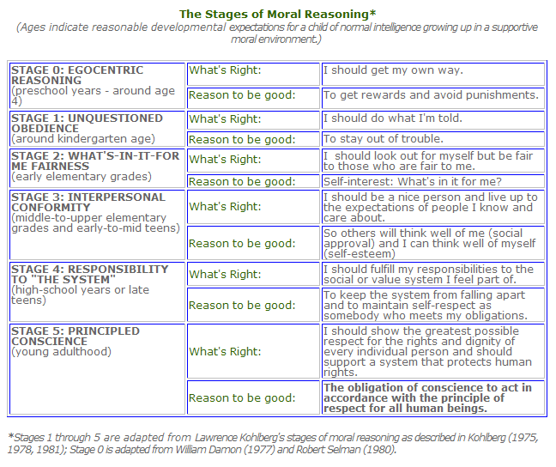
Kohlberg’s Stages of Moral Development
http://www.character-education.info/Articles/stages_of_moral_development.htm, accessed 2010-02-11
The stages
in this table
are different
from the ones
in the textbook.
Notes:
http://www.character-education.info/Articles/stages_of_moral_development.htm

Slide 4
An Ethical Dilemma Used by Kohlberg
Heinz Steals the Drug
In Europe, a woman was near death from a special kind of cancer. There was one drug that the doctors thought might save her. It was a form of radium that a druggist in the same town had recently discovered. The drug was expensive to make, but the druggist was charging ten times what the drug cost him to make. He paid $200 for the radium and charged $2,000 for a small dose of the drug. The sick woman's husband, Heinz, went to everyone he knew to borrow the money, but he could only get together about $ 1,000 which is half of what it cost. He told the druggist that his wife was dying and asked him to sell it cheaper or let him pay later. But the druggist said: “No, I discovered the drug and I'm going to make money from it.” So Heinz got desperate and broke into the man's store to steal the drug-for his wife. Should the husband have done that?
(Kohlberg, 1963, p. 19; quoted in: W.C. Crain. (1985). Theories of Development. Prentice-Hall. pp. 118-136.)
Notes:
https://www.cs.umb.edu/~hdeblois/285L/Kohlberg%27sMoralStages.htm
Kohlberg was interested in the reasons that children gave to their answers.
Kohlberg dissertation (U of Chicago) was in 1958.

Slide 5
Preconventional Morality (Level 1):
Obedience and Punishment (Stage 1)
Heinz was wrong to steal the drug because "It's against the law," or "It's bad to steal," as if this were all there were to it. When asked to elaborate, the child usually responds in terms of the consequences involved, explaining that stealing is bad "because you'll get punished" (Kohlberg, 1958b).
Although the vast majority of children at stage 1 oppose Heinz’s theft, it is still possible for a child to support the action and still employ stage 1 reasoning. For example, a child might say, "Heinz can steal it because he asked first and it's not like he stole something big; he won't get punished" (see Rest, 1973). Even though the child agrees with Heinz’s action, the reasoning is still stage 1; the concern is with what authorities permit and punish.
(W.C. Crain. (1985). Theories of Development. Prentice-Hall. pp. 118-136.)
Notes:
https://www.cs.umb.edu/~hdeblois/285L/Kohlberg%27sMoralStages.htm
Kohlberg was interested in the reasons that children gave to their answers.
Kohlberg dissertation (U of Chicago) was in 1958.

Slide 6
Preconventional Morality (Level 1):
Individualism and Exchange (Stage 2)
At this stage children recognize that there is not just one right view that is handed down by the authorities. Different individuals have different viewpoints. "Heinz," they might point out, "might think it's right to take the drug, the druggist would not." Since everything is relative, each person is free to pursue his or her individual interests.
fair exchange (deals): “If you scratch my back, I'll scratch yours.”
Respondents at stage 2 are still said to reason at the preconventional level because they speak as isolated individuals rather than as members of society. They see individuals exchanging favors, but there is still no identification with the values of the family or community.
(W.C. Crain. (1985). Theories of Development. Prentice-Hall. pp. 118-136.)
Notes:
https://www.cs.umb.edu/~hdeblois/285L/Kohlberg%27sMoralStages.htm
Kohlberg was interested in the reasons that children gave to their answers.
Kohlberg dissertation (U of Chicago) was in 1958.

Slide 7
Conventional Morality (Level 2):
Good Interpersonal Relationships (Stage 3)
Heinz was right to steal the drug because “He was a good man for wanting to save her,” and “His intentions were good, that of saving the life of someone he loves.” Even if Heinz doesn't love his wife, he should steal the drug because “I don't think any husband should sit back and watch his wife die.”
“It was really the druggist's fault, he was unfair, trying to overcharge and letting someone die. Heinz loved his wife and wanted to save her. I think anyone would. I don't think they would put him in jail. The judge would look at all sides, and see that the druggist was charging too much.”
This answer deserves the label “conventional morality” because it assumes that the attitude expressed would be shared by the entire community—”anyone” would be right to do what Heinz did
(W.C. Crain. (1985). Theories of Development. Prentice-Hall. pp. 118-136.)
Notes:
https://www.cs.umb.edu/~hdeblois/285L/Kohlberg%27sMoralStages.htm
Kohlberg was interested in the reasons that children gave to their answers.
Kohlberg dissertation (U of Chicago) was in 1958.

Slide 8
Conventional Morality (Level 2):
Maintaining the Social Order (Stage 4)
“I don't want to sound like Spiro Agnew, law and order and wave the flag, but if everybody did as he wanted to do, set up his own beliefs as to right and wrong, then I think you would have chaos. The only thing I think we have in civilization nowadays is some sort of legal structure which people are sort of bound to follow.”
In stage 4, subjects make moral decisions from the perspective of society as a whole, they think from a full-fledged member-of-society perspective.
Stage 1 children say, “It's wrong to steal” and “It's against the law,” but they cannot elaborate any further, except to say that stealing can get a person jailed. Stage 4 respondents, in contrast, have a conception of the function of laws for society as a whole
(W.C. Crain. (1985). Theories of Development. Prentice-Hall. pp. 118-136.)
Notes:
https://www.cs.umb.edu/~hdeblois/285L/Kohlberg%27sMoralStages.htm
Kohlberg was interested in the reasons that children gave to their answers.
Kohlberg dissertation (U of Chicago) was in 1958.

Slide 9
Postconventional Morality (Level 3):
Social Contract and Individual Rights (Stage 5)
“It is the husband's duty to save his wife. The fact that her life is in danger transcends every other standard you might use to judge his action. Life is more important than property.”
“From a moral standpoint” Heinz should save the life of even a stranger, since to be consistent, the value of a life means any life. When asked if the judge should punish Heinz, the subject replied: “Usually the moral and legal standpoints coincide. Here they conflict. The judge should weight the moral standpoint more heavily but preserve the legal law in punishing Heinz lightly.”
“Morality” and “rights” take some priority over particular laws.
(W.C. Crain. (1985). Theories of Development. Prentice-Hall. pp. 118-136.)
Notes:
https://www.cs.umb.edu/~hdeblois/285L/Kohlberg%27sMoralStages.htm
Kohlberg was interested in the reasons that children gave to their answers.
Kohlberg dissertation (U of Chicago) was in 1958.

Slide 10
Postconventional Morality (Level 3):
Universal Principles (Stage 6)
In the Heinz dilemma, all parties--the druggist, Heinz, and his wife--take the roles of the others. (Recall Rawls’s “Veil of ignorance”)
If the druggist did this, even he would recognize that life must take priority over property; for he wouldn't want to risk finding himself in the wife's shoes with property valued over life. Thus, they would all agree that the wife must be saved--this would be the fair solution. Such a solution requires not only impartiality, but the principle that everyone is given full and equal respect. If the wife were considered of less value than the others, a just solution could not be reached.
At stage 6, a commitment to justice makes the rationale for civil disobedience stronger and broader. Martin Luther King, for example, argued that laws are only valid insofar as they are grounded in justice, and that a commitment to justice carries with it an obligation to disobey unjust laws. King also recognized, of course, the general need for laws and democratic processes (stages 4 and 5), and he was therefore willing to accept the penalties for his actions. Nevertheless, he believed that the higher principle of justice required civil disobedience
(W.C. Crain. (1985). Theories of Development. Prentice-Hall. pp. 118-136.)
Notes:
https://www.cs.umb.edu/~hdeblois/285L/Kohlberg%27sMoralStages.htm
Kohlberg was interested in the reasons that children gave to their answers.
Kohlberg dissertation (U of Chicago) was in 1958.

Slide 11
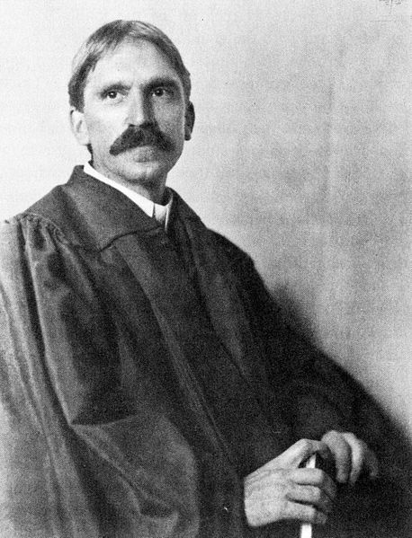
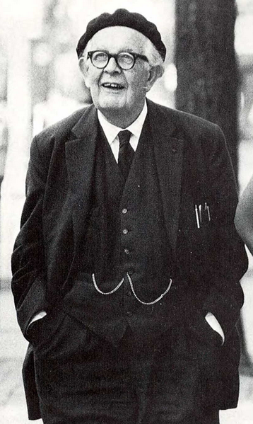
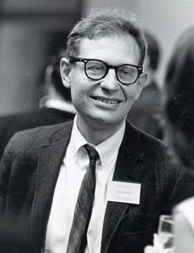
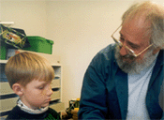
Cognitive Development and Ethics
John Dewey Jean Piaget Lawrence Kohlberg Seymour Papert
(1859-1952) (1896-1980) (1927-1987) (1928-2016 )

Slide 12
The Logo Programming Language
[Seymour] Papert [co-director of the MIT AI Lab with Marvin Minsky] was among the first to recognize the revolutionary potential of computers in education. In the late 1960s, at a time when computers still cost hundreds of thousands of dollars, Papert came up with the idea for Logo, the first programming language for children. Children used Logo to program the movements of a “turtle” — either in the form of a small mechanical robot or a graphic object on the computer screen. In his seminal book Mindstorms: Children, Computers and Powerful Ideas (1980), Papert argued against “the computer being used to program the child.” He presented an alternative approach in which “the child programs the computer and, in doing so, both acquires a sense of mastery over a piece of the most modern and powerful technology and establishes an intimate contact with some of the deepest ideas from science, from mathematics, and from the art of intellectual model building.” Quoted from: http://news.mit.edu/2016/seymour-papert-pioneer-of-constructionist-learning-dies-0801, accessed 2019-10-24.
Notes:
Papert was a student of Piaget, who said that "no one understands my ideas as well as Papert“ (see https://en.wikipedia.org/wiki/Seymour_Papert, accessed 2019-10-24, for full reference.). A version of Logo called NetLogo, was used by Prof. Jose Vidal as a simulation language in Multiagent Systems Courses.

