Slide 1
CSCE 390
Professional Issues in Computer Science and Engineering
Ch.6: The Ethical Decision-Making Process
Fall 2020
Marco Valtorta
mgv@cse.sc.edu
Notes:
The slides are based on Barger’s textbook and other sources

Slide 2
Why a Process?
To document how you decided
To help obtain a better decision

Slide 3
Steps 1-3
Briefly describe the ethical issues in this case
Identify the stakeholders in this case and tell what you think each of them would like to see as an outcome
(A) Propose three possible solutions to the case (two extremes and a compromise). Mark them a), b), and c). (B) Give a best-case and worst-case outcome for each solution and, for each solution, indicate whether you could tolerate the worst-case outcome. (C) Which of the three solutions would you choose?

Slide 4
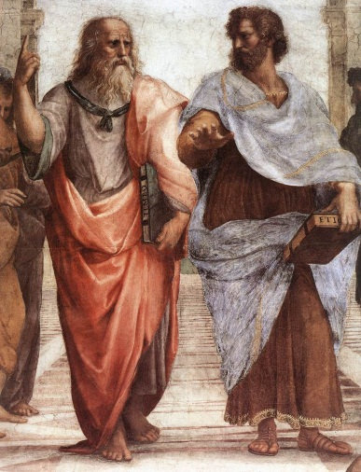
Steps 4-5
(A) Would you be willing for everyone to be permitted to use the solution you chose? Explain. (B) Does this solution treat people as ends rather than as means only? Explain.
(A) Is this solution in accord with what is natural (e.g., in accord with human nature, the environment, or the inherent purpose of anything else involved in the case)? Explain. (B) Is this solution balanced between an approach that might be excessive on one end and deficient on the other? Explain.

Slide 5
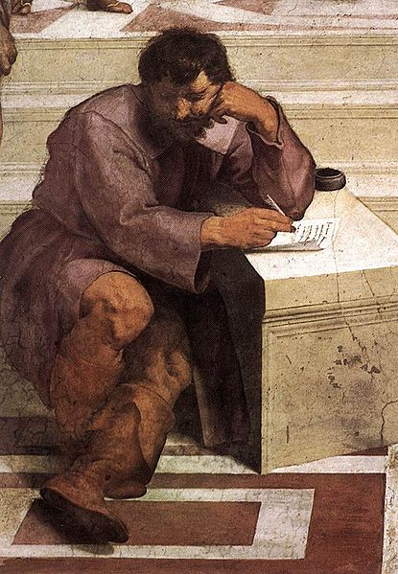
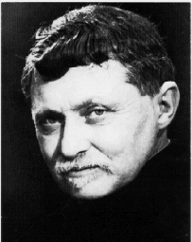
Steps 6-7
6. (A) Would there be majority agreement that this solution is the most efficient means to the end? Explain. (B) Will it produce the greatest good for the greatest number of people? Explain.
7. (A) Is this solution the one you feel most committed to in your conscience regardless or whether or not it benefits you personally? Explain. (B) Do you choose this solution in an autonomous manner, free from the influence of others? Explain.

Slide 6
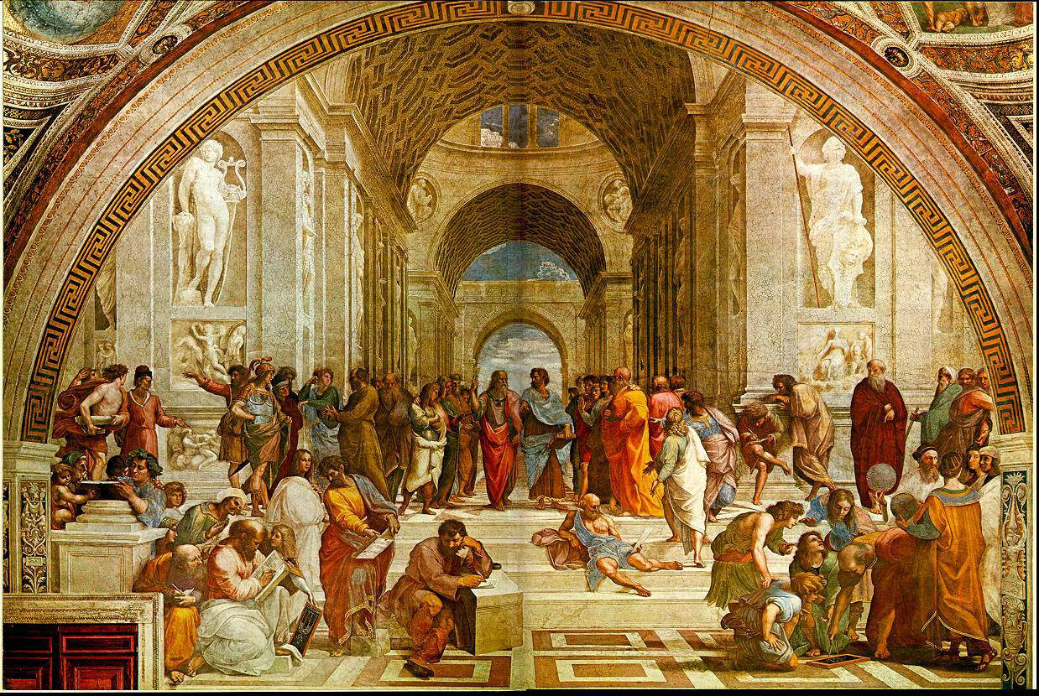
Step 8
Which philosophical belief system do you feel was most influential in your solution to this case? Why?

Slide 7
The Culture Clash on the Net Case
http://home.utah.edu/~nahaj/ethics/culture.clash.html, accessed 2014-10-02, written 1996, updated 2000
Local copy: https://cse.sc.edu/~mgv/csce390f20/cultureClashOnNet_NoTypos.pdf

Slide 8
IRAC
A methodology for legal analysis
Issue
Rule
Application
Conclusion
Notes:
Source: (after mention by Prof. Kuo) Wikipedia

Slide 9
A Framework for Ethical Decision Making in Journalism
Start with an open mind
Get all the facts you can
Listen to what your gut is saying
Identify what duties are at stake
Find out what kind of conflict you’re facing
Brainstorm and analyze
Reach a conclusion---and try to reach consensus with co-workers too
Try to minimize whatever harm your decision might cause
Look toward the future
Notes:
Stephanie Craft and Charles N. Davis. _Principles of American Journalism: An Introduction_. Routledge, 2013.
This method is based on one proposed by Michael J. Meyer.

Slide 10
A Framework for Ethical Decision Making
Recognize an Ethical Issue
  Could this decision or situation be damaging to someone or to some group? Does this decision involve a choice between a good and bad alternative, or perhaps between two "goods" or between two "bads"?
  Is this issue about more than what is legal or what is most efficient? If so, how?
Get the Facts
  What are the relevant facts of the case? What facts are not known? Can I learn more about the situation? Do I know enough to make a decision?
  What individuals and groups have an important stake in the outcome? Are some concerns more important? Why?
  What are the options for acting? Have all the relevant persons and groups been consulted? Have I identified creative options?
Evaluate Alternative Actions
  Evaluate the options by asking the following questions:
  Which option will produce the most good and do the least harm? (The Utilitarian Approach)
  Which option best respects the rights of all who have a stake? (The Rights Approach)
  Which option treats people equally or proportionately? (The Justice Approach)
  Which option best serves the community as a whole, not just some members? (The Common Good Approach)
  Which option leads me to act as the sort of person I want to be? (The Virtue Approach)
Make a Decision and Test It
  Considering all these approaches, which option best addresses the situation?
  If I told someone I respect-or told a television audience-which option I have chosen, what would they say?
Act and Reflect on the Outcome
  How can my decision be implemented with the greatest care and attention to the concerns of all stakeholders?
  How did my decision turn out and what have I learned from this specific situation?
Notes:
Santa Clara University’s Markkula Center for Applied Ethics, https://www.scu.edu/ethics/ethics-resources/ethical-decision-making/a-framework-for-ethical-decision-making/, retrieved 2016-09-29. See https://cse.sc.edu/~mgv/csce390f20/MarkkulaFramework.pdf for a detailed description.

