Slide 1
CSCE 390 Professional Issues in Computer Science and Engineering Ch.7: Psychology and Computer Ethics
Fall 2017
Marco Valtorta
mgv@cse.sc.edu
Notes:
The slides are based on Barger’s textbook and other sources

Slide 2
Kohlberg’s Stages of Moral Development, Ch.7[B] Version
Level | Stage | Social Orientation
Pre-conventional | 1 | Obedience and Punishment
(child) | 2 | Individualism/Instrumentalism
Conventional | 3 | “Good boy/Good girl”
(adolescent) | 4 | Law and Order
Post-conventional | 5 | Social Contract
(adult) | 6 | Principled Conscience

Slide 3
Kohlberg’s Stages of Moral Development
http://www.character-education.info/Articles/stages_of_moral_development.htm, accessed 2010-02-11
The stages
in this table
are different
from the ones
in the textbook.
Notes:
http://www.character-education.info/Articles/stages_of_moral_development.htm

Slide 4
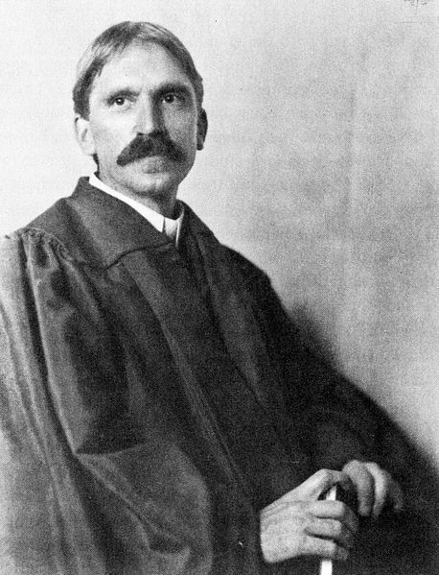
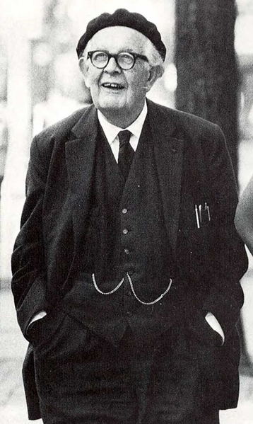
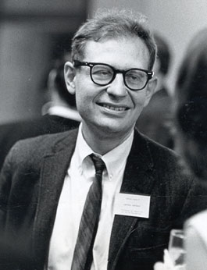
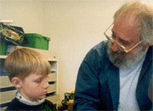
Cognitive Development and Ethics
John Dewey Jean Piaget Lawrence Kohlberg Seymour Papert
(1859-1952) (1896-1980) (1927-1987) (1928-2016 )

