Slide 1
CSCE 390
Professional Issues in Computer Science and Engineering
Ch.3: Philosophic Belief Systems, part II: Pragmatism and Existentialism
Fall 2016
Marco Valtorta
mgv@cse.sc.edu
Notes:
The slides are based on the textbook and other sources

Slide 2

Pragmatist Metaphysics
Reality is not the (hidden) ideal; it is not physical matter; it is a process
  Is chewing gum a food?
Heraclitus (ca. 535—475 BC): panta rei: everything flows
“You cannot step into the same river twice”
For the pragmatist, everything is essentially relative---the only constant is change; there are no absolutes
Pragmatism is also called consequentialism and utilitarianism, especially in its modern, Anglo-Saxon forms

Slide 3
Pragmatist Epistemology
Reason cannot be trusted
Senses cannot be trusted
Knowledge is achieved by open testing
  Reality is the experience of the group
Truth is reached by consensus
Truth is not permanent: it may be revised
Truth is not absolute: it is true as long as it is useful

Slide 4
Pragmatist Ethics
The pragmatist turns “Is it good?”into “Is it good for what?”
A pragmatist may believe that killing is always bad, but only because that pragmatist believe that killing always leads to worse consequences than an alternative action, not because it is intrinsically wrong
The end justifies the means, or, positively,
A means is good if it achieves an end more efficiently
Evil is that which is counterproductive
A pragmatist attempts to achieve the greatest good for the most people

Slide 5
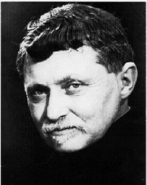
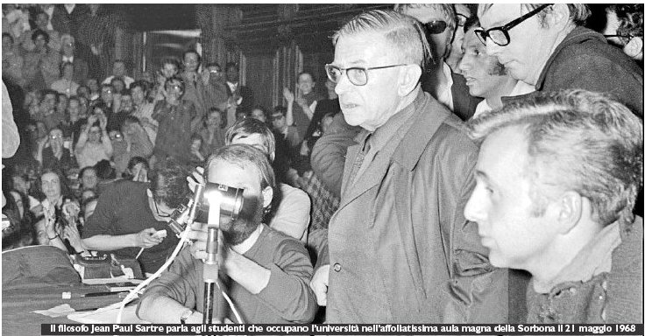
Existentialist Metaphysics
Reality is not fixed and static
Reality is not obtained by consensus
Reality must be achieved individually
Jean-Paul Sartre (1905-1980): the world is absurd (without meaning); what meaning there is only holds for the individual
Gabriel Marcel (1889-1973): the world is recognized by each individual in a unique way, by action of the will
Reality is different for each individual

Slide 6
Existentialist Epistemology
The individual produces his or her own truth
There can be multiple, incompatible truths
Communication is very difficult; you cannot fully understand each other
Science is very difficult
We may agree on something being true, but we reach this consensus independently

Slide 7
Existentialist Ethics
The individual must create his or her own value
One cannot escape the need to decide
The individual is fully responsible for his or her choices
Individual choice and responsibility are paramount
Existentialism is tough! The only guide to one’s actions is one’s conscience: no ideals as a guide, no nature to follow, no group consensus to accept

Slide 8
Joseph Pieper (German, 1904-1997)
Pieper (a religious idealist) contrasts idealism with existentialism.
First and foremost, a presupposition must be clarified and then accepted, namely, the belief that a man "ought to". In other words, not everything in his action and behavior is well and good just as it is. It makes no sense trying to convince a pig it ought to act and behave "like a real pig."
That the rude line by Gottfried Benn -- "The crown of creation: the pig man" -- can be spoken at all and, further, hold true in such terrible ways: this fact alone shows that humanity must still realize the truly human in the domain of lived realities; it means man, as long as he exists, "ought to."
Of course, one can formulate the concept somewhat less aggressively than Gottfried Benn. In this way, for example: "Fire does by necessity what is true and right according to its being, not so man, when he is doing the good.” This is a sentence from Anselm of Canterbury's DIALOGUE ON TRUTH. Two statements are there by made about man. Man, on the one hand, is free; and, on the other hand, meaning is given to him regardless of his opinion or his permission.
…
Notes:
Originally published in "Die Aktualitat der Kardinaltugenden", BUCHSTABIER-UBUNGEN (Munich: Kosel-Verlag, 1980). Translated by Margareta Svjagintsev. Retrieved from http://www.pc.maricopa.edu/ss/phi101/supplementary/more/OUGHT_TO-PIEPER.htm on 2011-01-12.
Also see: http://bearspace.baylor.edu/Scott_Moore/www/Pieper_info.html

Slide 9
Joseph Pieper (German, 1904-1997)
Pieper (a religious idealist) contrasts idealism with existentialism.
…
It is precisely this last fact that all existentialism resists and, as it reaches far beyond the domain of a special philosophical school, also determines the common attitude of the people of our time; this is exactly what Jean-Paul Sartre's famous sentence means: "There is no such thing as human nature!"
To one who does not acknowledge that the human being "is" homo sapiens in a totally different manner than water "is" water; that, to the contrary, the human being ought to become what he is (and therefore not already, eo ipso "is"); that one can speak of all other earthly creatures in the indicative, in simple statements, but of man, if one wants to express his actual reality, one can only speak in the imperative -- to him who cannot see this or does not want to admit to its truth it would be understandably meaningless to speak at all of an "ought to" and it would make no sense to give instructions or obligations, be it in the form of a teaching on virtue or otherwise.
Notes:
Originally published in "Die Aktualitat der Kardinaltugenden", BUCHSTABIER-UBUNGEN (Munich: Kosel-Verlag, 1980). Translated by Margareta Svjagintsev. Retrieved from http://www.pc.maricopa.edu/ss/phi101/supplementary/more/OUGHT_TO-PIEPER.htm on 2011-01-12.
Also see: http://bearspace.baylor.edu/Scott_Moore/www/Pieper_info.html

Slide 10
Moor’s Proposal (ch. 5)
A unified ethics:
  Pare down possible courses of action using universal imperatives
  Choose among remaining courses of action using their usefulness
  So: idealism plus pragmatism

