Slide 1
StripeSpotter Application to Track Zebras
Matthew Zimmermann
CSCE 390
04/21/2011

Slide 2
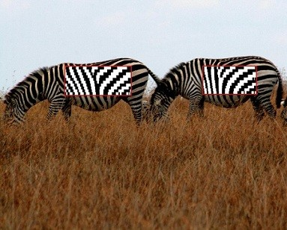
StripeSpotter turns wild zebras into tackable barcodes from Engadget by Christopher Trout
Less invasive way to track individual animals
Use stripes as barcodes
Takes isolated portion of zebra photograph and slices into series of horizontal bands
Each pixel then converted to black and white
Encoded into StripeStrings
Information stored in database to directly identify animals
http://www.engadget.com/2011/04/11/stripespotter-turns-wild-zebras-into-trackable-barcodes/

Slide 3
Ethical Decision-Making Process
1) Problem – To identify and track animals to observe patterns
2) Interested parties – the animals, the researchers, the developers of the application
3) Solutions
Use of tracking devices attached to animals
Use of photographic scanning to track
Direct observation of animals
4) Acceptance of using photographic scanning to track animals would be acceptable for all parties involved

Slide 4
Ethical Decision-Making Process
5) Compromises with helping both researchers and animals
6) Helps researchers track and allows animals to live freely
7) Believed to be most fair option because hinders the least amount of people
8) Idealistically this is most beneficial for the animals and does not hurt researchers’ ability to track animals

Slide 5
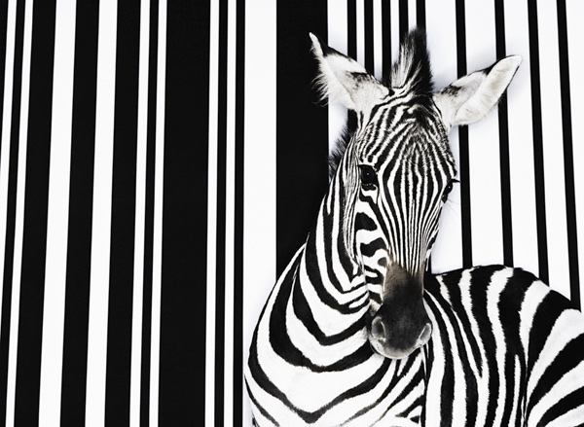
Code Application
Barcode application offers significant advantages
Less invasive for tracking zebras than physical tracking devices
Removes cost of physical devices
Researchers’ ability to track and observe animals not hindered
Outcome is best possibility for the public, environment, and animals
http://www.newscientist.com/blogs/onepercent/2011/04/barcode-scanner-for-zebras.html

