Slide 1
APL
Tanner Smith Alexa Breeland Tyler Sims

Slide 2
Overview
Functional Language
Named after the book A Programming Language
Paradigms:
  Array, functional, structured, modular
Important influence on development of spreadsheets, and computer math packages, such as MATLAB
Still used today for certain applications, especially financial/mathematical applications
Chains of monadic or dyadic functions/operators acting on arrays.
Normally interpreted, not often compiled

Slide 3
History
Developed in 1960s by Kenneth E. Iverson
He developed a mathematical notation for manipulating arrays that he taught to his students while working at Harvard
Iverson then worked at IBM in 1960 and created APL with Adin Falkoff.
Originally used inside IBM for short research reports on computer systems and comparing stack machines versus register machines

Slide 4
History
The development of a special IBM typewriter interchangeable typeball with special APL characters on it helped the development of APL by making it easier to use
IBM was responsible for making APL mainstream by making it available in 1967 for the IBM 1130. It ran in as little as 8k 16 bit words of memory and used a dedicated 1 megabyte hard disk.
In the early 1980s, Jim Brown developed a new version of APL, named APL2, which had the addition of nested arrays
The first microcomputer implementation of APL was in 1973 on the MCMC/70, the first general purpose personal computer.

Slide 5
Design
APL has many nonstandard primitives (single symbol, or combination of a few symbols)
Early APL did not have control structures, but by using array operations, an operation could be carried out on all of elements of an array
More recent implementations include control structures, making data structure and program flow easier
APL environment is called a workspace
  Inside the workplace, defined programs and data values can also exist outside the programs, making it easier to manipulate data

Slide 6
Design
V <- 6 3 4 9 5
  Assigns vector value 6 3 4 9 5 to V
+/V
  Sums all of the values in the vector, giving you 34
Most people who code in APL have to get a special keyboard. It can be done in ASCII characters, but almost never is.
APL is very simple, for example typing ‘Hello, world’ is all you need for the typical Hello World program

Slide 7
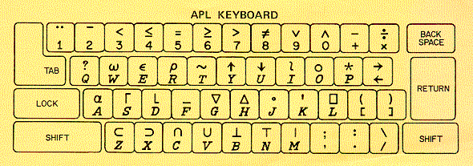
Design

Slide 8
Design
Design theme in APL is to define default actions, the reason our ‘Hello, world’ string displays is because display is APL’s default action when no action is explicitly defined.
A lot of statements in APL work which would generally give a Syntax error in another language.
  For example, 2⋆2 gives you 2^2. However, if you simply do ⋆2, APL assumes the base is e, and gives you the result of e^2
  This is also related to APL’s theme of default actions

Slide 9
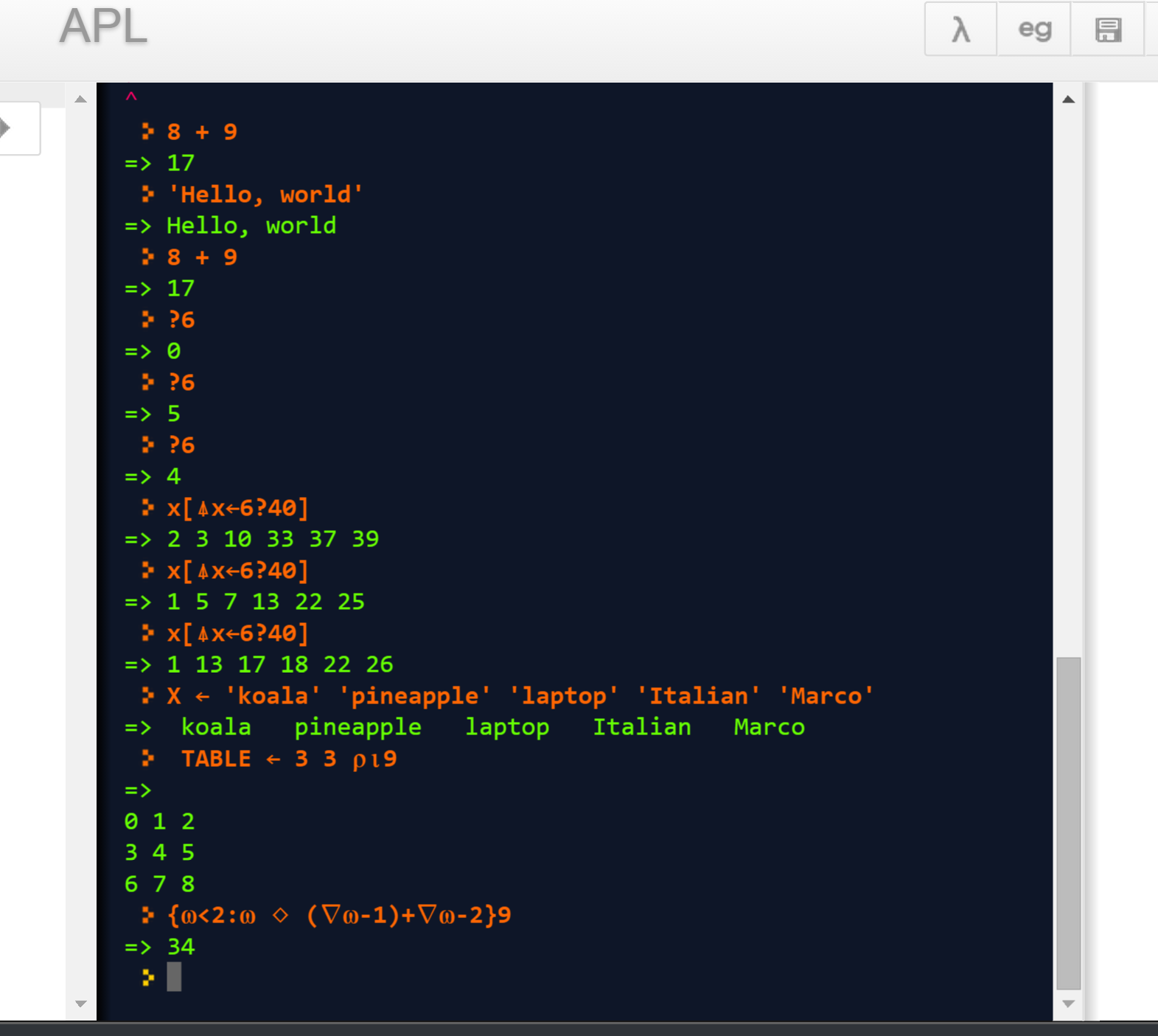
Examples

Slide 10
Example
∇R←A CLASSIFY B
[1] :If B=0
[2] :AndIf A=0
[3] R←'Both arguments are zero'
[4] :ElseIf B=0
[5] :OrIf A=0
[6] R←'One argument is zero'
[7] :Else
[8] R←'Neither argument is zero'
[9] :End
∇

Slide 11
Comparison
Since APL is very concise, it is common for APL programs to have a much smaller number of lines compared to the same programs in other languages.
  Since APL is a symbolic language, many of these symbols can replace lines of code
  Conway’s game of life, for example, can be executed in a single line of code
Another huge difference between APL and other languages is the fact that APL is read from right to left
APL is similar to J, which was also created by Kenneth Iverson and others
  J was created to not require the special characters that APL required, making it more popular and easier to use

