Slide 1
Ruby
Tien Ho and Brandon Hostetter

Slide 2
Overview
Object-oriented, functional, imperative, and reflective
Interpreted language
Influenced by Perl, Smalltalk, Eiffel, Ada, and Lisp
Used mostly for web development (Ruby on Rails)
“I hope to see Ruby help every programmer in the world to be productive, and to enjoy programming, and to be happy.”
~ Yukihiro “Matz” Matsumoto

Slide 3
History
Developed by Yukihiro Matsumoto in Japan during the mid-1990s
Ruby 0.95 (1995): included garbage collection, inheritance, iterators, object-oriented design, closures, exception handlings, and mixins.
Ruby 1.3 (1999): made its way to English speaking countries
Ruby on Rails (2005): ignited Ruby’s popularity
Ruby 2.1.2 (2014): most current stable version

Slide 4
History
Currently 9th in the TIOBE Index
Syntactically simple like Lisp
Influenced by the object system in Smalltalk
Follows Perl’s principle of there is more than one way to do it (TIMTOWTDI).

Slide 5
Language Concepts
Everything is an object (even classes and integers).
Everything is true except false and nil.
Classes are open.
Blocks are used as in higher-order functions.
Can be passed as an argument to a method
Single inheritance only
Modules
Mixins ~ multiple inheritance

Slide 6
Language Concepts
Use sigils to denote variable scope
var - Local variable
@var - Instance variable
@@var - Class variable
$var - Global variable
Dynamic Type Checking
Type checking is performed at run-time instead of compile-time

Slide 7
Language Concepts
Metaclasses
Class is an instance of a class.
Duck typing
Concerned with how an object behaves as opposed to the type of an object
Reflection
Ability to observe and modify code at run-time
Garbage collection

Slide 8
Example - Objects
Notes:
http://www.tutorialspoint.com/ruby/ruby_blocks.htm
http://www.tutorialspoint.com/ruby/ruby_classes.htm
http://www.tutorialspoint.com/ruby/ruby_modules.htm

Slide 9
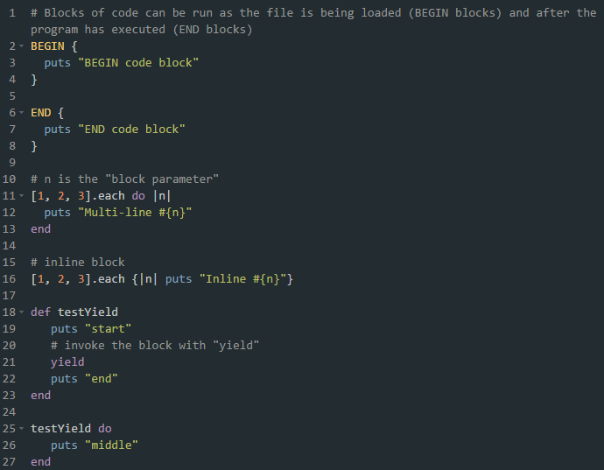
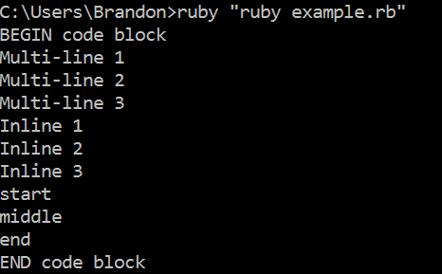
Example - Blocks
Notes:
http://www.tutorialspoint.com/ruby/ruby_blocks.htm
http://www.tutorialspoint.com/ruby/ruby_classes.htm
http://www.tutorialspoint.com/ruby/ruby_modules.htm
class Sample
def hello
puts "Hello Ruby!"
end
end
# Now using above class to create objects
object = Sample. new
object.hello
# Blocks of code can be run as the file is being loaded (BEGIN blocks) and after the program has executed (END blocks)
BEGIN {
# BEGIN block code
puts "BEGIN code block"
}
END {
# END block code
puts "END code block"
}
module A
def a1
puts "a1"
end
def a2
puts "a2"
end
end
module B
def b1
puts "b1"
end
def b2
puts "b2"
end
end
class Sample
include A
include B
def s1
puts "s1"
end
end
samp=Sample.new
samp.a1
samp.a2
samp.b1
samp.b2
samp.s1

Slide 10
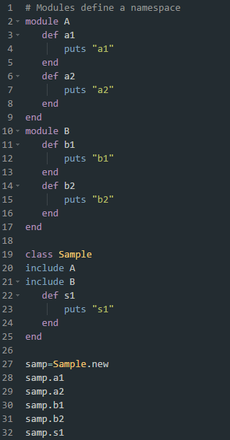
Example - Modules & Mixins
Notes:
http://www.tutorialspoint.com/ruby/ruby_blocks.htm
http://www.tutorialspoint.com/ruby/ruby_classes.htm
http://www.tutorialspoint.com/ruby/ruby_modules.htm
class Sample
def hello
puts "Hello Ruby!"
end
end
# Now using above class to create objects
object = Sample. new
object.hello
# Blocks of code can be run as the file is being loaded (BEGIN blocks) and after the program has executed (END blocks)
BEGIN {
# BEGIN block code
puts "BEGIN code block"
}
END {
# END block code
puts "END code block"
}
module A
def a1
puts "a1"
end
def a2
puts "a2"
end
end
module B
def b1
puts "b1"
end
def b2
puts "b2"
end
end
class Sample
include A
include B
def s1
puts "s1"
end
end
samp=Sample.new
samp.a1
samp.a2
samp.b1
samp.b2
samp.s1

Slide 11
Comparison
 | Perl | Ruby | Java
Object Oriented | primitive types are not objects | everything is represented as an object | primitive types are not objects
Garbage Collection | yes | yes | yes
Data-typing | dynamic | duck | strong
Interpreted / Compiled | interpreted | interpreted | compiled
Notes:
https://www.ruby-lang.org/en/documentation/ruby-from-other-languages/

Slide 12
References
Cooper, Peter. "The Ruby Ecosystem." Beginning Ruby: From Novice to Professional. 2nd ed. New York: Apress, 2009. 101. Print.
Halmagean, Cezar. "Mastering Ruby Blocks In Less Than 5 Minutes." Mix & Go: Ideas Brought to Life. 20 Jan. 2015. Web. 21 Nov. 2015.
"Ruby Modules and Mixins." Tutorials Point. Web. 22 Nov. 2015.
"The History of Ruby." Gunner Technology. Gunner Technology, 29 Nov. 2011. Web. 21 Nov. 2015.
"TIOBE Index for November 2015." TIOBE Software: The Software Quality Company. TIOBE Software BV, 1 Nov. 2015. Web. 21 Nov. 2015.
Notes:
http://www.gunnertech.com/2011/11/the-history-of-ruby/
http://www.tiobe.com/index.php/content/paperinfo/tpci/index.html
https://books.google.com/books?id=VCQGjDhhbn8C&pg=PA101&lpg=PA101&dq=ruby+influences&source=bl&ots=u8pCV8ydmc&sig=JzritLI79ESh_sm60fxgeHjTsao&hl=en&sa=X&ved=0ahUKEwiOk9mXvqLJAhWM5SYKHW3vCMgQ6AEIWTAE#v=onepage&q=ruby%20influences&f=false
http://mixandgo.com/blog/mastering-ruby-blocks-in-less-than-5-minutes

