Slide 1
GIMMEH LOLCODE
Bryan J. Haines
Courtney Trocke
Juan Villa
References:
http://lolcode.org/
http://atl.me/2007/lolcode
https://esolangs.org/wiki/LOLCODE
http://progopedia.com/language/lolcode/
https://code.google.com/p/lolcode-dot-net/
http://www.zoominfo.com/p/Adam-Lindsay/1272505587
http://www.slideshare.net/Tetraboy/the-best-web-language-lolcode
http://www.istartedsomething.com/20070809/teched-day-2-lolcode/
http://www.dalkescientific.com/writings/diary/archive/2007/06/01/lolpython.html

Slide 2
Overview
Esoteric
Procedural
In context of problem domains
Notes:
LOLCODE is an esoteric programming language. This means that it is a language that was designed for the purpose of testing the boundaries of programming, and intended for the use of those with more specialized knowledge as opposed to widespread dissemination.
LOLCODE is a procedural, or imperative, language; just like Fortran, COBOL, and C. Procedural languages use a list of instructions to tell the computer what to do, as opposed to object-oriented programming which rely on objects to solve problems.
LOLCODE is a fully functional programming language that can be used to solve any computing problem solvable by any other procedural language.

Slide 3
History
Five W’s
Parent language
Evolution
Notes:
Developed in 2007 by Adam Lindsay, a researcher at the Computing Department of Lancaster University in the United Kingdom. LOLCODE was inspired by lolspeak, or internet slang, which is characterized by atrocious grammar and skewed syntax. This language is based on the C programming language. LOLCODE is not centrally controlled, therefore many offshoots of the original code have been developed with at least some of them meeting the standard of being Turing-complete. This means that, at least for an imperative language, it has conditional branching and the ability to change an arbitrary amount of memory locations.

Slide 4

History
Notes:
This is an example of the type of lolcat meme, utilizing lolspeak, that inspired the development of LOLCODE.

Slide 5
Language Concepts
New concepts
Interesting concepts
Structure
Procedures
Notes:
LOLCODE, like all esoteric languages, is largely based on the concept of obfuscation. In the context of these types of languages, this means that the average programmer will not be able to interpret the code to predict the outcome of an algorithm. LOLCODE is not as obfuscated as most esoteric languages, but it’s syntax, grammar, and spelling can make it hard to interpret the code by sheer cringe factor. One interesting concept incorporated into this language is the use of internet slang to write the actual programming code. This modern cultural approach to a programming language is probably more interesting from a sociological context than a computer science context, but it is interesting, never the less. Keywords in LOLCODE are drawn from internet slang, but function exactly like the more normal syntax of any language that you may be familiar with.
In the subject of actual code execution, as has already been stated, LOLCODE is a procedural language that uses a list of instructions to solve computational problems.

Slide 6
Language Concepts
Formatting
  Whitespace
  BTW, OBTW, TLDR
  HAI 1.3, KTHXBYE
Variables
  Scope
  Naming
  I HAS A, ITZ
Notes:
Formatting:
Spaces are used in LOLCODE to mark tokens. Some keywords do contain spaces, but the interpreter understands the difference. The number of spaces or tabs is not relevant to the interpreter, so indentation is meaningless for the proper execution of the code, though it may aid in readability. Commands generally start at the beginning of a line and end at the newline character, there are of course exceptions to this, as well. Commas can be used to put multiple commands on a single line and ellipsis can be used to continue a command to a subsequent line.
In order to comment a single line of code, you start the comment with “BTW”, which of course stands for “by the way”. Multi-line comments are begun with “OBTW”, for “oh, by the way”, and ended with “TLDR”, for “too long, didn’t read”.
As far as file creation goes, you only need to know two things. All LOLCODE programs must start with “HAI”, followed by the current language version. A file must end with “KTHXBYE”, for “okay, thanks, bye” to close the code block.
Variables:
The scope of a variable in LOLCODE is limited to the block that it is written in. There is no global scope for variables.
Variable names must start with a letter and must contain only letters, numbers, and underscores. These variable names are case sensitive.
To declare a variable you must use the “I HAS A” keyword. To assign a value to the variable, you must use the keyword “ITZ” followed by the value.

Slide 7
Language Concepts
Types
  NOOB
  TROOF
  NUMBR, NUMBER
  YARN
  Array
Notes:
Untyped variables are declared as type “NOOB”, for “new, inexperienced person”. These types can only be cast to Boolean false value or empty / zero values for any other type
Boolean variables are declared as type “TROOF”, for “truth”. The two values for this type are “WIN” for true, and “FAIL” for false.
Numerical types are declared as “NUMBR” for integers, or “NUMBER” for floats.
Strings are declared as type “YARN” and double quotes are used for their values.
Arrays are not yet centrally implemented and vary from version to version.

Slide 8
Language Concepts
Operators
  PRODUKT, QUOSHUNT, BIGGR, SMALLR
  WON OF
  BOTH SAEM, DIFFRNT
  SMOOSH, MKAY
  MAEK
Input / Output
  VISIBLE
  GIMMEH
Notes:
Operators:
Mathematical operators are given in the form “SUM OF <x> AN <y>”. The usual misspellings and grammar are used for operations such as “PRODUKT”, “QUOSHUNT”, “BIGGR”, and “SMALLR”.
Boolean operators are implemented in a similar fashion, using words such as “WON OF”.
Comparisons are performed using terms such as “BOTH SAEM”, and “DIFFRNT”.
Concatenation is accomplished using “SMOOSH … MKAY”
Casting is done using “MAEK”.
Input / Output:
The print operator is “VISIBLE”. Input from the user is accomplished using “GIMMEH”

Slide 9
Language Concepts
Flow Control
  Conditionals
    O RLY?, YA RLY, NO WAI, OIC
    WTF?, OMG, OMGWTF
  IM IN YR, IM OUTTA YR, GTFO
Functions
  HOW IZ I, IF U SAY SO
  FOUND YR
  I IZ, MKAY
Notes:
Flow Control:
The first conditional statement here is the if-then statement, the second one is the case statement
Next we see the loop control statement.
Functions:
The first bullet shows the keywords used for defining a function.
The second bullet shows the keywords for returning a value
The third bullet shows the keywords for calling a function

Slide 10
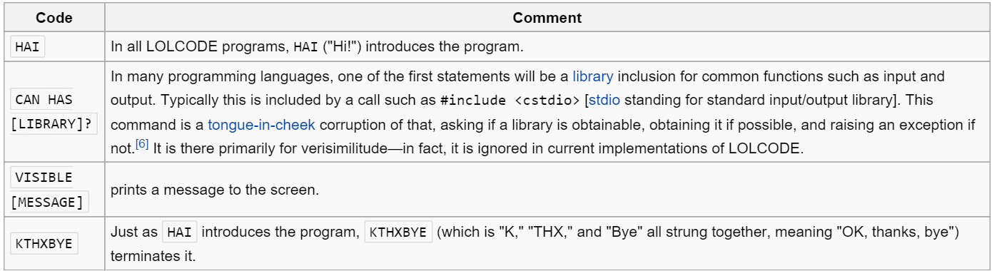
Language Concepts

Slide 11
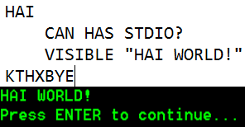
Hello World

Slide 12
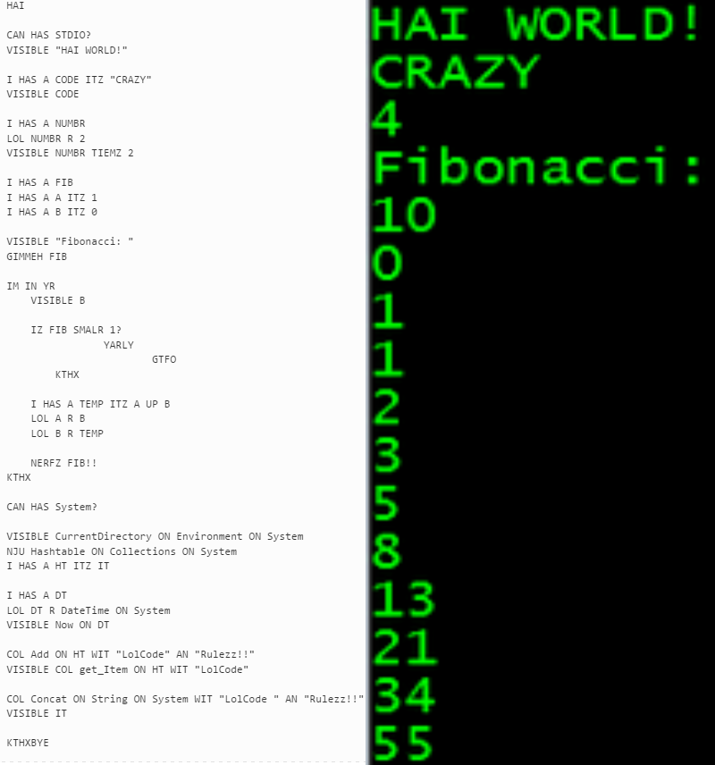
Fibonacci Sequence

Slide 13
Comparison
Imperative vs Declarative
Procedural vs Object-Oriented
Notes:
LOLCODE is an imperative language as opposed to a declarative language, such as SQL. This means that LOLCODE uses explicit steps to implement its’ algorithms, whereas SQL and similar languages express their logic without describing its flow of control.
LOLCODE is a procedural language as opposed to an object-oriented language such as Java. This means that LOLCODE uses a list of instructions to tell the computer what to do step-by-step, whereas Java uses instances of objects to carry out computations.
It should be noted that sometimes the terms “imperative” and “procedural” are used interchangeably, but we have explicitly defined these here as separate terms.

Slide 14
Questions?

