Slide 1
Pascal
CSCE 330 Fall 2015
Elizabeth Pruett, Eric Gonzalez and Nick Puig

Slide 2
Overview
Originally designed 1968-1969
Principle objectives:
Efficiency
Structure and organization
Educational
Imperative and procedural
Notes:
Efficiency in implementation, structure in programming, and a means of teaching important programming concepts to others.

Slide 3
History
Created by Professor Niklaus Wirth as an innovative new language (1971)
Named after mathematician Blaise Pascal
1970s to early 1990s as educational tool in colleges
Decreased in popularity with rise of OOP
Primary high-level language in development of Apple Lisa, still used for developing Windows applications
Notes:
Original published definition in ‘71, revised in ‘73

Slide 4
Evolution
ALGOL W/60
Pascal
Object, Turbo Pascal
Notes:
Pascal is directly descended from ALGOL 60, and draws upon ALGOL 68 and ALGOL-W
A derivative of Pascal, Object Pascal, was designed for object-oriented programming in 1985

Slide 5
History
The original popular Pascal compilers were Apple’s Lisa Pascal and a Pascal compiler for the IBM PC
IBM Pascal was acquired by Borland and renamed to Turbo Pascal
Turbo Pascal offered size and speed advantages over its competitors due to its highly optimized assembly code
ObjectPascal, an Object Oriented extension to Pascal was developed at Apple in collaboration with creator Niklaus Wirth
Notes:
Original published definition in ‘71, revised in ‘73

Slide 6
History
Borland discontinued Turbo Pascal with MS-DOS version 7
FreePascal was developed when Borland announced its discontinuation of Turbo Pascal
Object Pascal were the foundations for Borland Pascal’s successor Delphi
Today Pascal lives on in the Free Pascal Compiler and as the foundations for Delphi

Slide 7
History - Problem Domain
Pascal developed with the intention of being a small, efficient, compiled language
Over time Pascal became a staple in professional software development for multiple operating systems and architecture
Pascal is a great tool for those looking for a human readable, strongly typed, clean compiled language
Pascal does not have much of a niche in software development today because of relative lack of community support, libraries, and the language’s evolution into Delphi

Slide 8
Design
Built-in data types and user-defined data types
Defined data structures
Dynamic and recursive
Strong data typing
Records, enumerations, subranges, pointers, and sets
Notes:
Built-in data types: integer, real, character, boolean
Defined data structures: arrays, records, files, sets. Designed to be easy to build dynamic and recursive data structures like lists, trees, and graphs.
Strong data typing: one type of data cannot be interpreted as another without explicit conversions

Slide 9
Paradigms
Imperative : uses statements to change a program’s state
Procedural : functions contain a series of steps to be carried out

Slide 10
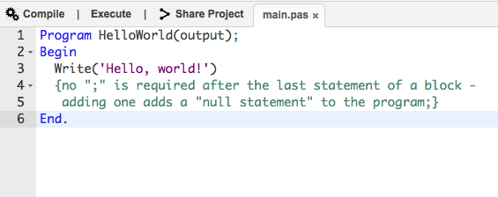
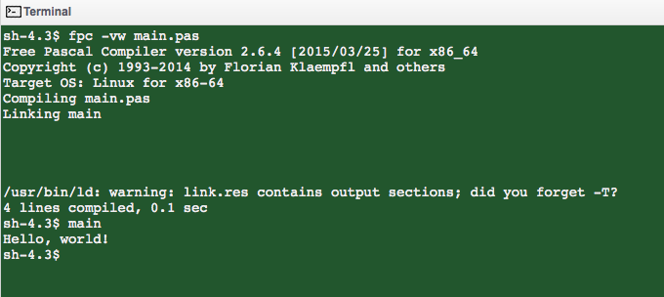
Examples

Slide 11
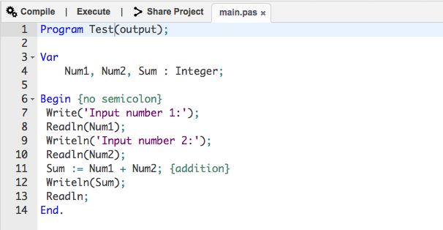
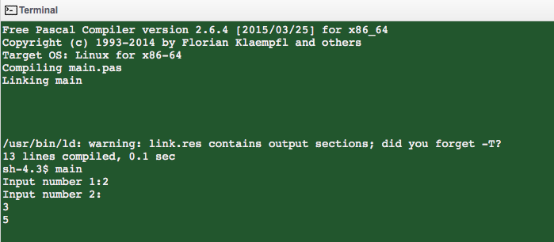
Examples

Slide 12
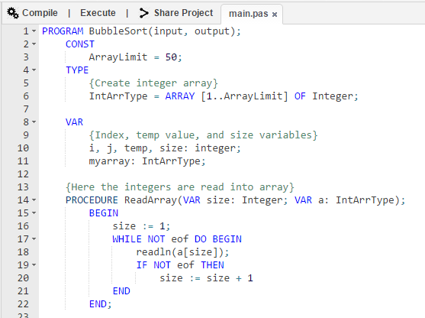
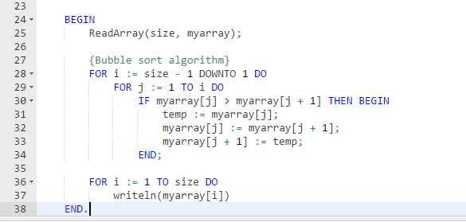
Examples - Bubble Sort

Slide 13
Comparisons
Allows nested procedure definitions to any depth level, and allows most kinds of definitions inside subroutines
Similar to Java, C, C++
Strongly typed
Similar to Java, C, C++
Frequently uses keywords rather than symbols
Ex. “and” rather than “&&”
Similar to Python

Slide 14
Comparisons
No static variables or initializations
Object Oriented support (later versions)
Similar to Java, C++, Python
Compiled
Similar to C, C++, Haskell, Fortran

Slide 15
References
“Pascal Programming,” Wikibooks, 2014. [Online]. Available at: https://en.wikibooks.org/wiki/pascal_programming. [Accessed: 2015].
S. Moore, “The ISO 7185 Standard Pascal Page,” Standard Pascal. [Online]. Available at: http://www.standardpascal.org/documents.html. [Accessed: 2015].
“The Pascal Language Page,” The Language Guide, 1996. [Online]. Available at: http://groups.engin.umd.umich.edu/cis/course.des/cis400/pascal/pascal.html. [Accessed: 2015].
V. Saliba, “Programming Tutorial ,” Pascal Programming, 2006. [Online]. Available at: http://pascal-programming.info/lesson1.php. [Accessed: 2015].

