Slide 1
Perl
Cory Redmond Zachary Trim Jeffery Dumas

Slide 2
Overview
Current Release: Perl 5.22.0, June 2015
  Perl 6 started out to replace Perl 5, but is now its own language
Multi-Paradigm
  functional
  object oriented
  imperative
Interpreted language
The "Duct Tape of the Internet"

Slide 3
History
Created by Larry Wall 1987
Needed a way to efficiently process reports
Wanted to fill the gap between using C or a shell script
Heavily influenced from C, AWK, sed, sh

Slide 4
Evolution of Perl
Perl 1 - Dec 18, 1987
Perl 2 - 1988
  Added support for binary streams
Perl 3 -1989
  Improved regular expression engine
Perl 4 - 1991
  From Man Page to The "Camel Book"
Perl 5 - Oct 17, 1994
  Almost complete rewrite of interpreter
  Comprehensive Perl Archive Network (CPAN)
    Over 150,000 modules
Perl 6 - 2000
  Still in development
  Not a successor to Perl 5

Slide 5
Language Concepts
Perl did not have object-oriented programming (OOP) until after Perl 4. Perl 5 introduced:
  objects, packages, modules, classes and methods into Perl.
  Perl 5 also introduced elements to support complex data structures.
All variables in Perl are marked with a leading sigil
  Unlike most other programming languages that use sigils Perl doesn’t use sigils to denote the type of the variable but instead the type of the expression.
All statements in Perl have a value, and thus are also expressions,
  These expressions can be used in large expressions.

Slide 6
Language Concepts
Perl has automatic data-typing and memory management
  Perl is able to do this because the interpreter already knows the type and storage requirements for each data type.
  This allows the interpreter to free storage as necessary, and type conversions are done in real time.
    If the type conversion is illegal it will cause a fatal error.
The features of Perl were created in an attempt to make computer programming quicker and easier
  But at a cost of greater CPU and memory requirements.

Slide 7
Language Concepts
Perl has many and varied applications, but most commonly used for Common Gateway Interfaces (CGI).
  Examples these types of websites are: Priceline.com, CraigsList, and TicketMaster.
Perl is also commonly used as a scripting language to help systems or interfaces work together even if they were not designed to interoperate.
  Other uses for Perl scripting is data munging (converting or processing large amounts of data).
There are no written specifications or standards for Perl in existence.
  The exception to this is Perl 6 which is working on making the specifications and standards.

Slide 8
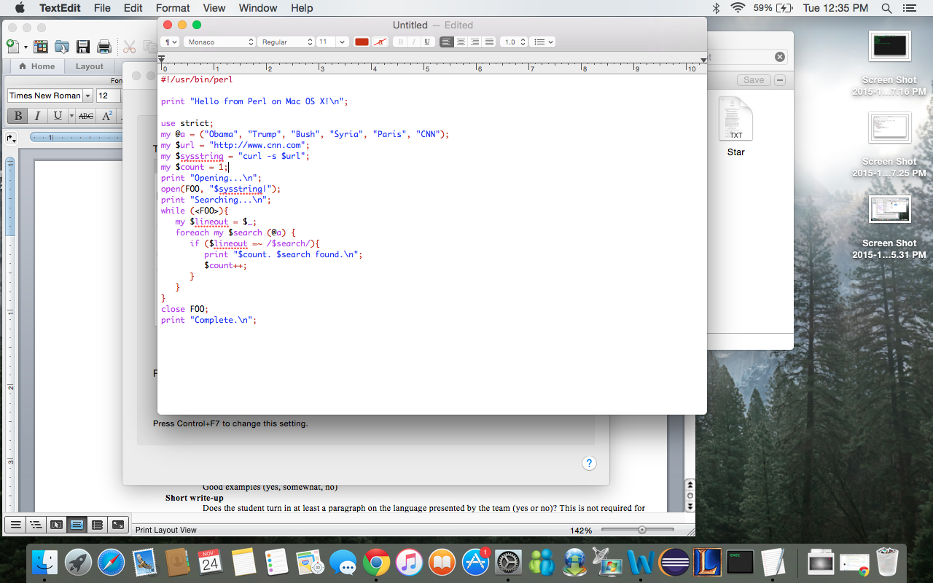
Example

Slide 9
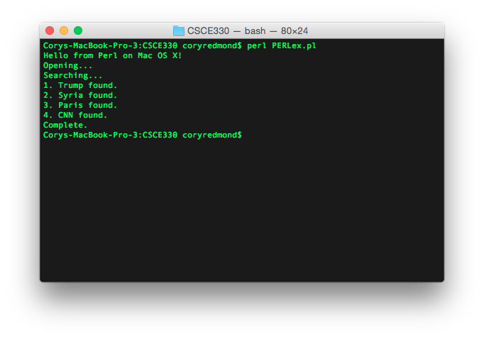
Example

Slide 10
Comparison
A big difference between PERL and other languages, is that PERL only has three main variable types. (Scalars, Arrays, Hashes)
  A scalar can be integers, strings, or floating point numbers. PERL will automatically convert between them.

Slide 11
Questions?

