Slide 1
Lua
References:
http://stackoverflow.com/questions/2100902/is-lua-interesting-from-a-programming-language-design-perspective
http://www.tutorialspoint.com/lua/lua_overview.htm
http://notebook.kulchenko.com/programming/lua-good-different-bad-and-ugly-parts
https://en.wikipedia.org/wiki/Lua_(programming_language)
http://www.lua.org/pil/16.2.html
http://stackoverflow.com/questions/5128375/what-are-lua-coroutines-even-for-why-doesnt-this-code-work-as-i-expect-it
https://en.wikipedia.org/wiki/Coroutine#Common_uses
www.lua.org
http://lua-users.org/wiki/LuaVersusPython
The A-Z of Programming Languages
Cody Scoggins,
Dion de Jong,
Victor Reynolds

Slide 2
Overview
Scripting language
Named after language it replaced (SOL, “Simple Object Language”)
Paradigms:
Scripting, imperative, functional
Used today in many applications (such as Adobe Lightroom)
Data description constructs based on associative arrays and extensible semantics
Dynamically typed, runs by interpreting bytecode for a register-based virtual machine
Automatic memory management with incremental garbage collection

Slide 3
History
Created by Prof. Ierusalimschy, Luiz Henrique de Figueiredo, and Waldemar Celes
Worked for Tecgraf, based in Brazil
Bottom-up creation style/method
Keep the language simple and small
Keep the implementation simple, small, fast, portable, and free
Designed by a committee of three people
Real users since day one

Slide 4
History (cont’d.)
DEL -> Sol -> Lua
Rather than adopt another language (Tcl), decision was made to create new language (Lua), a modification of Sol
Wanted a light, generic language
Since version one, improvements have been demanded from users, such as performance increases, newer functionality, etc.
Version 2 onwards, decision was made to always try to improve the language, even at the cost of minor compatibility issues with previous versions
Some functionality was more difficult to implement, so initially it was just postponed until later and worked around until a solution could later be determined (Ex. Lexical scoping, wanted since version 2.2, not actually implemented until version 5.0)

Slide 5
Design
Lua = Fast, Small, Portable, easy-to-use, embeddable, and extendable.
Extendable scripting language = unique b/c overall package = highly refined.
Other scripting languages wish “To claim to be "as fast as Lua.
Small = 1/8 the size of the Python, Source code = 23000 lines, interpreter = 180 kB.
Easy Integration → Interpreter = ANSI C →Run on everything
Embedding = easy w/ API→ b/c user-defined abstract types are kept.
“Multi-paradigm” = small set of general features = extended to fit problems → Avoid rules, allow freedom, adapt to problems.
Notes:
Technically well designed and executed. Lua is an extendable scripting language that is unique as a result of what the highly refined overall package provides, rather than what any of the individual features do.
Easy Integration → Interpreter = ANSI C → can run/compile on almost anything from microcontrollers to browsers to game engines to mobile toolkits.
Embeds and easily integrates with other code due to simple APIAllows user-defined abstract types to participate in the embedding easily.
“Multi-paradigm” = small set of general features that can be extended to fit different problems → Avoid rigid specifications in favor of creativity/freedom within programming → adaptable to the programmers problems.

Slide 6
Metatables:
No built in namespaces, classes, or inheritance.
Tables + first-class function = classes
Inheritance implemented with metatables.
How? Lua object generation = assign
characteristics & functions. Object =
assigned metatable (holds keys
to associated functions/values and
points to super-object) → New
function = override function
& store in metatable.
Function call → Check object
definition, then object’s metatable,
if there is no result, Lua will
then check the metatable and
attempt to match a key there, if
no match → check the base
class’s metatable.
Code Sidebar: Classes: Account = {} Account.__index = Account function Account.create(balance) local acnt = {} setmetatable(acnt,Account) acnt.balance = balance return acnt End | -- new object -- handle lookup -- initialize object
Notes:
Lua does not have built-in
implementation of namespaces
classes, or inheritance.
Classes implemented with
first-class functions and tables.
Inheritance implemented with metatables.
But how?! When Lua generates an “object” or ”instance of a class”, the class assigns a set of characteristics and functions that go with it. The created object is assigned a metatable which holds the keys to all functions and values associated with that object. This metatable/class may also have inherited characteristics from another base class/metatable, which will be pointed to. If a new function is created override a function from the base class, it is stored in the more specific class’s metatable. When a function is called on the new object, Lua will first check that object for a definition of the function in question, if there is no result, Lua will then check the metatable and attempt to match a key there, if there is still no match, it will finally check the base class where the function will likely have a value.

Slide 7
Coroutines:
No Coroutines → Lua choose reenter a routine or pause it at will = multi-tasking.
What if task has 100’s of
coroutines but only needs
15 at a time?
Can selectively start or
pause & store the on the stack
Allows State machines, the
Actor Model, Generators for
streams, and communicating
sequential processes.
Code Sidebar: -- level script -- a volcano erupts every 2 minutes function level_with_volcano( interface ) while true do wait(seconds(5)) start_eruption_volcano() wait(frames(10)) s = play("rumble_sound") wait( end_of(s) ) start_camera_shake() -- more stuff wait(minutes(2)) end end
Notes:
No Coroutines → Lua choose reenter a routine or pause it at will = multi-tasking.
Complex tasks like games may have 100’s of coroutines designed, and may only need to run 15 at one particular instance of time.
The ability to selectively start or pause coroutines and store the state on the stack is extremely useful!
Allows for State machines, the Actor Model, Generators for streams, and communicating sequential processes.

Slide 8
Other strange Tidbits:
Only data types = boolean, numbers (double floats), and strings.
No Arrays, sets, lists, or records.
First-class functions = functional programming.
Full lexical scoping
Stack with direct indexing.
Marshalling data between C and Lua = Arguments → stack
Tables and strings indexed starting at 1, not 0.
Assigned value of nil = remove the value from table.
No brackets for conditionals!
Functions can return multiple values

Slide 9
Lua vs Python
Python
more beginner documentation
whitespace sensitive
More extensive Unicode support
has a remote debugger
dictates a specific model for OO programming
Lua
simpler, more minimalistic syntax
uses less memory
faster interpreter
does not dictate any particular OO system, build your own and tailor it to your needs

Slide 10
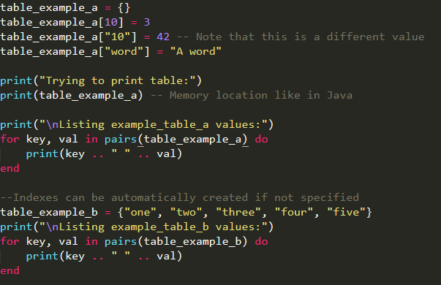
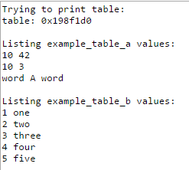
Short Program (Part 1)

Slide 11
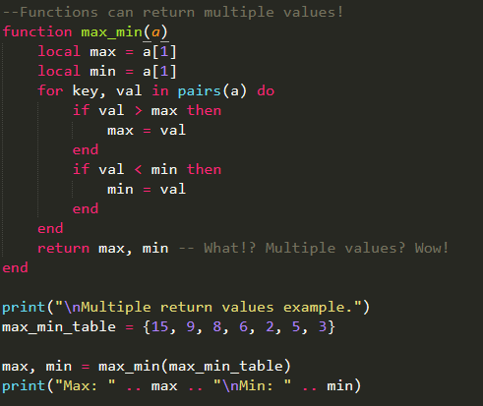
Short Program (Part 2)

Slide 12
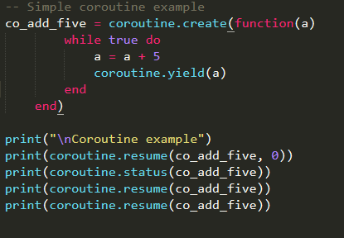
Short Program (Part 3)

