Slide 1
Spin
Tara Crunk ▪ Alex Douglas ▪ Akhila Yeruva
Sources:
http://www.parallax.com/propeller/qna/Content/QnaTopics/QnaSpin.htm
https://en.m.wikipedia.org/wiki/Spin_(programming_language)#Built_in_SPIN_byte_code_interpreter

Slide 2
Why did Parallax make SPIN?
Made specifically for the Parallax Propeller Chip
Provides control for Propeller’s multicore hardware
Application Design was not represented by existing languages
Inspired by portions of C, Delphi, and Python

Slide 3
What about SPIN?
Multi tasking high-level computer programing language
Designed by Parallax’s co-founder & president, Chip Gracey
Spin code is written on the Propeller Tool, This compiler will convert the code into bytecode which is loaded on the RAM
When Spin starts up it creates several threads for the 8 core chip on the machine.

Slide 4
Cool Stuff About SPIN
Spin allows users to avoid memory segmentation issues
Spin is similar to python – it uses indentation/whitespace rather than curly bracket to delimit block
It is more space efficient than Propeller assembly language.

Slide 5
Coding SPIN
Spin is broken down into following blocks:
VAR: contains global variables
CON: contains program constants
PUB: contains public subroutine code
PRI: contains private subroutine code
OBJ: contains the codes for objects
DAT: Holds predefined data along with assembly code

Slide 6
Coding SPIN
A few sample keywords:
  waitcnt – waits on the system controller to equal or exceed a given value
  waitvid – waits on the video timing before proceeding to output the data
  coginit – starts a processor on a new task

Slide 7
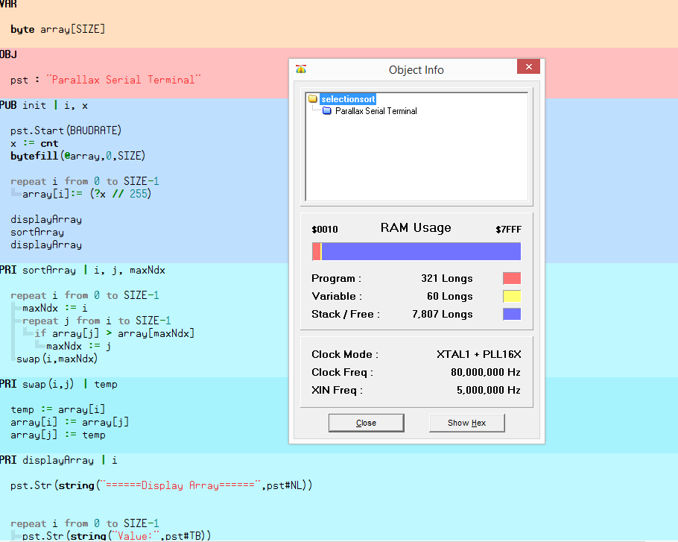
Examples of Use
An example of selection sort program in Spin.

Slide 8
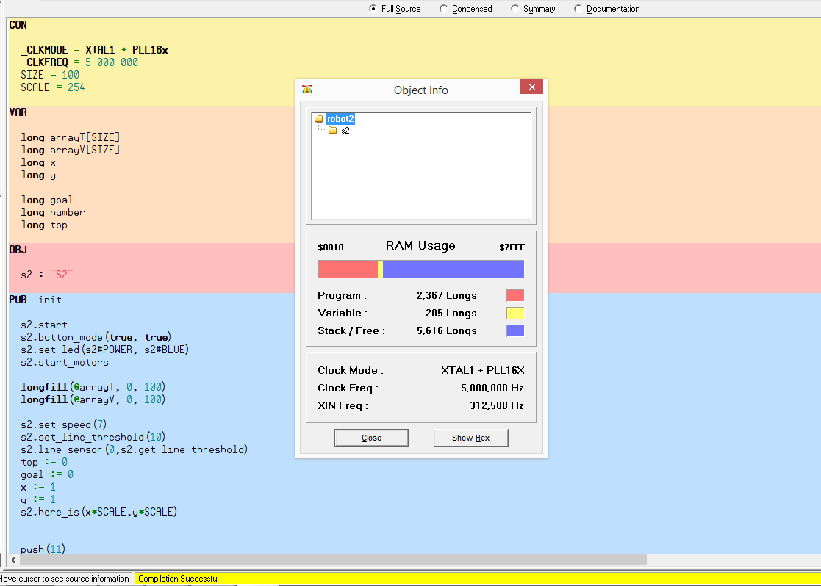

Slide 9
Examples of Use
The robot is programmed to find dark spots on a white floor.
Show video (too large for DropBox upload)

Slide 10
Comparison
Spin is “Object-Based”
Differs from “Object-Oriented”
Modular programming sees objects as devices that are collected together in an application, each working to do it’s own job. This is similar to inheritance or polymorphism in an object-oriented based language, such as C++ or Java.

