Slide 1
Bash
Jerome Lewis
Kelly Benson
Andrew Kimble

Slide 2
Overview
Shell Language (UNIX based)
Paradigms – Command, Scripting
Has ability to read straight from command line, as well as run imported script files
Are there any modern day uses for Bash?
Bash is very efficient at communication and piping data between programs
“Real Life” uses include system administration, web application deployment, data crunching, etc.

Slide 3
History
Written by Brian Fox as a free scripting language, and released in June of 1989.
Created to serve as replacement for the Bourne shell, where it’s name derives from (Bourne-Again shell)
Original purpose was to be a widely available open source version of the Bourne shell

Slide 4
History
Was a GNU project, designed primarily for UNIX developers.
Entire project was funded by Richard Stallman and the FSF (Free Software Foundation)
Some of the added features that Bash could offer over it’s predecessors were command history, command-line editing, a directory stack, more environment variables, and command completion.

Slide 5
Design
GNU OS*/Mac OS X/ etc.
*Implemented atop Linux kernel
Portable: runs on every version of Unix
The Bash shell added several new functions such as:
Job control
Line editing
Command history (unlimited size)
Filename completion
Provides command-line editing
Able to manipulate command line with emacs/vi

Slide 6
Design
Three main tokens:
Reserved words: “if” “while”
Operators: < , > , | , +, -, ** (exponentiation)
x=3**3 # 3 * 3 * 3
Words: Numbers, assignment statements, etc.
“all the rest”
Can run most sh scripts
Extension of the Unix sh program
Indexed arrays have unlimited size
Implements “aliases”
Shortcuts/abbreviations
Essentially sh + more features

Slide 7
Design
Pipeline: linear list of commands where output of one command in the list becomes the input of the next
Bash uses pipelining like most shells
Data gets read from terminal
Can also read from scripts
Data passes through multiple stages
Break characters into lines -> parser -> commands
Command is executed and collects return status

Slide 8
Design

Slide 9
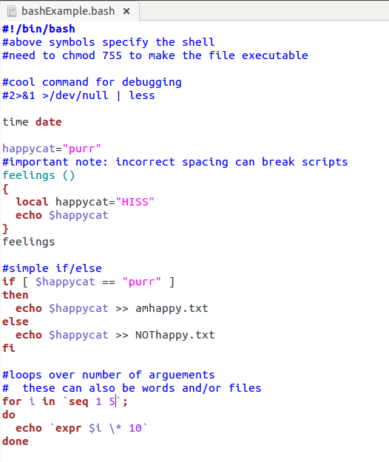
Example

Slide 10
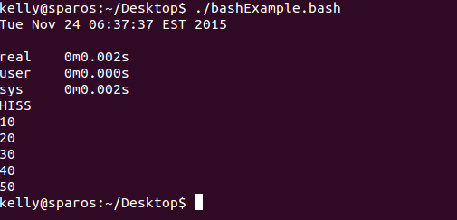
Examples

Slide 11
Comparison
Programming languages
Similarities
Variables, flow control, quoting, and functions
Differences
A shell. Can interpret commands as well.
Do not need to declare datatypes. Only assign values.
Notable Bash improvements over Bourne:
C-style for loops
Word completion
! for negating pipeline return values
Aliases
Local variables
Etc.

Slide 12
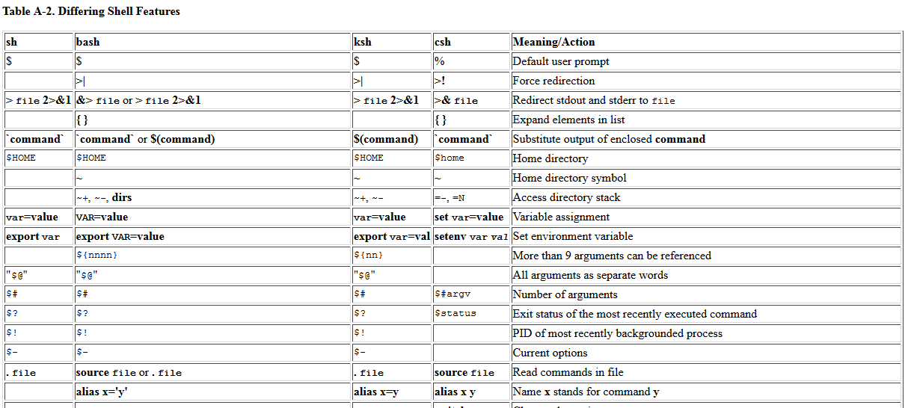
Comparison Cont.

Slide 13
References (add here)
http://aosabook.org/en/bash.html
^one of the “resources” I used along with:
Boyko Batchev's List of Interviews with Programming Language Creators from Computerworld's Series "The A-Z of Programming Languages
http://www.ibm.com/developerworks/library/l-linux-shells/
http://www.tldp.org/LDP/abs/html/
http://www.gnu.org/software/bash/manual/html_node/Major-Differences-From-The-Bourne-Shell.html
http://tldp.org/LDP/Bash-Beginners-Guide/html/x7369.html

