Slide 1
Go
Jeff Barnhart, Eric Reeves, Bryson Lee

Slide 2
Overview
Developed at Google to provide an open-source programming language modeled after C and C++, but that provides more advanced features like networking and multiprocessing
Go is clearly a derivative of C, but makes changes to improve conciseness, simplicity, and safety
It is an imperative, compiled and statically typed language

Slide 3
History
Created by Robert Griesemer, Rob Pike, and Ken Thompson, all Google employees and first released on November 10, 2009
The most significant update was released in August of this year
Designed to provide the conciseness and simplicity of C, but with many more powerful features built in
The designers disliked C++, saying it was overly complex

Slide 4
History
Used by many people, both inside and outside Google
Google uses Go on the their download server, dl.google.com
Also used by SoundCloud, Dropbox, and the BCC
Was named the Programming Language of the Year in 2009, and ranked 14th on the TIOBH rankings in 2010
Has since fallen to 50th place in 2015

Slide 5
Language Concepts I - Multiprocessing
Built-in support for multi-threading on a CPU with a single core, multicores, or on separate, connected CPU’s
Uses the function ‘go’ to create new lightweight threads for concurrent or asynchronous operations
go waitForTimer();
Go uses ‘channels’ to create type-safe and synchronized ‘pipes’ which can carry data between different goroutines
Can be used to pipeline data and for background calls with a timeout

Slide 6
Language Concepts II - Networking
Go natively provides an interface for network I/O
TCP/IP, UDP, domain name resolution and Unix domain sockets
Provides good support for writing server software and network applications in general
Networking work greatly simplified with easy to use concurrency and included libraries such as HTTP, JSON, and XML packages

Slide 7
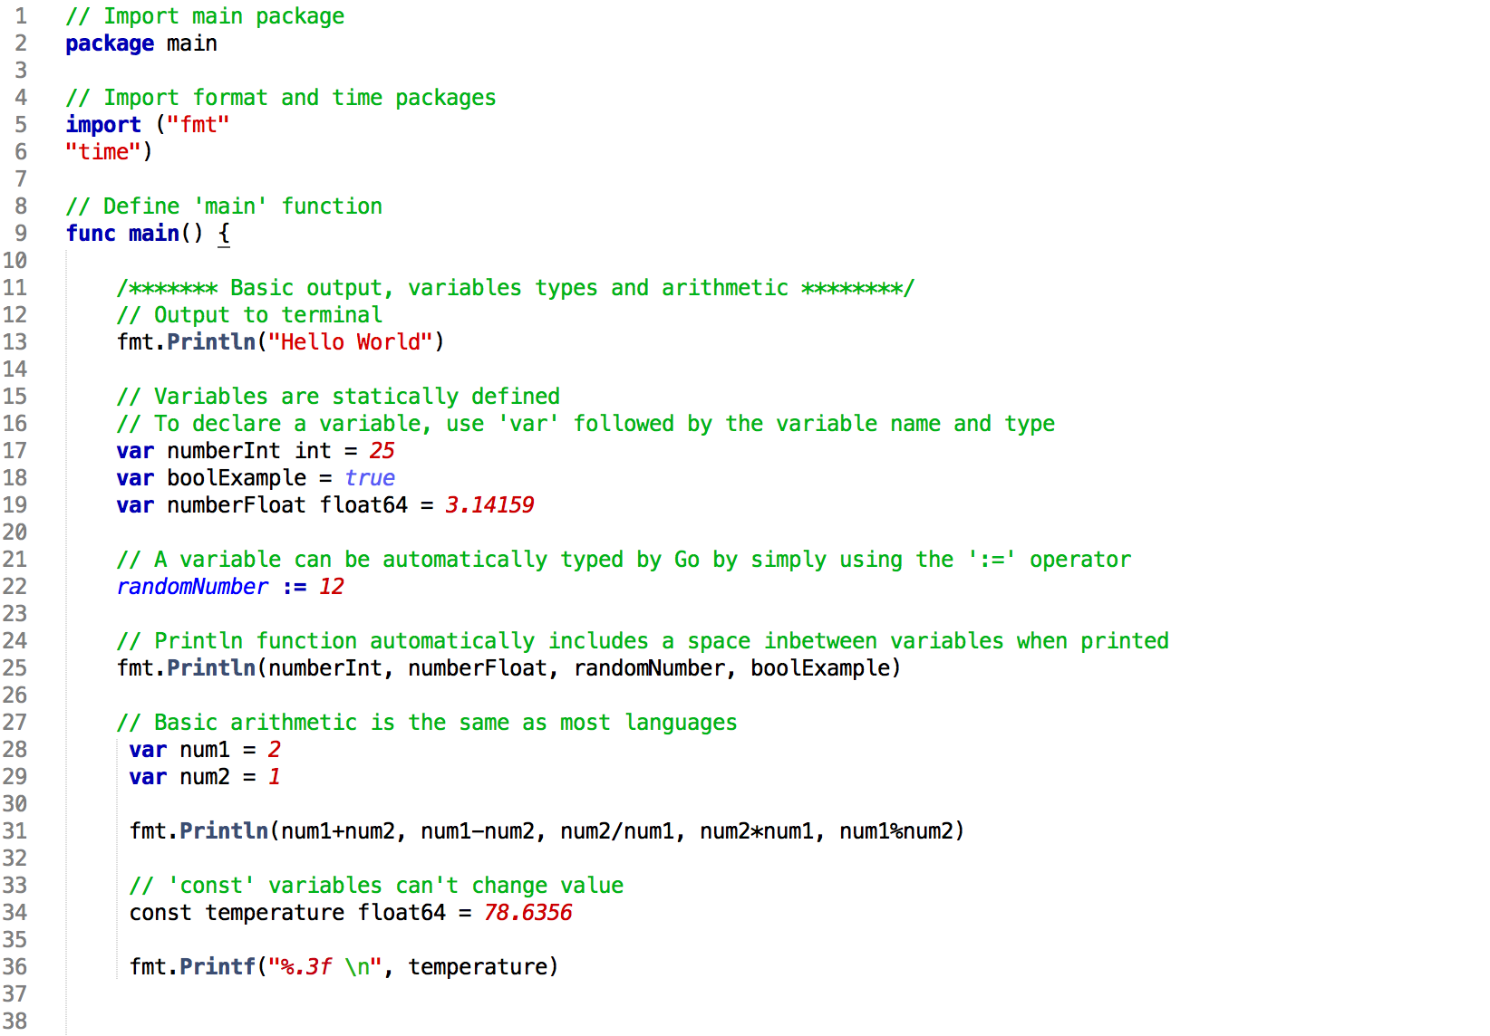
Go Demo I

Slide 8
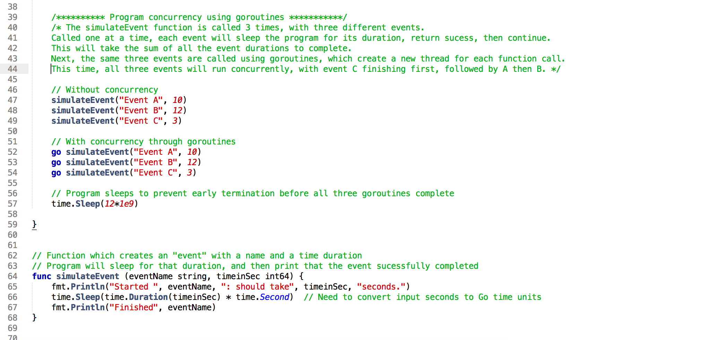
Go Demo II

Slide 9
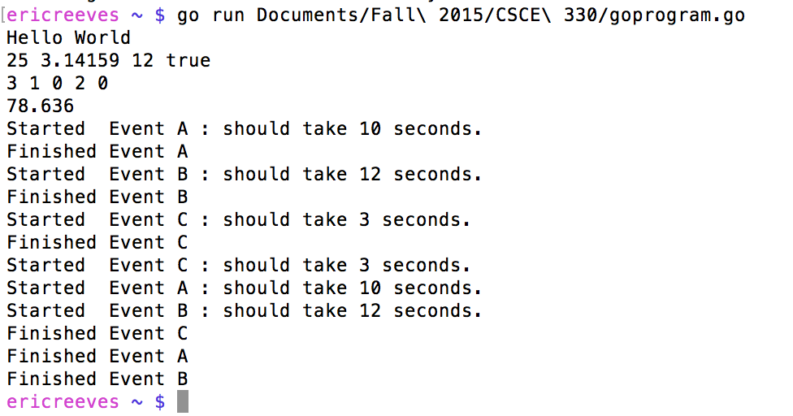
Go Example Execution

Slide 10
Comparison to other languages
Very syntactically similar to C
Significantly more efficient than other languages (Python) which provide similar built-in functionality
On average:
fewer lines of codes
quicker compilation time
reduced memory usage
important libraries are already included

Slide 11
References
https://golang.org/doc/faq
http://www.infoworld.com/article/2928602/google-go/whats-the-go-language-really-good-for.html
https://indico.cern.ch/event/449425/session/1/contribution/6/attachments/1168560/1685802/DAS_python_vs_go.pdf
https://github.com/golang/go/wiki

