Slide 1
Bradley, Barbare, Wagner
For References, see slide 13

Slide 2
Overview
“Julia is a high-level, high-performance dynamic programing language”
Its design is for technical computing
Technical computing, according to Wikipedia, is the application of the mathematical and computational principles of scientific computing
Julia’s programming domain is imperative
It is open-source, so it can be extended and optimized by anyone
Julia can be ran on an interpreter, but has the capabilities to be statically compiled
Can easily call methods defined in C and Python

Slide 3
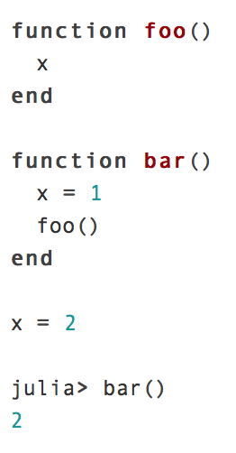
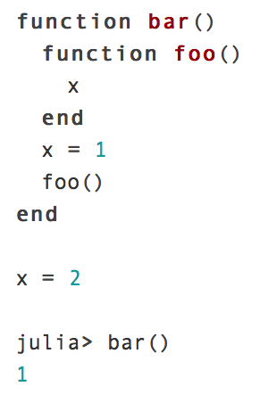
Variables
Code 1
Code 2
Execution 1
Execution 2
There is no local declaration of x for the function foo()
x is locally defined to 1 for the function foo()

Slide 4
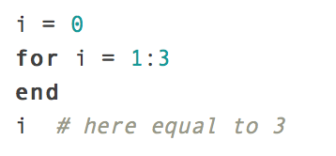
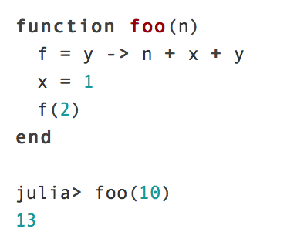
Variables
Variable names can be functions and the variable stores the value of the function
List comprehension creates a new local scope

Slide 5
Ternary Operators
Single ternary operator
if x = 1 and y = 2 then “less than” is printed
if x = 2 and y = 1 then “not less than” is printed
Chain of multiple ternary operators
if x = 1 and y = 2 then “x is less than y” is printed
if x = 2 and y = 1 then “x is greater than y” is printed

Slide 6
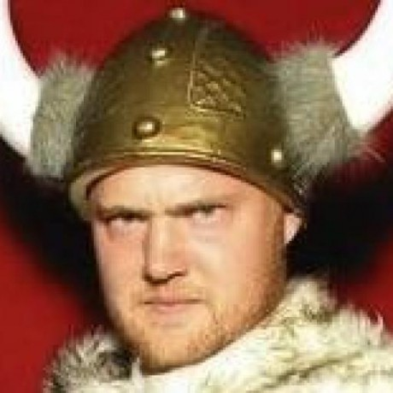
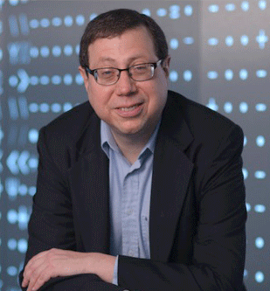
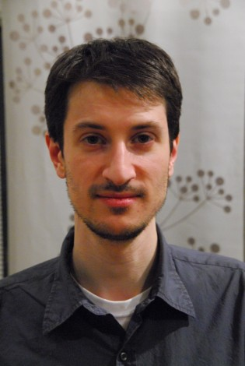
History
4 Co-Founders:
Image sources (left to right):
https://github.com/StefanKarpinski;http://www-math.mit.edu/~edelman/;https://www.google.com/search?q=jeff+bezanson&espv=2&biw=950&bih=936&source=lnms&tbm=isch&sa=X&ved=0ahUKEwik0Y7O7aTJAhXF7CYKHbxeDkUQ_AUICCgD#imgrc=_;https://www.linkedin.com/in/viralbshah
Stefan Karpinski
Alan Edelman
Jeff Bezanson
Viral Shah

Slide 7
History
2009:
Stefan Karpinski is frustrated while developing a network simulation tool.
August 2009: Karpinski speaks to Viral Shah
Development begins at MIT.

Slide 8
History
2009:
Goals for the Julia language:
Combine the pros of iron out the cons of each of the scientific computing languages into one open sourced, liberally-licensed language
Efficiency and speed
Simplicity
Parallel computing simplified
Dynamism (define functions for multiple argument types)
Less need to mention argument types
Homoiconicity
2012: first public release with a liberal MIT license
0.2.0 (now unmaintained)
2014: second release
0.3.0 (only critical bugfixes supported)
2015: current release (as of 9/22/2015)
0.4.1
http://www.infoworld.com/article/2616709/application-development/new-julia-language-seeks-to-be-the-c-for-scientists.html
http://www.wired.com/2014/02/julia/
http://julialang.org/blog/2012/02/why-we-created-julia/

Slide 9
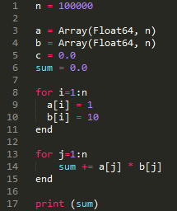
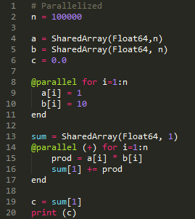
Julia By Example, Dot Product
Serial
Parallel

Slide 10
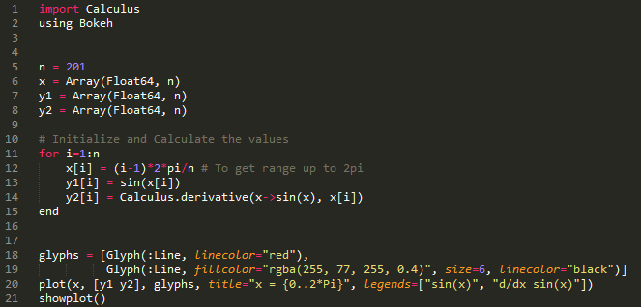
Julia By Example, Derivatives

Slide 11
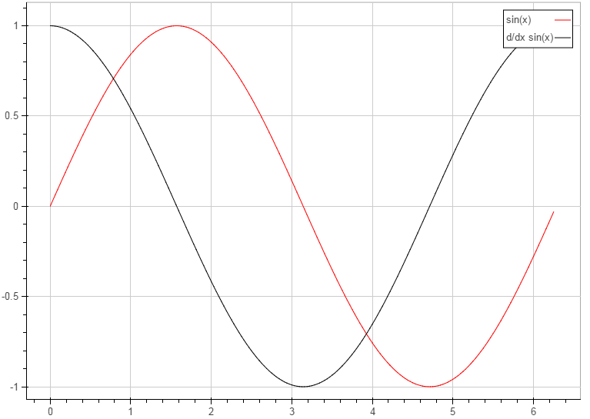
Julia By
Example
Plotted
Results

Slide 12
Language Comparison

Slide 13
References
www.julialang.org/
http://www.infoworld.com/article/2616709/application-development/new-julia-language-seeks-to-be-the-c-for-scientists.html
http://www.wired.com/2014/02/julia/
http://julialang.org/blog/2012/02/why-we-created-julia/

