Slide 1
Lua
Catharine West
Bo Aye
Saljin LaRocca
references
http://wiki.roblox.com/index.php?title=Comparison_between_Lua_and_other_languages

Slide 2
Overview
Imperative and Functional Language
Embeddable scripting language
Based on Associative Arrays and extensible semantics
Runs by interpreting bytecode for register-based VM
Used in games and applications as plugins
some examples: World of Warcraft, Adobe Lightroom, and Apache HTTP Server
Notes:
Overview in context of language family / problem domains

Slide 3
History of Lua
Lua was created in order to solve a particular problem
Needed an easy-to-configure language. At the time the other comparable language was TCL.
Before Lua was SOL (Simple Object Language). ‘Sol’ means sun in Portuguese, and ‘Lua’ means moon – as Lua is ‘smaller’ than SOL.
Notes:
Set language in its historical and problem domain context. How did it evolve?

Slide 4
How Lua has evolved
After first being implemented in 1993, Lua had many features that were desired but not included in the language.
One of these, lexical scoping, was finally introduced in Lua 5.0 in 2003 via a new algorithm.
Lua was also ported into Perl via the inline::Lua, a PERL extension for embedding Lua scripts into PERL code.
Lua is still used by many game developers today as a convenient scripting language (RPG maker and WoW hello).
Notes:
Evolve – cont.

Slide 5
Lua Concepts
simple
efficient
portable
free
Notes:
Language concepts – new, interesting

Slide 6
Lua Concepts
--comment
--[[comment]]
local var1 or local var2 = nil (default value for all uninitialized variable)
local var3 = “Abc” (String)
local var4 = {} – declaring an array
And,end,in,repeat,do,else,elseif,if (Reserved names)
Notes:
Language concepts (cont.)

Slide 7
Lua Concepts
local string a = “Hello world”
local number num= 10
local function = type()
“..” use for concatenation
local b = “Hello”..”World”
Notes:
Language concepts (cont.)

Slide 8
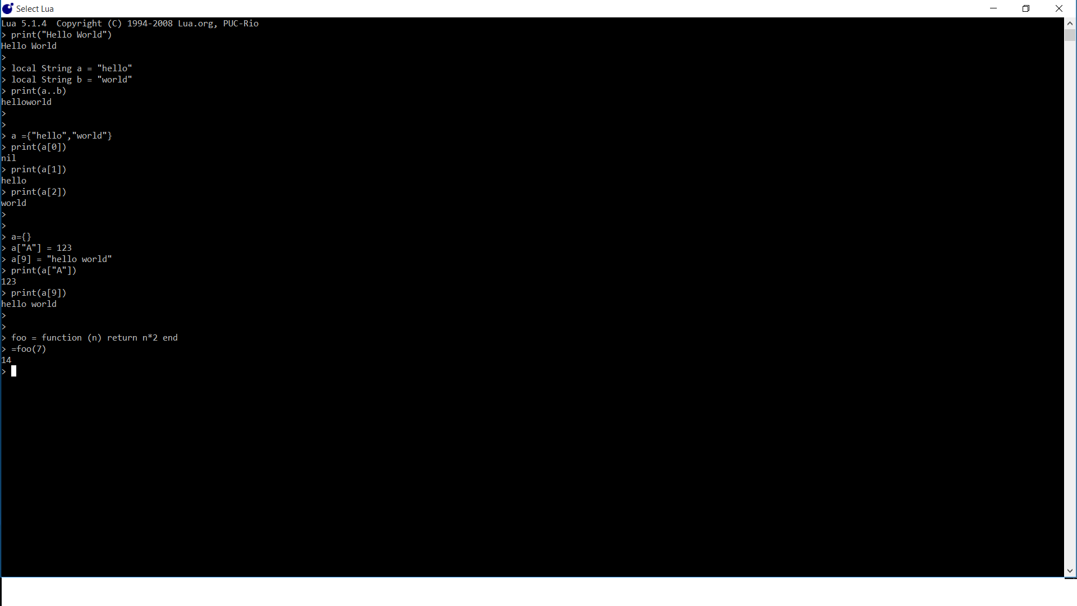
He
Examples of usage : short program with concepts highlighted

Slide 9
Comparison with other languages (C,C++)
Differences
•Null is know as nil
•else if is combined into one keyword elseif
•Uses different arrays that are known as tables.
•Strings in lua are not tables
•Does not use braces for opening and closing blocks of code. It uses the end statement.
•Is not a function based language, though functions are a big part of it.
•Function calling requires parenthesis.”()”

