Slide 1
TCL
Matthew Hamod
Nicholas Will

Slide 2
Problem Domain
Designed to act as a powerful command language (scripting language)
Could be implemented as a library package
Not intended to be a standalone language
Easy to create new features as part of the language

Slide 3
Historical Context
Developed by John Ousterhout
Stands for "Tool Command Language"
GUI applications becoming popular
Tools for creating GUI applications were complex
Some features of Tk may have influenced Java development

Slide 4
Evolution of the Language
Started as a Unix only language
  Eventually able to run on Windows and Mac
Started as a slow language
  Originally, TCL code was completely interpreted
  Brian Lewis created a bytecode compiler
    Increased speeds by 5-10x

Slide 5
Language Concepts
; or newlines are command separators
} are command terminators
A word that starts with a $ is a variable
  i.e. $variable
  $variable(index) is an array
# is used for one line comments
  Ending a line in a \ allows the comment to span multiple lines
  A comment should only be placed where a command is expected

Slide 6
Language Concepts
Strings
  Don't need quotes
    set greeting Hello! # this is perfectly valid
  Quotes or braces are used for grouping
    set example "this is one group"
    set example {this is another}
  String groups can span multiple lines and the newline will be included

Slide 7
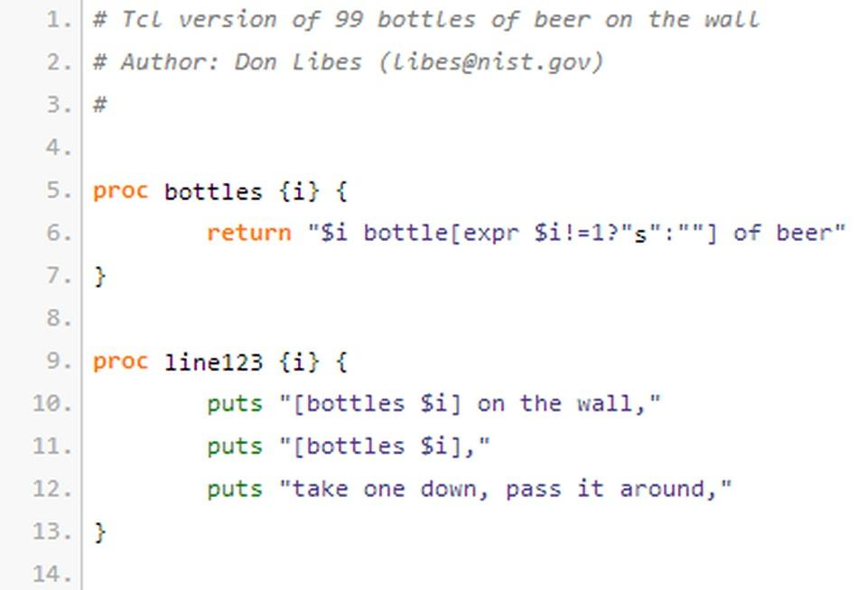
Examples of Use

Slide 8
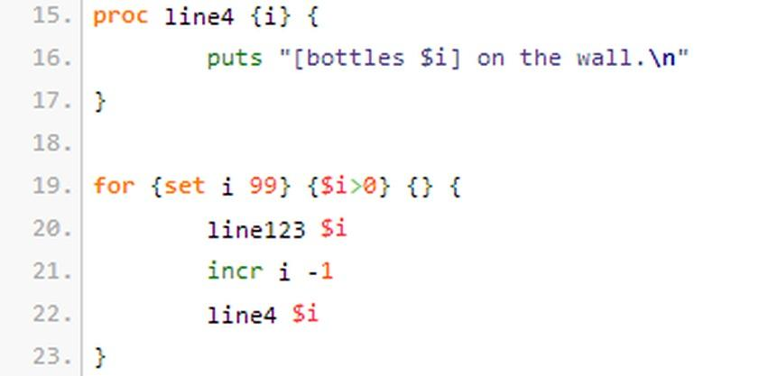
Examples of Use

Slide 9
Comparison to Python
Both can be used as an extension or as a standalone language
TCL is weaker on data structures
TCL executes typical code much slower than Python
TCL lacks features needed for writing large programs (for instance, modular namespace)
  Tk toolkit adds namespaces and increases speed

Slide 10
Comparison to Perl
TCL passes arrays by name
  Perl can pass arrays by reference or by value
Perl can analyze a script for errors in syntax without execution
  TCL cannot, because it executes one line at a time
TCL is better at being used as a configuration file parser
  TCL's command line library is well suited to being used from Perl

