Slide 1
JavaScript
By: Louis Roselli & Michael Reynolds

Slide 2
Problem Domain
JavaScript is programming code that can be inserted into HTML pages.
JavaScript inserted into HTML pages, can be executed by all modern web browsers.
JavaScript support is built right into all the major web browsers, including Internet Explorer, Firefox and Safari.

Slide 3
Historical Context
Created in 1994 by Brandon Eich in Netscape.
Was implemented in September 1995.
Named Mocha during development, Livescript during it’s first shipment, and then later renamed JavaScript once it shipped with Netscape.

Slide 4
Language Evolution
JavaScript started off in the development stage called Mocha.
Mocha was renamed to LiveScript when it first shipped in its beta state with Netscape Navigator 2.0.
LiveScript was renamed JavaScript when Netscape added support for Java.

Slide 5
Language Concepts
Used mainly for client-side scripting and webpage design.
JavaScript is mostly used in conjunction with HTML to write functions embedded within the HTML.
JavaScript is a dynamic language with syntax that was heavily influenced by C.

Slide 6
Example of Changing HTML Elements
<!DOCTYPE html>
<body>
<h1>My First Web Page</h1>
<p id="demo">My First Paragraph.</p>
<script>
document.getElementById("demo").innerHTML="My First JavaScript";
</script>
</body>
</html>

Slide 7
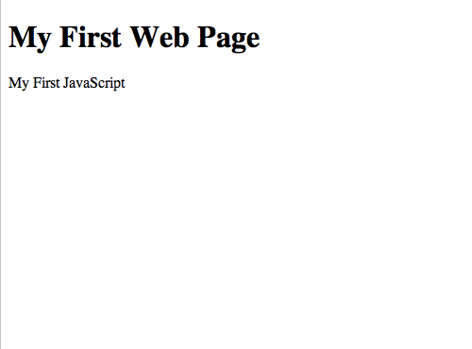

Slide 8
Example of Alert Box
<!DOCTYPE html>
<head><script>
function myFunction(){
alert("Hello! I am an alert box!"); }
</script></head>
<body>
<input type="button" onclick="myFunction()" value="Show alert box" />
</body>
</html>

Slide 9
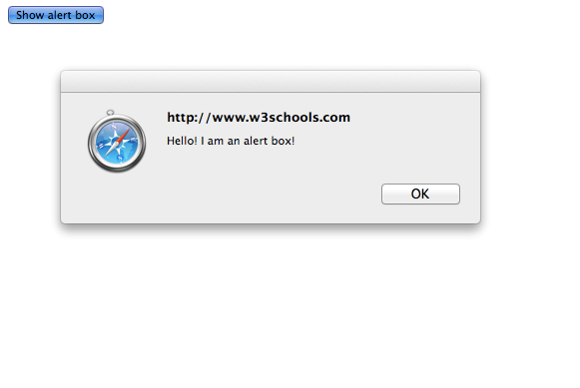

Slide 10
Comparison to Python
JavaScript is very clear, readable syntax
JavaScript is embeddable within HTML as a scripting interface
Python is a high-level language with a huge standard library.
Python is server side. Slower.
To make Python Client Side, pyjamas Python -> JS

Slide 11
JavaScript VS. Java
JavaScript is lightweight
JavaScript is a hybrid – OOP & Scripting
JavaScript runs in Browser
Java runs in applet or through a JVM.

Slide 12
Other Examples
81% of Websites in 2006 use some form of JavaScript.
92% of Websites today use JavaScript.
Frameworks: Prototype, jQuery, Dojo, and more.
Apple, CNN, Facebook, Twitter, and more.
Future?

Slide 13
Sources
http://www.htmlgoodies.com/beyond/javascript/article.php/3470971/Java-vs-JavaScript.htm
http://en.wikipedia.org/wiki/JavaScript
http://www.w3schools.com/js/js_examples.asp
http://w3techs.com/technologies/details/cp-javascript/all/all
http://elie.im/blog/web/45-of-the-popular-websites-use-a-javascript-framework/

