Slide 1
COBOL
William, Andrew, Stephanio, Michael

Slide 2
Introduction
COmmon Business Oriented Language
Created in 1959
It is an imperative language
It was created to be used in business and administrative systems for companies and governments

Slide 3
Historical Context
The creators of the COBOL programming language, a committee of researchers from various universities and private industry leaders, drew upon languages such as FLOW-MATIC (B-0) and IBM's COMTRAN.
FLOW-MATIC was the first English-like processing language and became public in 1958

Slide 4
Problem Domain
The language continued to evolve well after its creation in 1959.
In 1968, the American National Standards Institute created a standard from of COBOL, known as ANS COBOL
In 1985, ANSI published a second revised version of COBOL (first was in 1974), containing constructs such as END-IF and END-PERFORM

Slide 5
COBOL Concepts
Data processing language
Readable code statements
functions written out, such as ADD
statements end with "."
Still evolving
implemented Object-Oriented design
Code split into Divisions
IDENTIFICATION DIVISION
ENVIRONMENT DIVISION
DATA DIVISION
PROCEDURE DIVISION

Slide 6
Concepts (cont.)
IDENTIFICATION DIVISON
first division
2 required entries:
division header
program-id (name of program)
ENVIRONMENT DIVISION
second division
2 allowable sections:
CONFIGURATION SECTION
characteristics of computer system
INPUT-OUTPUT SECTION
files that will be used (patron file & output)

Slide 7
Concepts (cont.)
DATA DIVISON
data processed program
2 sections:
FILE SECTION
data items of input and output defined here
file descriptions for all files used
WORKING-STORAGE SECTION
field not present in input or output file
PROCEDURE DIVISION
actions program will complete
has different paragraphs
work like methods in C++/Java
ex. PRINT-SALES-REPORT

Slide 8
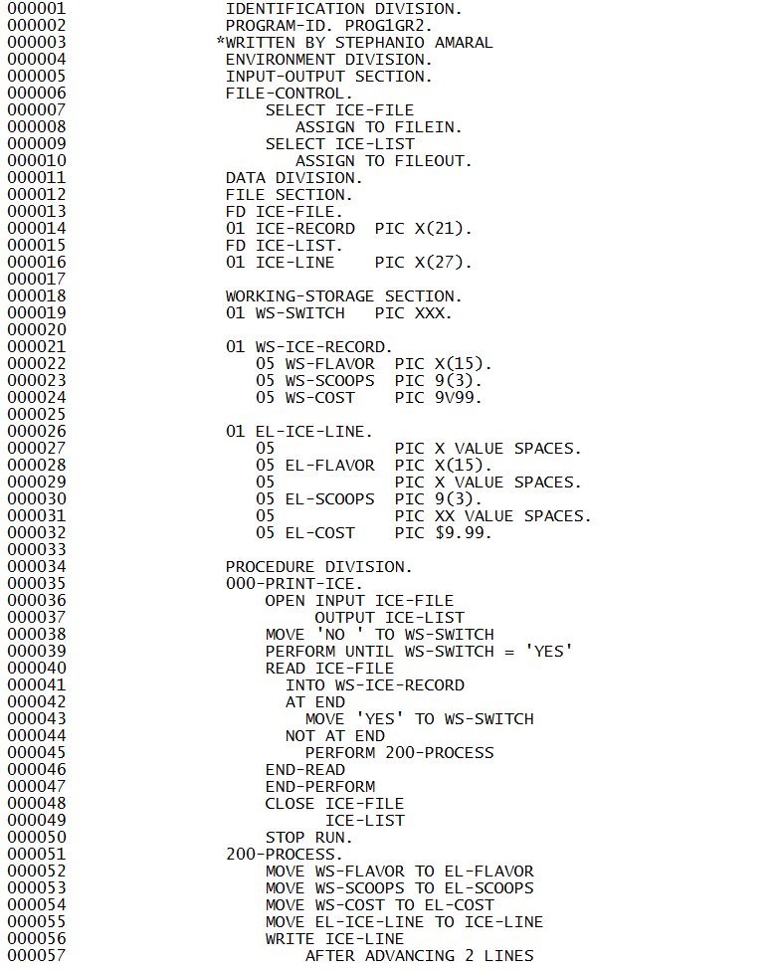

Slide 9
Comparison
Cobol has defined structure
Some languages like C++ and Java don't have the same structure so it is harder to read
Was designed for Business Oriented Applications
Doesn't focus on visual side of applications like newer languages; it focuses on processing information efficiently

