Slide 1
Introduction to Probability
(CSCE 317)
January 16, 2018
Marco Valtorta
INNOVA 2269
mgv@cse.sc.edu

Slide 2
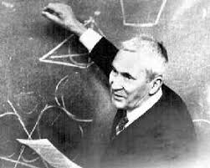
Purpose of the Introductory Slides
Review the axioms of probability:
  Kolmogorov’s axioms
Review models of the axioms

Slide 3
Probabilities
A set of events is a set of subsets of the set of sample points Ω s.t:
  Ω is an event,
  If E₁ and E₂ are events, then E₁ U E₂ is an event,
  If E is an event, then its complement is an event
Let Ω be a set of sample points (outcomes), F be a set of events relative to Ω, and P a function that assigns a unique real number to each E in F . Suppose that
  P(E) >= 0 for all E in F
  P(Ω) = 1
  If E₁ and E₂ are disjoint subsets of F , then P(E₁ V E₂) = P(E₁) + P(E₂)
Then, the triple (Ω, F ,P) is called a probability space, and P is called a probability measure on F
Notes:
A set of events is a set of subsets of the sample points with three properties: (1) Omega is an event, (2) If E1 and E2 are events, then E1 U E2 is an event, (3) if E is an event, then its complement is an event.
The three properties of probability in the second half of the space are called the axioms of Kolmogorov.

Slide 4
Conditional probabilities
Let (Ω, F ,P) be a probability space and E₁ in F such that P(E₁) > 0. Then for E₂ in F , the conditional probability of E₂ given E₁, which is denoted by P(E₂| E₁), is defined as follows:
Notes:
This should be considered a fourth axiom (besides the three axioms of Kolmogorov) that needs to be shows true in every (proper) model of probability.

Slide 5
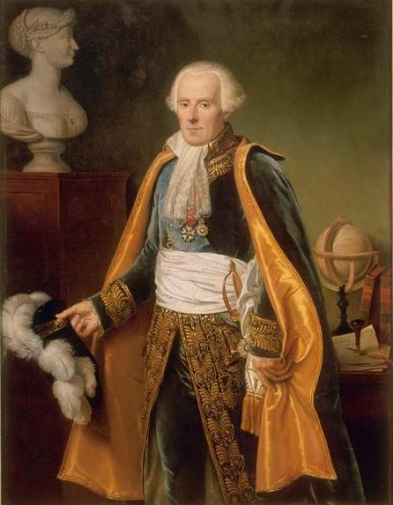
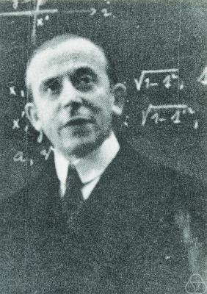
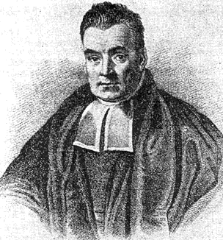
Models of the Axioms
There are three major models (i.e., interpretations in which the axioms are true) of the axioms of Kolmogorov and of the definition of conditional probability.
The classical approach
The limiting frequency approach
The subjective (Bayesian) approach
Left: Pierre-Simon Laplace
(1749-1827)
Right: Richard
von Mises
(1883-1953)
Left: Thomas
Bayes
(1749-1827)
Notes:
https://en.wikipedia.org/wiki/Pierre-Simon_Laplace; 1749-1827
https://en.wikipedia.org/wiki/Richard_von_Mises; 1883-1953
https://en.wikipedia.org/wiki/Thomas_Bayes; 1701-1761

Slide 6
Derivation of Kolmogorov’s Axioms in the Classical Approach
Let n be the number of equipossible outcomes in Ω
If m is the number of equipossible outcomes in E, then P(E) = m/n ≥0
P(Ω) = n/n = 1
Let E1 and E2 be disjoint events, with m equipossible outcomes in E1 and k equipossible outcomes in E2. Since E1 and E2 are disjoint, there are k+m equipossible outcomes in E1 V E2, and:
P(E1)+P(E2) = m/n + k/n = (k+m)/n = P(E1 V E2)

Slide 7
Conditional Probability in the Classical Approach
Let n, m, k be the number of sample points in Ω, E1, and E1&E2. Assuming that the alternatives in E1 remain equipossible when it is known that E1 has occurred, the probability of E2 given that E1 has occurred, P(E2|E1), is:
k/m = (k/n)/(m/n) = P(E1&E2)/P(E1)
This is a theorem that relates unconditional probability to conditional probability.

Slide 8
The Subjective Approach
The probability P(E) of an event E is the fraction of a whole unit value which one would feel is the fair amount to exchange for the promise that one would receive a whole unit of value if E turns out to be true and zero units if E turns out to be false
The probability P(E) of an event E is the fraction of red balls in an urn containing red and brown balls such that one would feel indifferent between the statement "E will occur" and "a red ball would be extracted from the urn."
Notes:
Neapolitan, after De Finetti (first definition)
I believe that the second definition is due to Dennis V. Lindley

Slide 9
The Subjective Approach II
If there are n mutually exclusive and exhaustive events E_{i}, and a person assigned probability P(E_{i}) to each of them respectively, then he would agree that all n exchanges are fair and therefore agree that it is fair to exchange the sum of the probabilities of all events for 1 unit. Thus if the sum of the probabilities of the whole sample space were not one, the probabilities would be incoherent.
De Finetti derived Kolmogorov’s axioms and the definition of conditional probability from the first definition on the previous slide and the assumption of coherency.
Notes:
Neapolitan, p.56. This is De Finetti’s Dutch Book theorem

Slide 10
Definition of Conditional
Probability in the Subjective Approach
Let E and H be events. The conditional probability of E given H, denoted P(E|H), is defined as follows: Once it is learned that H occurs for certain, P(E|H) is the fair amount one would exchange for the promise that one would receive a whole unit value if E turns out to be true and zero units if E turns out to be false. [Neapolitan, 1990]
Note that this is a conditional definition: we do not care about what happens when H is false.
Notes:
Neapolitan, 1990, p.57

Slide 11
Derivation of Conditional Probability
One would exchange P(H) units for the promise to receive 1 unit if H occurs, 0 units otherwise; therefore, by multiplication of payoffs:
One would exchange P(H)P(E|H) units for the promise to receive P(E|H) units if H occurs, 0 units if H does not occur (bet 1); furthermore, by definition of P(E|H), if H does occur:
One would exchange P(E|H) units for the promise to receive 1 unit if E occurs, and 0 units if E does not occur (bet 2)
Therefore, one would exchange P(H)P(E|H) units for the promise to receive 1 unit if both H and E occur, and 0 units otherwise (bet 3).
But bet 3 is the same that one would accept for P(E&H), i.e. one would exchange P(E&H) units for the promise to receive 1 unit if both H and E occur, and 0 otherwise, and therefore P(H)P(E|H)=P(E&H).
Notes:
The derivation of P(H)P(E|H) = P(E & H) in the subjective approach given above is on p.57 of [Neapolitan, 1990]

