Slide 1
CSCE 317
Computer Systems Engineering
Introduction
Marco Valtorta
Spring 2016
January 12, 2016

Slide 2
Course Description
317 — Computer Systems Engineering (3) Prereq: CSCE 212, MATH 242, STAT 509 System-level modeling and evaluation of computer systems: requirements elicitation and specification, architectural design, reliability and performance evaluation, Markov modeling, life-cycle cost analysis, project management.

Slide 3
Published Course Objectives
Take an overall system and lifecycle view of the design and operation of a system.
Model and evaluate the reliability of system architectures.
Model and evaluate the performance and dynamic behavior of a system.
  Queueing Theory
Model and evaluate the economics of cash flows in system design, development, and operation.
Notes:
http://www.cse.sc.edu/files/CSCE317.pdf

Slide 4
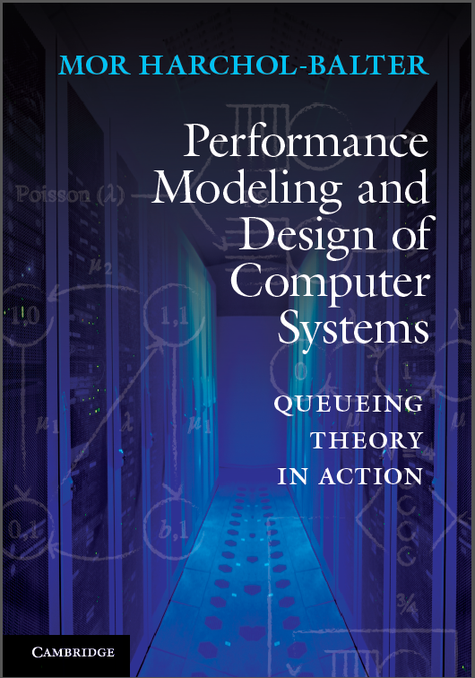
Textbook
Performance Modeling and Design of Computer Systems:
Queueing Theory in Action
Author: Mor Harchol-Balter
Published: February 2013
Publisher: Cambridge University Press
ISBN: 9781107027503
We will refer to the textbook as [H]
Notes:
http://www.cs.cmu.edu/~harchol/PerformanceModeling/book.html

Slide 5
Syllabus
We will cover most of the first 13 chapters of the textbook
Homework assignments
Quizzes or in-class exercises
Midterm
Final

Slide 6
What is Queueing Theory?
The theory of Queues
Notes:
Section 1.1[H]

Slide 7
Examples
Supermarket
Production System
Post Office
Data Communication
Parking Lot
Assembly of Printed Circuit Boards
Call Center of an Insurance Company
Mainframe Computer
Toll Booths
Traffic Lights
Hospital Emergency Department
Mobile Communication Network
Notes:
These examples are by Ivo Adan and Jacques Resing. See http://www.win.tue.nl/~iadan/queueing.pdf.

