Slide 1
CSCE 317 Computer Systems Engineering Introduction
Marco Valtorta
Spring 2015

Slide 2
Course Description
317 — Computer Systems Engineering (3) Prereq: CSCE 212, MATH 242, STAT 509 System-level modeling and evaluation of computer systems: requirements elicitation and specification, architectural design, reliability and performance evaluation, Markov modeling, life-cycle cost analysis, project management.

Slide 3
Published Course Objectives
Take an overall system and lifecycle view of the design and operation of a system.
Model and evaluate the reliability of system architectures.
Model and evaluate the performance and dynamic behavior of a system.
Queueing Theory
Model and evaluate the economics of cash flows in system design, development, and operation.
Notes:
http://www.cse.sc.edu/files/CSCE317.pdf

Slide 4
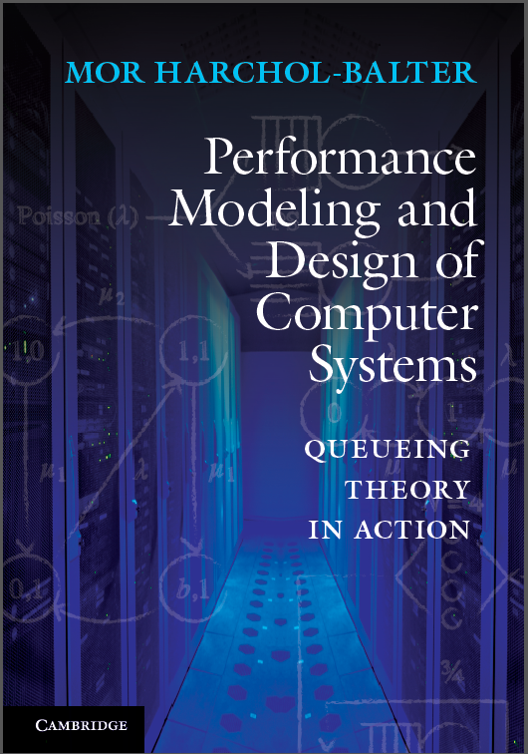
Textbook
Performance Modeling and Design of Computer Systems: Queueing Theory in Action
Author: Mor Harchol-Balter
Published: February 2013
Publisher: Cambridge University Press
ISBN: 9781107027503
We will refer to the textbook as [H]
Notes:
http://www.cs.cmu.edu/~harchol/PerformanceModeling/book.html

Slide 5
Syllabus
We will cover most of the first 13 chapters of the textbook
Homework assignments
Quizzes or in-class exercises
Midterm
Final

Slide 6
What is Queueing Theory?
The theory of Queues
Notes:
Section 1.1[H]

Slide 7
Examples
Supermarket
Production System
Post Office
Data Communication
Parking Lot
Assembly of Printed Circuit Boards
Call Center of an Insurance Company
Mainframe Computer
Toll Booths
Traffic Lights
Notes:
These examples are by Ivo Adan and Jacques Resing. See http://www.win.tue.nl/~iadan/queueing.pdf.

