Slide 1
Academic advising
Fall 2019

Slide 2
Who is in the room? Raise your hand if…
You know who your Academic Advisor is.
You have received an email from your Undergraduate Academic Advisor to schedule an appointment.
You have scheduled an advising appointment.
You have already been advised.

Slide 3
Warm-up activity
Advising Trivia!

Slide 4
Are you required to meet with an academic advisor every semester?
Yes
No
Only during your first year

Slide 5
My assigned Academic Advisor is the only advisor I’m allowed to meet with.
True
False

Slide 6
Can you register for classes at any time?
Yes
No
Only if you’re a senior

Slide 7
Overview of advising at Carolina
You must be advised every semester in order to register for the next semester
No advisement = No registration (No exceptions!)
Your academic advisor is your primary contact for:
Advisement and Registration
Major Mapping and Degree Planning
Course Schedule Development
Transfer Course Evaluation

Slide 8
WHO advises CEC Students?
First-Year/Undergraduate “Staff” Advisors
Professional staff whose primary role is advising students
Advise all new, incoming CEC students (first-year, transfer, etc.)
Will be your advisor for your first two years at Carolina
Located in CEC Student Services (Swearingen 1A00)

Slide 9
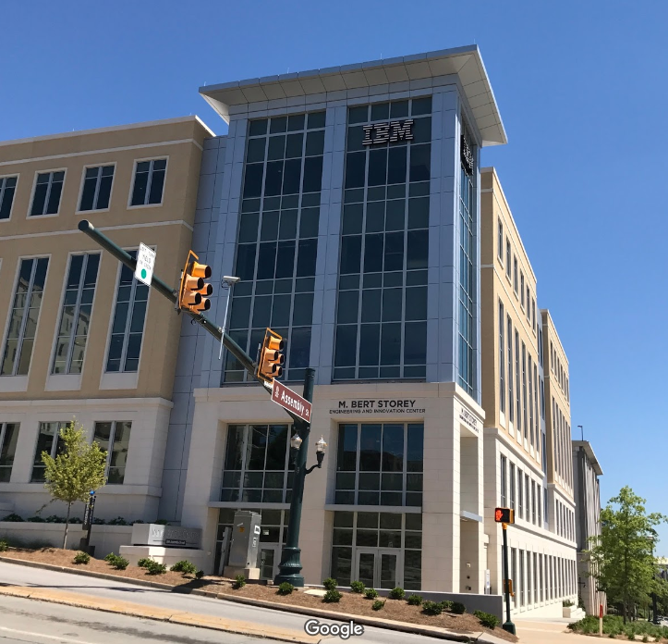
WHO advises CEC Students?
Faculty Advisors
Faculty members whose primary roles are research and teaching
Advise upperclassmen CEC students
Will be your advisor for your remaining time at Carolina
Located in your major’s department
CSCE Department – Storey Engineering and Innovation Center 2nd floor

Slide 10
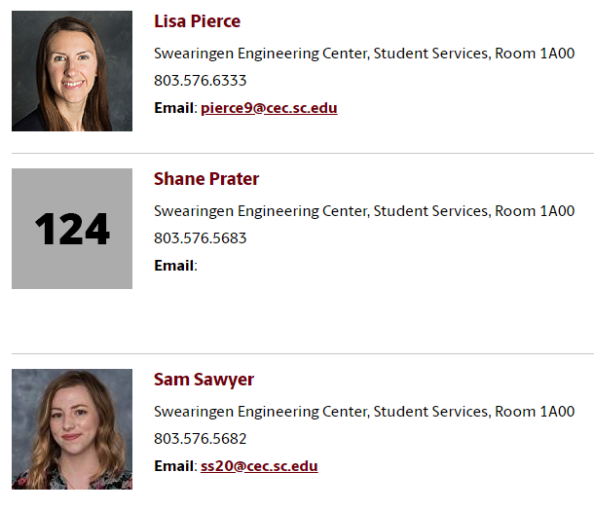
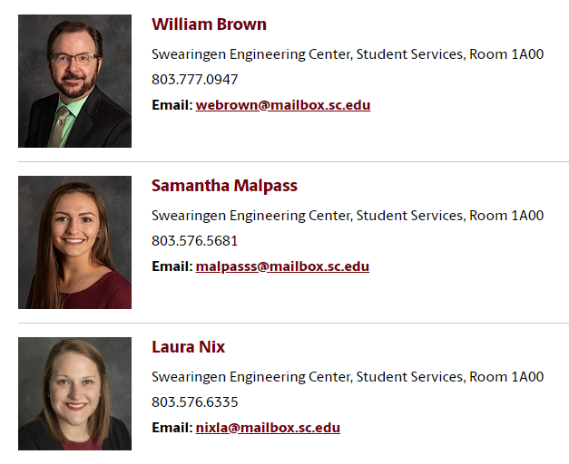
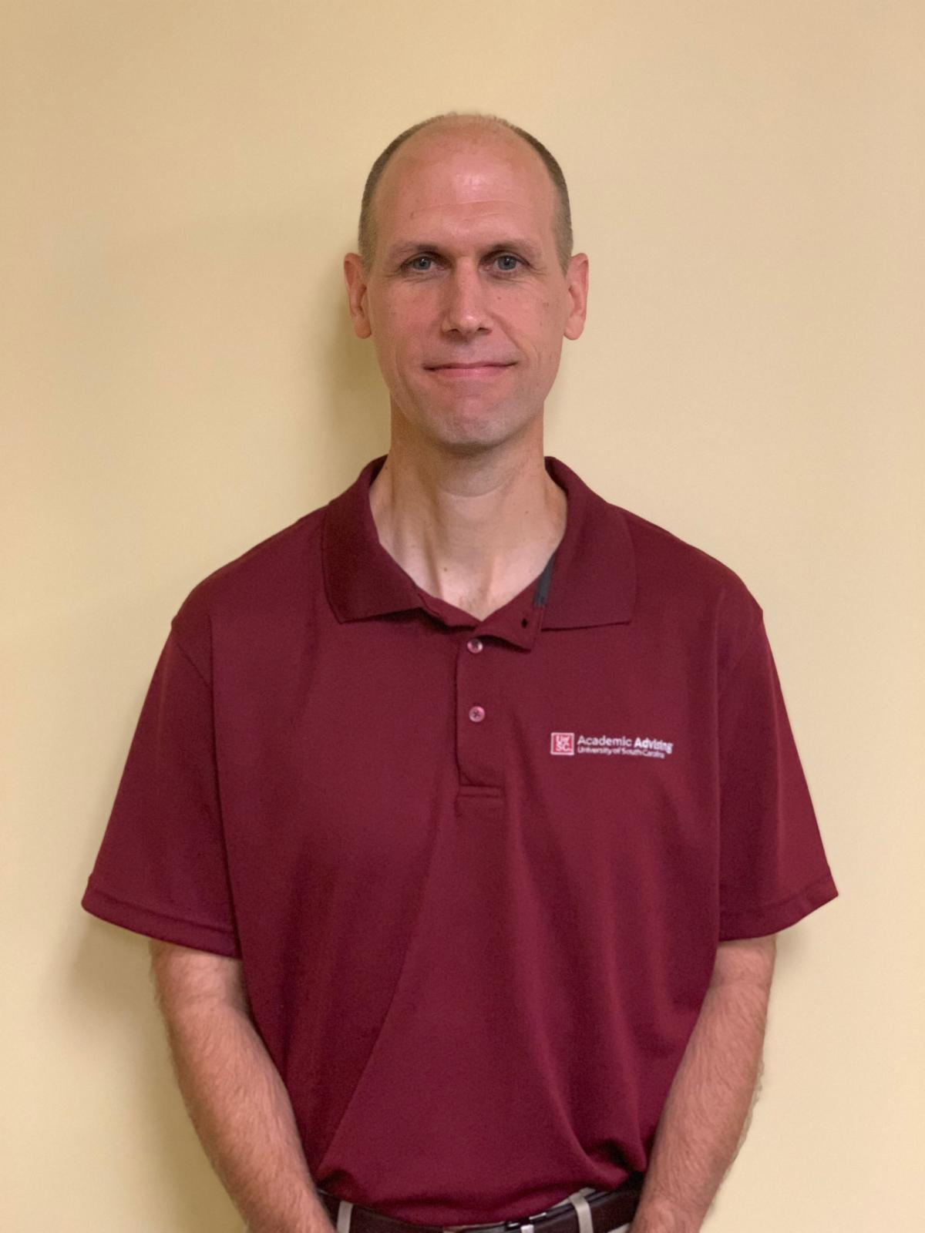
CEC Undergraduate STAFF advisors
Majors: Computer Science, Computer Information Systems, Integrated Information Technology
Majors: Biomedical Engineering, Chemical Engineering, Mechanical Engineering
Majors: Biomedical Engineering, Chemical Engineering, Mechanical Engineering
Majors: Computer Engineering, Mechanical Engineering, Civil Engineering, Electrical Engineering
Majors: Computer Science, Computer Information Systems, Integrated Information Technology
Majors: Aerospace Engineering, Mechanical Engineering, Civil Engineering, Electrical Engineering
Notes:
There are 6 FYA/UG Advisors in the CEC. Three of them work specifically with Computing students.

Slide 11
Overview of Advising resources
Department
College/School
University
Computer Science and Engineering Department
College of Engineering and Computing
University Advising Center
Notes:
As a CSCE major, you will have 3 different levels of advising resources:
UAC (university-wide advising information)
CEC (advising info specific to the College)
CSCE (advising info specific to the Dept)
We’ll use this pyramid on the next few slides to distinguish the different levels.
[next slide]

Slide 12
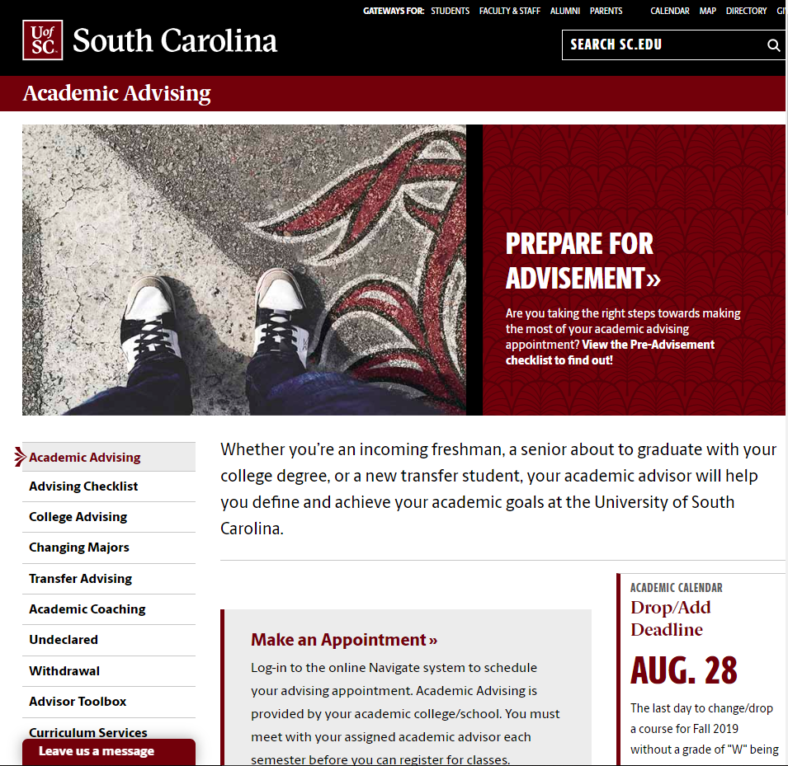
University Advising Center
University
sc.edu/advising
Located on the 3rd floor of Close-Hipp

Slide 13
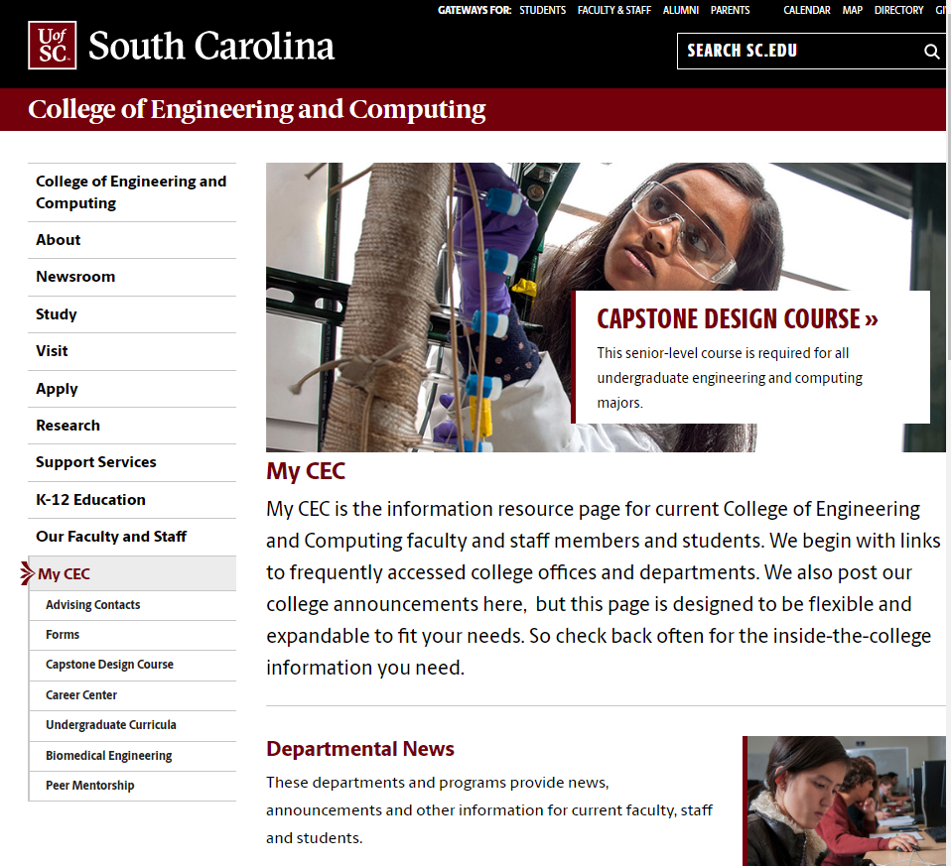
CEC Student Services
College
cec.sc.edu
Located in Swearingen Room 1A00

Slide 14
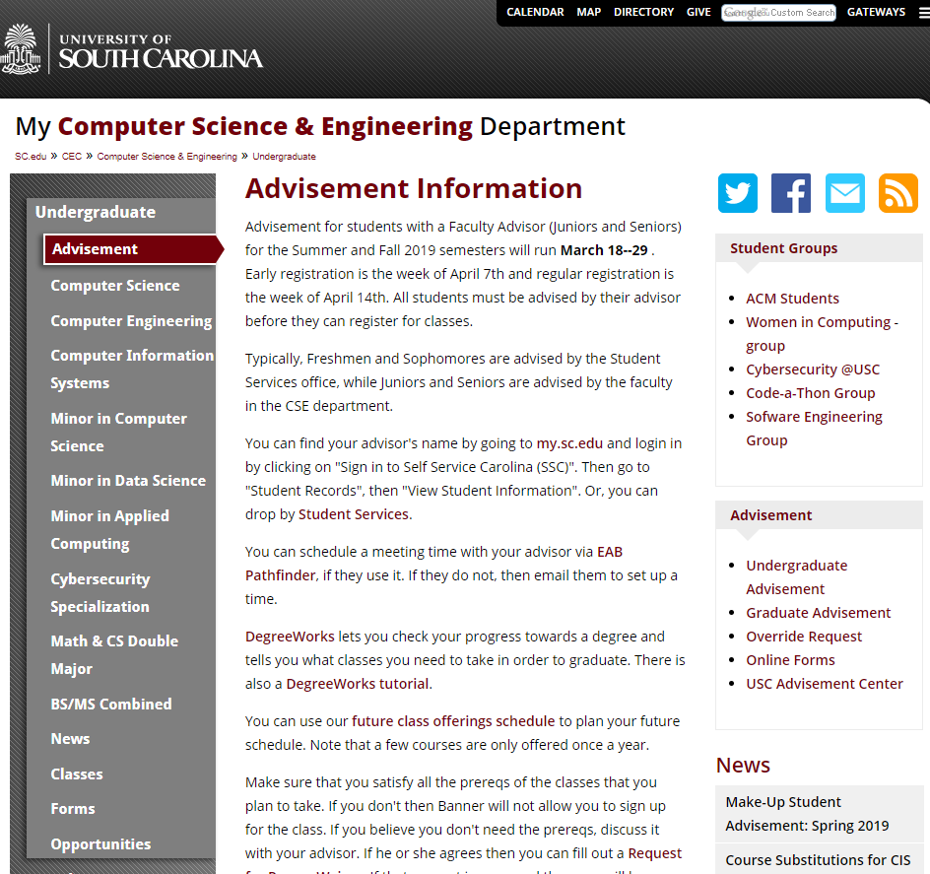
CSCE Department
Dept.
csce.sc.edu
Located on the 2nd floor of Storey Engineering and Innovation Center

Slide 15
Online Advising Resources
Notes:
We have identified different online resources that will help you understand and navigate your advisement at the University of South Carolina. For the remainder of the presentation we will cover each of those platforms, guide you through how to use them and show you what information can be found on which platform. Feel free to follow along on your laptop. [next slide]

Slide 16
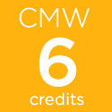
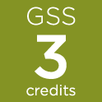
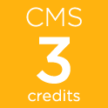
Carolina Core
www.sc.edu/carolinacore
Effective, Engaged and Persuasive Communication: Written
Analytical Reasoning and Problem Solving
Scientific Literacy
Aesthetic and Interpretive Understanding
Global Citizenship and Multicultural Understanding: Foreign Language
Global Citizenship and Multicultural Understanding: Social Sciences
Global Citizenship and Multicultural Understanding: Historical Thinking
Effective, Engaged and Persuasive Communication: Spoken Component
Information Literacy
Values, Ethics and Social Responsibility
Notes:
There are 10 requirements that make up the Carolina Core. Every student has to complete a minimum of what is on the screen.
Carolina Core electives CANNOT overlap with liberal arts or application area electives.

Slide 17
Carolina Core
www.sc.edu/carolinacore
Effective, Engaged and Persuasive Communication: Written
Analytical Reasoning and Problem Solving
Scientific Literacy
Aesthetic and Interpretive Understanding
Global Citizenship and Multicultural Understanding: Foreign Language
Global Citizenship and Multicultural Understanding: Social Sciences
Global Citizenship and Multicultural Understanding: Historical Thinking
Effective, Engaged and Persuasive Communication: Spoken Component
Information Literacy
Values, Ethics and Social Responsibility
Notes:
CSCE majors can only choose FOUR of their Carolina Core electives: AIU, GSS, GHS, and GFL.
The rest of your CC outcomes are fulfilled by courses specifically required by your major (ex. CSCE 145= ARP; CSCE 390= VSR)
CIS majors can also choose 2 CC-SCI electives.

Slide 18
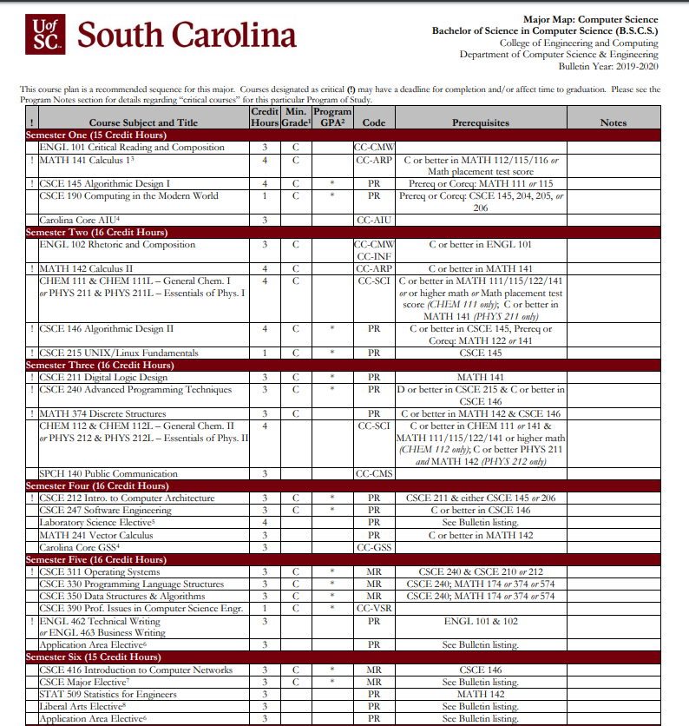
Major Maps
Notes:
A Major Map is a layout of required courses in a given program of study, including critical courses and suggested course sequence to ensure a clear path to graduation.

Slide 19
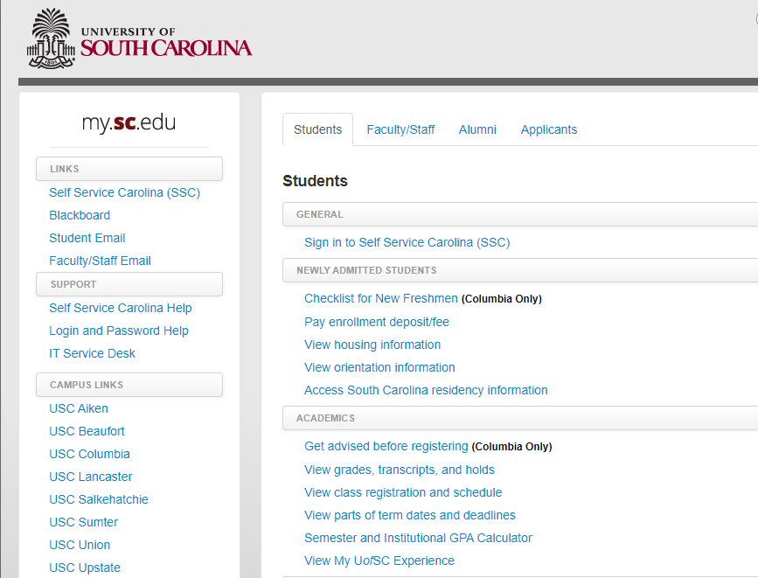
Self service Carolina
my.sc.edu
Notes:
Self Service Carolina is the resource you should be most familiar with. On SSC you can find all of your personal, academic, and financial information. You will also register for classes and check your final grades through Self Service.

Slide 20
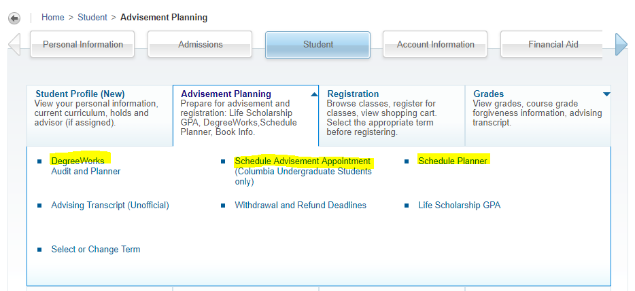
Self Service Carolina
my.sc.edu
Notes:
[click] All of your academic and advising information will be located under the “Student” tab.
Today we’ll be talking about 2 different areas under the student tab:
[click] Student Profile and Advisement Planning.
[next slide]

Slide 21
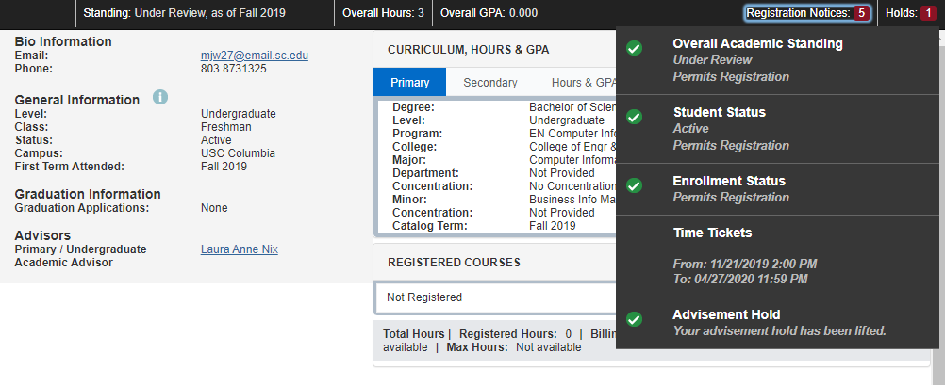
Student profile
Notes:
The Student Profile is your one-stop-shop for all of your academic information. You can also see your Academic Advisor on your student profile and email him/her by clicking the hyperlink with his/her name. [click]
You can check your registration notices and holds in the top right-hand corner of your student profile. Your registration time ticket, which is the time you can begin registering for classes, will be also listed in this section. [click]
If you have an advisement hold, that means you haven’t met with your advisor yet and still need to be advised before you can register for classes. [click]
You can also see what other holds may be on your account. Any hold on your account will restrict you from registration. You must get these holds removed PRIOR to registration. [click]
[next slide]

Slide 22
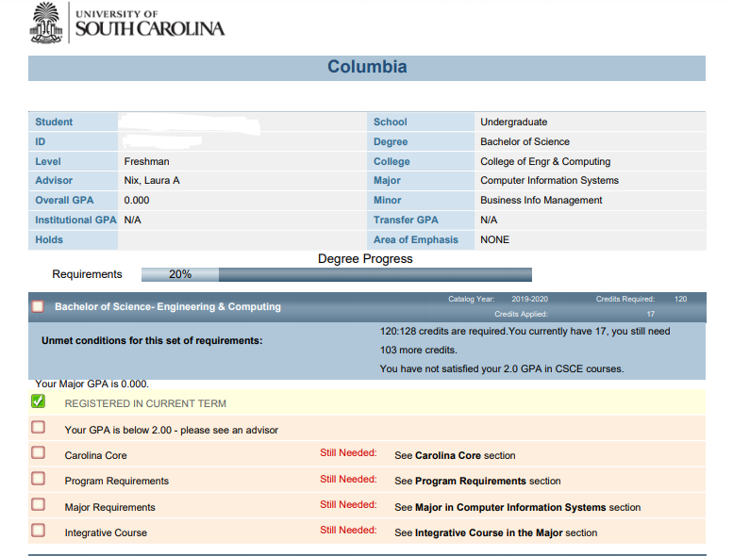
Degree Works
Notes:
Degree Works is a degree audit system that tells students what is required to complete their degree and what they have completed/have left to complete. There is also a cool function that lets you see your degree audit if you were to switch your major.
To access Degree Works, we will start in Self-Service Carolina on the “Student Tab.” Then you’ll click the “Advisement Planning” box and then select “Degree Works”
[next slide]

Slide 23
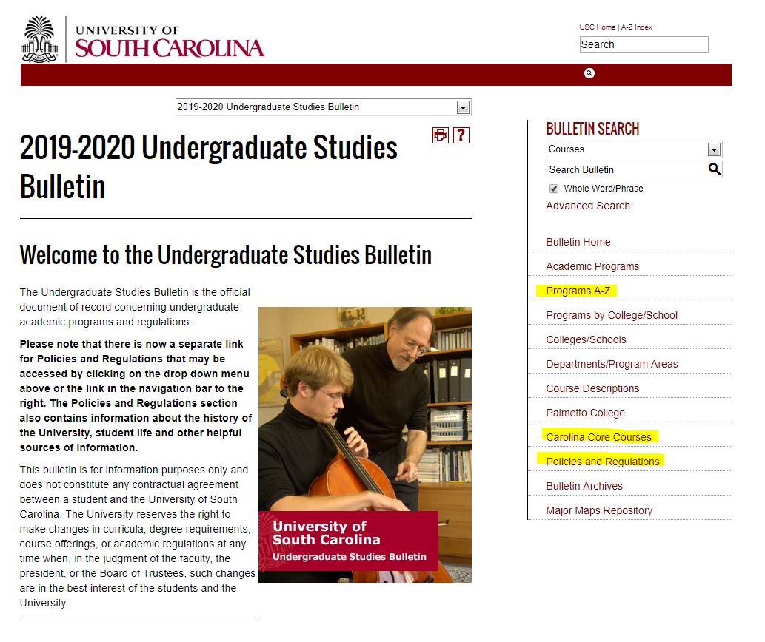
Academic Bulletin
bulletin.sc.edu
Notes:
The next resource we’re going to cover is the Academic Bulletin. The Bulletin is the official document of record concerning undergraduate academic programs and regulations. In the bulletin you can find important things like:
Programs A-Z. List of all Majors and Minors at Carolina
Carolina Core course options. Degree Requirements. Courses and Requirements for all degrees at Carolina Academic Policies. All academic policies and procedures at Carolina
[next slide]

Slide 24
Scheduling your Advising Appointment
sc.campus.eab.com
Notes:
Three different ways to schedule your advising appointment:
Click the direct scheduling link in the advising email that was sent to you on Friday, Sept 13
Go to SSC → Student tab → Advisement planning → Schedule advising appointment
Go to sc.campus.eab.com
[next slide]

Slide 25
Important information
Academic Policies & Procedures

Slide 26
ACADEMIC STANDARDS policies
University
Academic Probation
When a student’s cumulative USC GPA at the end of any semester is less than a 2.00, he or she is placed on academic probation
First-year freshmen on probation must attend an academic coaching session within the first 6 weeks of their 2nd semester before being eligible to register for their 3rd semester
Students on probation must achieve a certain cumulative USC GPA at the end of the semester in order to avoid university suspension
Based on total institutional GPA (chart on next slide)

Slide 27
ACADEMIC STANDARDS policies
University
Academic Probation Chart
Total USC GPA Hours | Placed on Probation | Continue on Probation (Avoid Suspension) | Removed from Probation
12-35 | below 2.00 institutional GPA | 1.500 or higher institutional GPA | 2.00 or higher institutional GPA
36-71 | below 2.00 institutional GPA | 1.800 or higher institutional GPA | 2.00 or higher institutional GPA
72+ | below 2.00 institutional GPA | only with semester reprieve or by college petition | 2.00 or higher institutional GPA
SEMESTER REPRIEVE: Regardless of the total Institutional GPA, a student may continue on probation and avoid suspension if the current term grade point average is 2.50 or greater.

Slide 28
ACADEMIC STANDARDS policies
University
University Suspension
Students who are unable to meet the academic standards shown on the probation chart are suspended from USC for one fall or spring semester and the contiguous summer semester (approximately 8 months)

Slide 29
CEC policies
College
Minimum Grade Requirements
Some courses in your program require a grade of C or better
This includes most Math courses and ALL CSCE courses
Refer to your major map and/or the Academic Bulletin if you are unsure of which courses require a C or better grade

Slide 30
CEC policies
College
Repetition of Course Work
Our College allows a max of four repeated CEC courses (regardless of department, course number, or credit hours)
No CEC course may be taken a third time (only 2 attempts to pass!)
If you exceed four repeated CEC courses or do not pass a course after two attempts, you must change majors or transfer out of the College of Engineering and Computing

Slide 31
Save the dates
Last day to withdrawal from a class without penalty is November 6th
“W” – classes dropped by November 6th
“WF” – classes dropped AFTER November 6th
Registration begins as early as November 11th
Priority Registration: November 11-15
Undergraduate Registration: November 18-22

Slide 32
Questions?
Laura Nix, M.Ed.
Academic Advisor, CEC
nixla@mailbox.sc.edu
803-576-6335
Bill Brown, M.A.
Academic Advisor, CEC
webrown@mailbox.sc.edu
803-777-0947

