Slide 1
Academic Advising
College of Engineering and Computing
Fall 2018

Slide 2
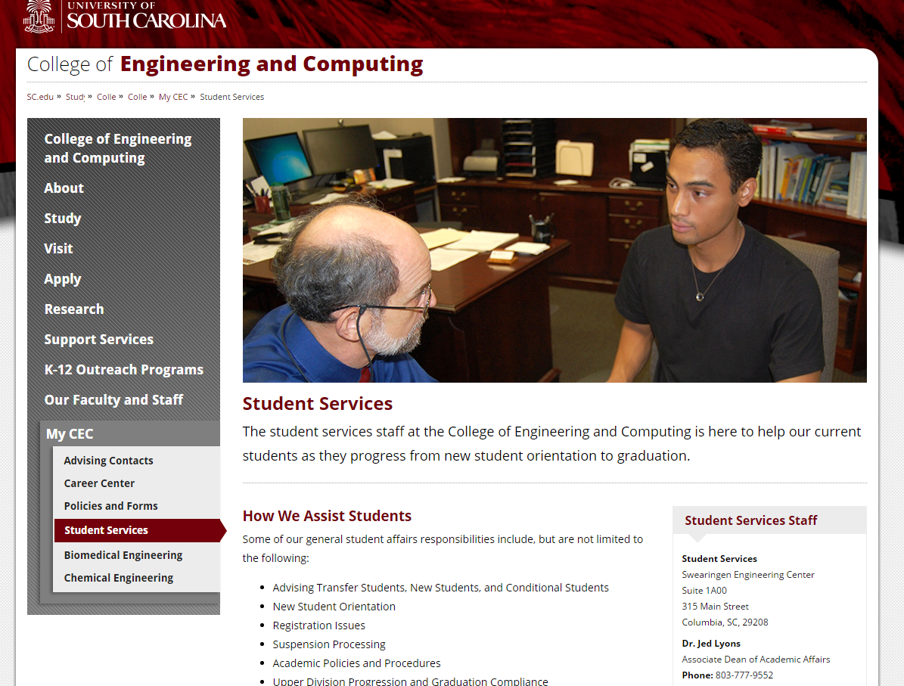
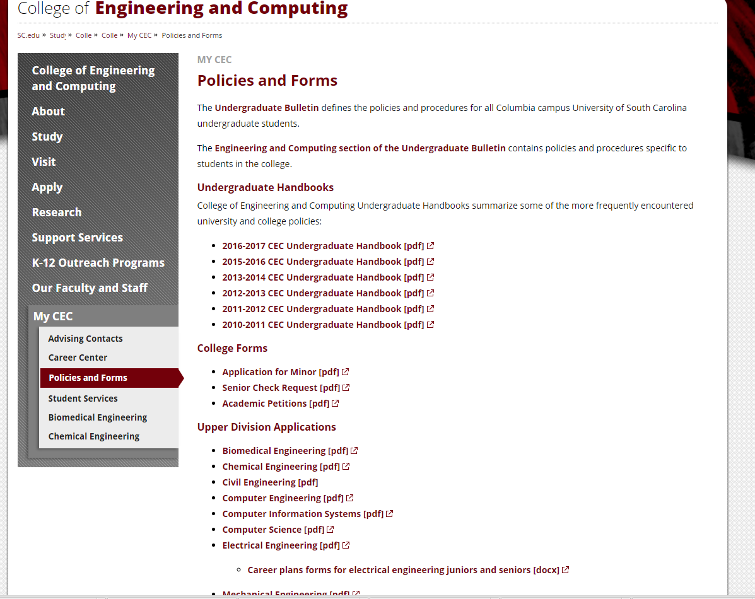
Advising Resources
www.cec.sc.edu
Notes:
This website will provide general information for all of the Majors in the College of Engineering and Computing. Here you will find contact information from staff in the Student Support Service Office, along with general information on Policies and various forms.

Slide 3
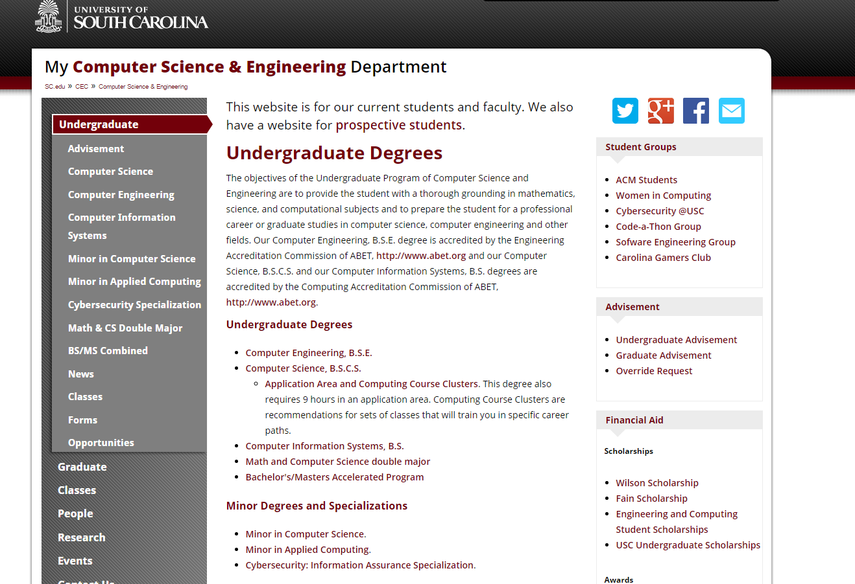
Advising Resources(Computing)
https://cse.sc.edu/undergraduate
Notes:
The computing website is very informative. It will include guidesheets, curriculum sheets, upcoming events, current advisement information, and so much more.

Slide 4
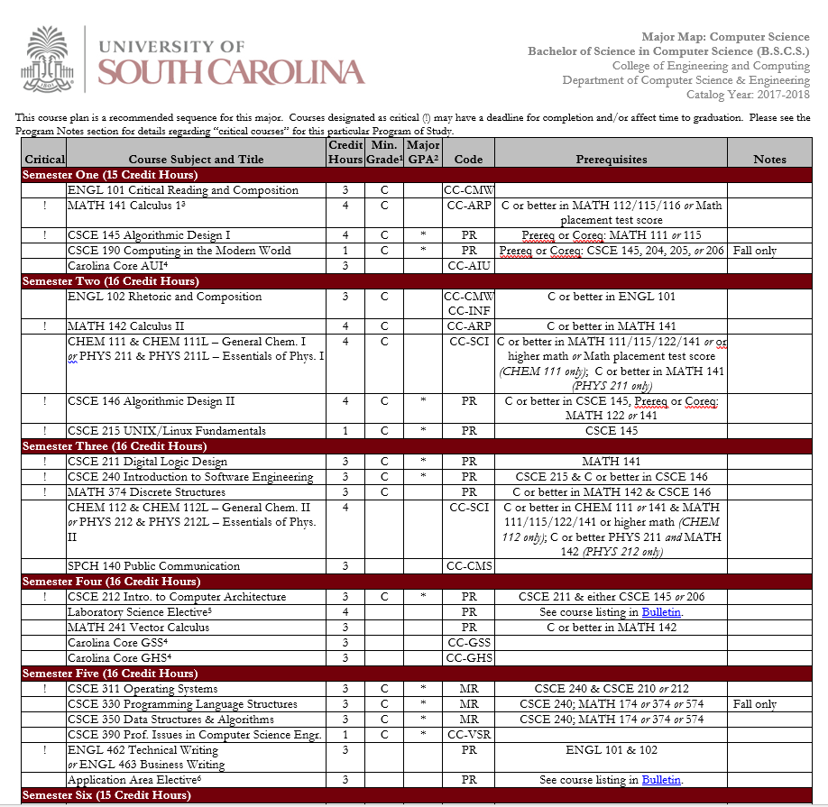
Example of a Guide sheet & Curriculum Sheet
Notes:
Although you will review this during Advisement, it is important for you (as students) to ensure that you have a copy of your guide sheet and Curriculum sheet. Your guidesheet will illustrate the prerequisites of courses needed for your Major as well as if the course must be passed with a “C” or better. Be sure that both the guidesheet and curriculum sheet has the year entered and use it to fill in as you go. Both sheets are equally important and will reflect the accurate record of the requirements of your Major.

Slide 5
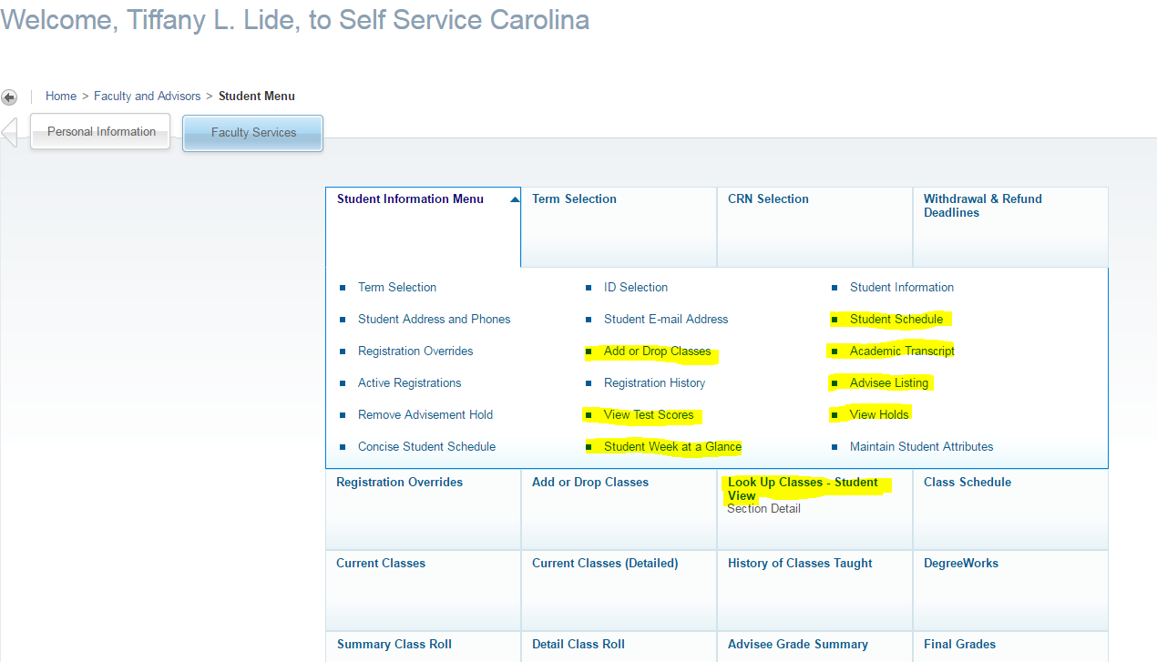
Self Service Carolina
Notes:
The Highlighted Material are links that you might want to become familiar with. It is important for you to know where to look for important academic information.

Slide 6
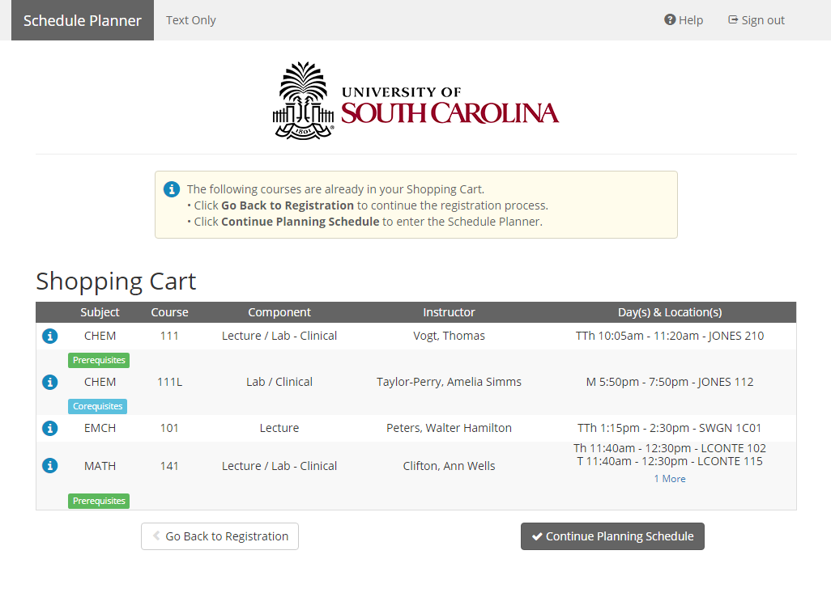
Schedule Planner

Slide 7
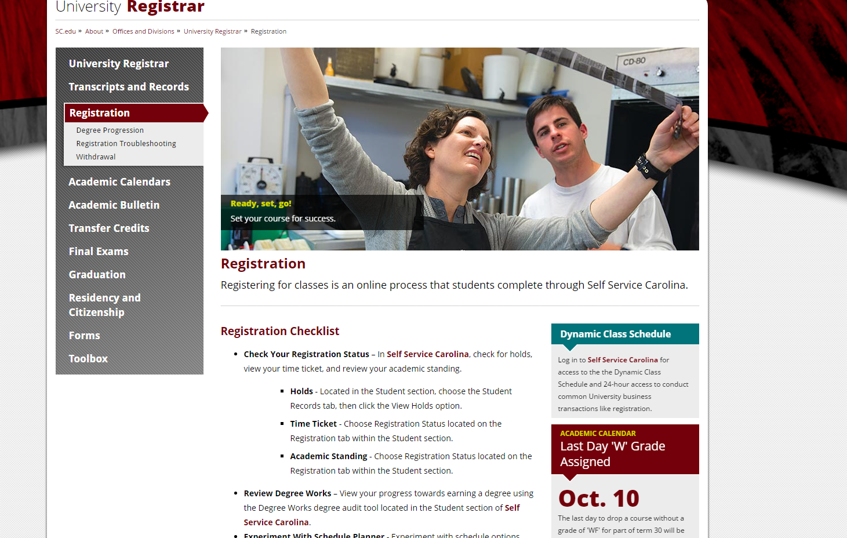

Slide 8

Bulletin
http://bulletin.sc.edu/
Notes:
It is important for you to know that your Bulletin is your “contract” for Academic requirements and Policies, the year you entered the University of South Carolina. It contains information for other Majors and Minors in the entire college.

Slide 9

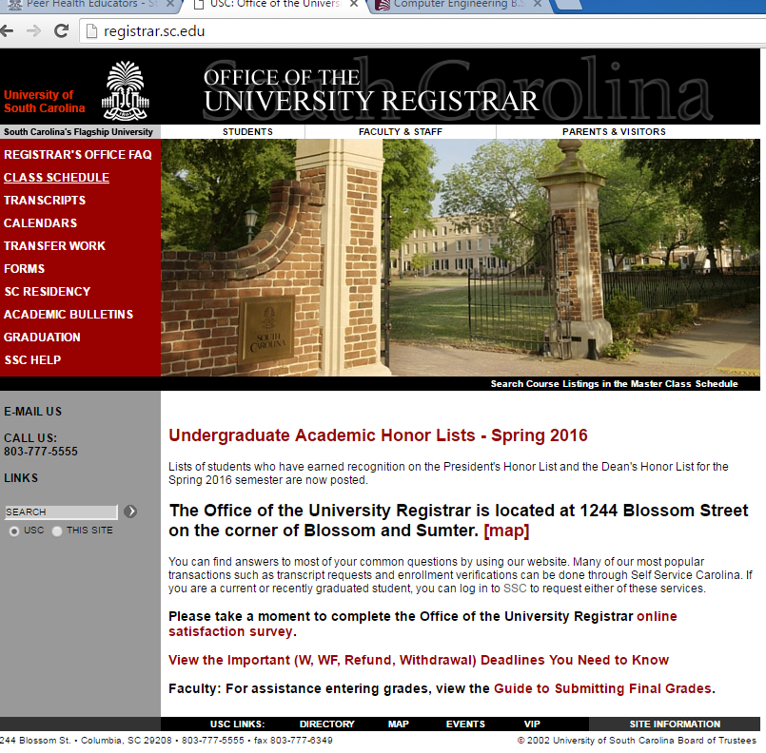
Important Dates to Remember
September 24- Advising Starts
October 18- Last day to drop a course or withdraw without a grade of “WF” being recorded.
October 18-19- No classes (Fall Break)
Nov. 21-25- Thanksgiving Recess (no classes)
December 7- Last day of classes
December 8- Reading Day
December 10-17- Final Examinations (includes exams on Saturday)
http://registrar.sc.edu/
Notes:
Be sure to write the following dates in your calendar.

Slide 10
Things you need to understand
University
College
Department
Related issues: Repeat Policy, Override into a College of Engineering and Computing course, Curriculum related issues, Transfer credit issue

Slide 11
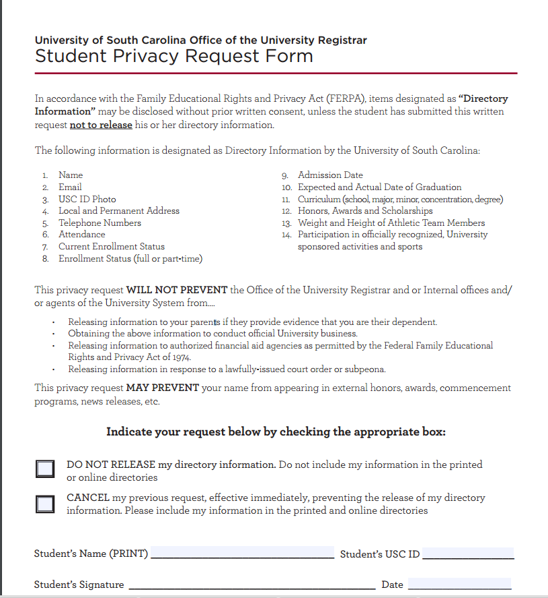
FERPA
Family Educational Rights and Privacy Act
The University will not release Information about students to most people, except for directory information.
A Student may file a Student Privacy Request form to prevent the release of directory information.
A student may file a FERPA Release form to allow parents or others access to grades and academic progress.
Additional details are on the forms and elsewhere on the Registrar’s Office website.
http://registrar.sc.edu/pdf/PrivacyRequest.pdf
Notes:
Advisors/Instructors can only speak to your parents if you both signed the FERPA release form, which is located on the Registrar’s Website.

Slide 12
Other Important Policies
Repetition of Course work-
-CEC allows a max of four repeated Engineering & Computing courses. Regardless of other satisfactory work a course may not be taken a third time (2 chances to pass!).
-If you exceed four repeated Engineering & Computing courses or do not pass a course after two attempts, you must change majors or transfer out of the College of Engineering & Computing.

Slide 13
Dropping of a Course-
-Until October 18th, any dropped course will reflect a “W” on your transcript.
-The “W” is grade-neutral; it is not calculated into your GPA.
-If you decide to drop after the Withdrawal deadline, you will receive a “WF” which is treated as an “F.”

Slide 14

Other Important Policies
Grade Forgiveness- You are allowed to take up to (2) undergraduate courses for a second time for the purpose of grade forgiveness. The grade must be a D+. D, F, or WF. Once grade forgiveness is applied to a repeated course, the action may not be revoked. The form is found on the Registrar’s webpage.
University Suspension-
1st suspension: Students unable to meet the standards shown on the chart (next slide) are suspended from USC for one Fall or Spring semester and contiguous summer (approximately 8 months). Students have the right to appeal to the petition committee.
Returning after First suspension : After the suspension has been served, a student will be considered for readmission by the college or school to which the student is seeking admission. A student readmitted following suspension continues on probation & is reviewed for suspension at the end of each Fall or Spring semester. A semester GPA of a 2.5 or higher must be achieved each semester.
Notes:
Students returning from a first suspension who fails to meet academic standards will be permanently suspended from the University. The duration of the second suspension is indefinite, and the student can be considered for readmission only after being approved for reinstatement by a successful petition from the college or school to which the student is seeking admission. A favorable decision by college petitions committee is unlikely within two years of the suspension. Credits earned while a student is on academic suspsension from the University cannot be applied toward a degree or used in improving grade point average.

Slide 15
Taking Courses from Another School (Transient Status)
Students can take up to 18 semester hours of courses in transient status provided:
  the student is in good standing by USC (2.0 GPA or higher)
  the courses are approved in advance by the Office of Student Services or First-Year Advisor
  USC grades of (D, WF, F) retaken at USC
  the transient institution is fully accredited
  the student is not in the last 30 degree hours
  transient grades must be a C or higher to be applied to degree program.
**Remember: The last 30 semester hours must be earned in residence at the University, and at least half of the credit hours in the student’s major courses and in the student’s minor courses (if applicable) must be taken at the University.

Slide 16
Typical Course load
Full-time Minimum | 12 Hours
Full-time Maximum | 18 Hours
Typical Class Load | 12-17 Hours
Notes:
Full-time enrollment is a minimum of 12 semester hours. Most students must complete 15 semester hours each semester to graduate in four years or to meet LIFE or Palmetto Scholarship requirements. Full-time fees are calculated on 12 to 16 semester hours. An additional fee per credit hour will apply to any course loads above 16 semester hours. It your responsibility to mindful of this. Also, first semester freshman students are not allowed to register for more than 18 hours. After the first semester, students may register for more than 18 hours if they have a USC gpa of a 3.) or better.

Slide 17
How does Advising Work?
Advisement Appointment- September/October
Advising Hold lifted
Early October- Find out Registration time
Early November- Registration

Slide 18

How can I find my Advisor in the future?
All students can find their advisor by logging into Self Service Carolina and click on the Student Tab → Student Records → View Student Information. It is the student’s responsibility to contact his/her advisor to set up an advisement appointment.

Slide 19
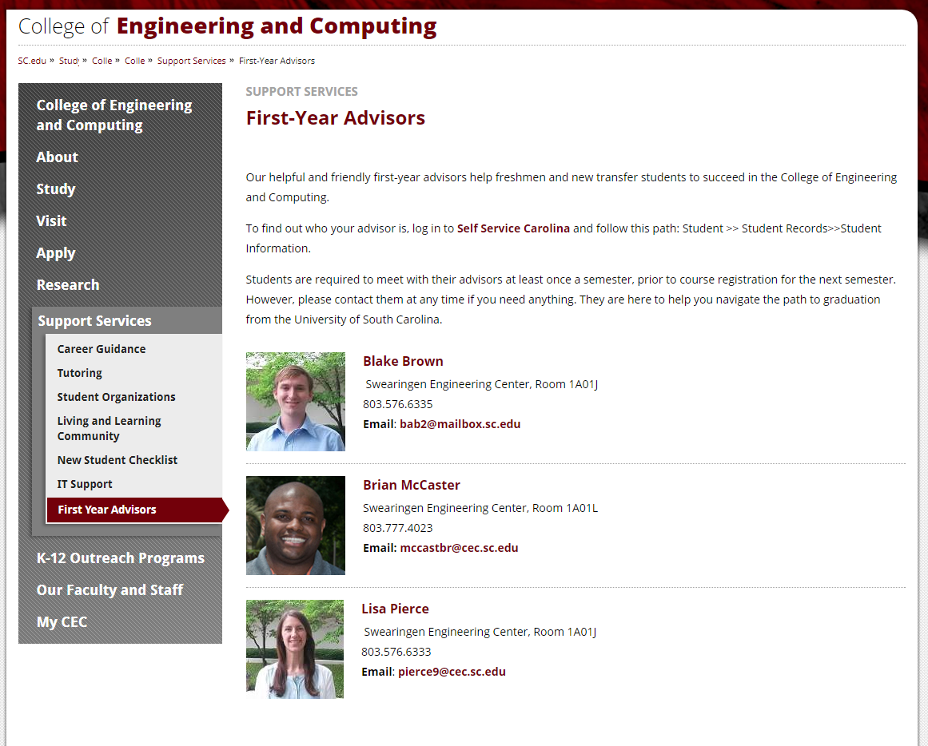
How to set up an Appointment…
https://sc.edu/study/colleges_schools/engineering_and_computing/supportservices/firstyearadvising.php

Slide 20
Questions?

