Slide 1
Computing careers in the real world
Or
“I have my degree, now what?”
Notes:
1

Slide 2
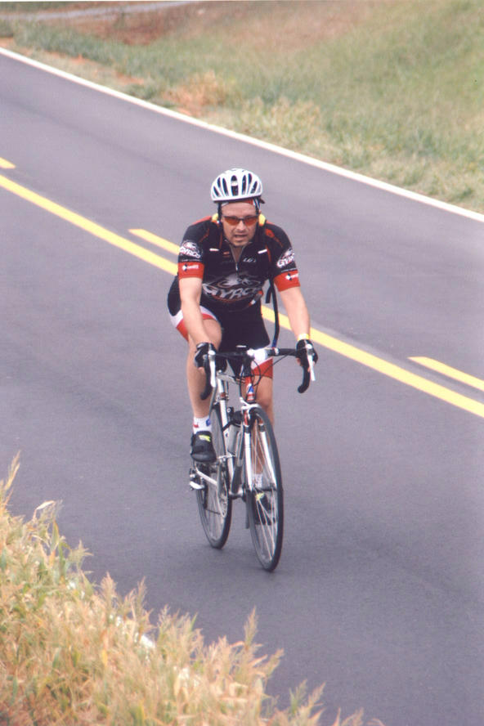
Who am I?
CS graduate (class of 1983)
Principal Software Engineer for Dell EMC
Living/working in Raleigh, NC since 1998.
Notes:
2

Slide 3
My Background
Graduated from Carolina in 1983 with a BS in Computer Science
Graduated from Texas A&M with a Master of Computer Science in 1985
Graduated from Kennedy-Western University in 2002 with a PhD in Computer Science
34 yrs of IT experience
Notes:
3

Slide 4
Job History
Job titles I've held:
Associate Engineer
Senior Software Engineer
Associate Programmer, Senior Associate Programmer
Sr System Administrator
Staff Software Engineer
Adjunct Lecturer
Advisory Programmer
Technical Consultant
Sr Software Engineer
Principal Software Engineer
Notes:
4

Slide 5
Job History (2)
Companies I've worked for:
Austin, TX Raleigh, NC
Lockheed Missiles and Space Corp IBM SWG Tivoli
Eagle Signal Controls IBM STG – High Perf Computing
IBM RS6000 Division DellEMC
Applied Research Labs Edgybees, Inc
Tivoli Systems
St. Edwards University
Notes:
5

Slide 6
Job History (3)
Areas I've worked:
System Test
Software Development
Infrastructure support
Build and Configuration control
Pre-sales support
Customer support
Startup – all tasks
Notes:
6

Slide 7
How many cities have I worked in?
one (1)
two (2)
three (3)

Slide 8
Current Position
US Software Development Lead, Edgybees, Inc
Responsibilities:
Work with US/DoD customers collecting requirements, adding support for additional cameras, bug fixing.
Demonstrating software capabilities and specific contract deliverables.
Notes:
8

Slide 9
Observations over 30+ years
Working for technology company is different than working in IT
Technology changes, don't be enamored so much with something you cannot adapt
Learning never stops, join professional societies, local user groups, take additional on-line course, etc.
Select a job that you like, not because of the boss. Odds are the boss will change long before the job does.
I continue to be in awe of what we have accomplished in the past 30 yrs, looking forward to the next 30.
Notes:
9

Slide 10
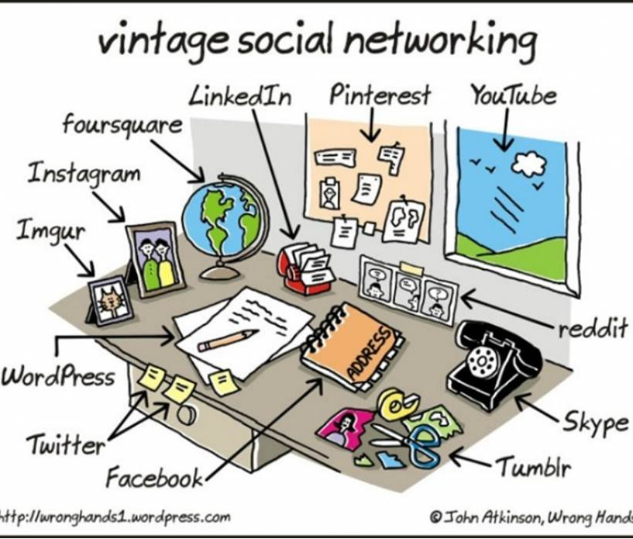
The world before the Internet

Slide 11
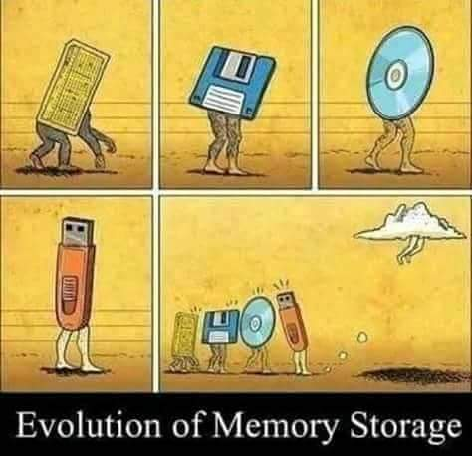
How computer storage has evolved

Slide 12
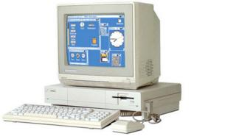
My first personal computer
512KB memory
640x480 video
Motorola 68000 @ 7 Mhz
Dual floppy system
Cost: $1900 (1986)
Notes:
12

Slide 13
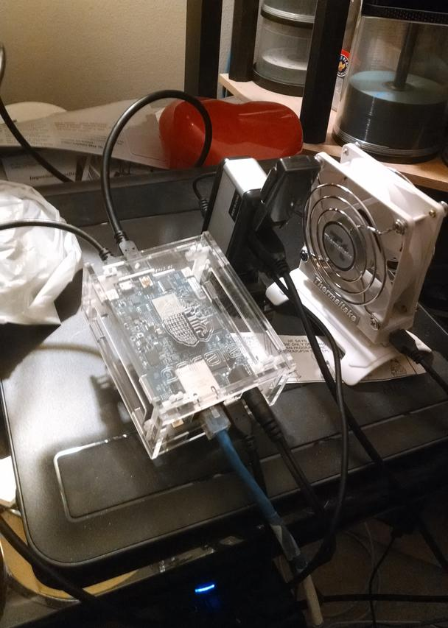
My latest computer
1 GB memory
dual core ARM processor @ 1.5 GHz
16 core co-processor
16GB SD card
1Gb Ethernet
1920x1080 HDMI video
Linux OS
Cost: $149 (2014)
Notes:
13

Slide 14
My first computer had how much memory?
16KB of memory
512KB of memory
8MB of memory
8GB of memory

Slide 15
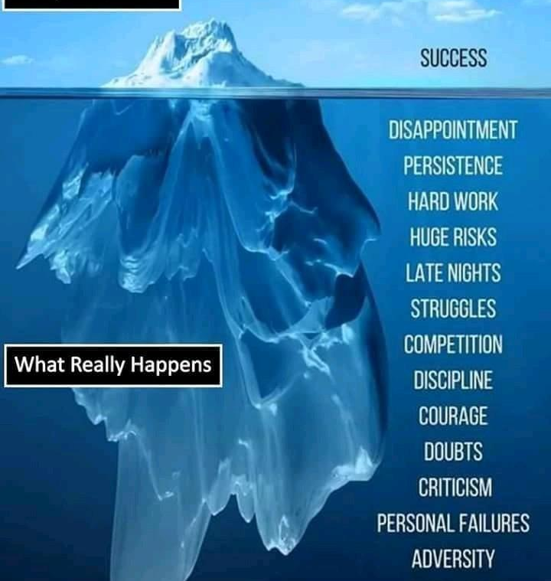
Things to remember
. What people see is the end result
. Only you (and your co-workers) know the real story.
. Celebrate your successes
. When you are part of a team, realize that words of encouragement work better than finger pointing and blame.

Slide 16
Q & A
Feel free to ask anything
If you think of something after I leave, feel free to contact me at jerry.heyman@edgybeesus.com
Notes:
16

