Slide 1

The Career Center and
Helping you Prepare for the STEM Fair

Slide 2
Our Agenda for this Evening:
What is the Career Center?
How Do I Prepare for the Gamecocks Get Hired: STEM Majors Fair?
  What is Handshake?
  How do I start my Resume?
Notes:
Learning Outcomes:
Explain the purpose of a professional resume.
Identify the Career Center’s career management platform, Handshake.
Explain the importance of networking.

Slide 3
Our Mission
The mission of the University of South Carolina Career Center is to educate and empower students in their development of lifelong career management skills.

Slide 4
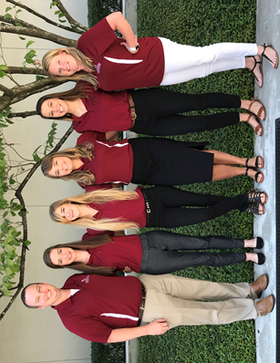
CEC CAREER CENTER
Chris
Lewandowski
Assistant Director
Taryn
Asbury
Career
Coach
Christina
Wentworth
Graduate Assistant
Christine Mosich
Career
Coach
Shannon McCormack
Graduate Assistant
Kati Jennings Reception Coordinator

Slide 5

How does the Career Center help?
Mock Interviews
Company Research
Salary Negotiation
Resume Reviews
Professional Development
Major & Career
Exploration
Handshake
Internship & Co-op
Search

Slide 6

CAREER STYLE

Slide 7

Your academic major is the most important factor to an employer decision.

Slide 8

Generation Z will have on average
12 to 17 jobs

Slide 9

Market demand should determine my choice of major and career.

Slide 10
Most students change their major at least once.

Slide 11
HOW TO BECOME EMPLOYABLE

Slide 12


Slide 13

Stem majors career fair
Notes:
Before we jump into the content of our presentation today, I wanted to make you all aware of our next set of career fairs coming up this fall, if you aren’t already aware. The Gamecocks Get Hired Career Day Days will be on Tuesday, September 24th and Wednesday, September 25th from 12PM to 4PM in the Columbia Metropolitan Convention Center. The first day will be focused on students entering into the STEM fields and the second day will be focused on all other majors and a more diverse representation of industries. To obtain more information regarding the fair, I would encourage you to check out the fair in Handshake.

Slide 14




Preparing for the career fair
Craft A
Resume
Research Employers
Practice Elevator Pitch
Prepare for the Day of
Notes:
In order to make the most of any career fair, there are 4 key success factors that we encourage every student to complete. The first one is to craft a resume that highlights all the relevant experiences and skills you can bring to the table. The second one is to research employers so you know more about what they can do and can answer questions professionally during a one-on-one interaction. The third key success factor is to practice and polish your elevator pitch. By a show of hands, how many of you have heard of an elevator pitch before? Can anyone explain it for me? An elevator pitch is a brief synopsis of your background and experience and is something you would use to sell yourself if you only had 30 seconds with the CEO of your favorite company. The last key success factor is to prepare for the day of by planning what you’re going to wear, what you’re going to bring and how you going to communicate with employers. Today we’re going to go through each of these key success factors in detail and provide you with sample materials to help you make the most of the career fairs we have coming up this semester.

Slide 15
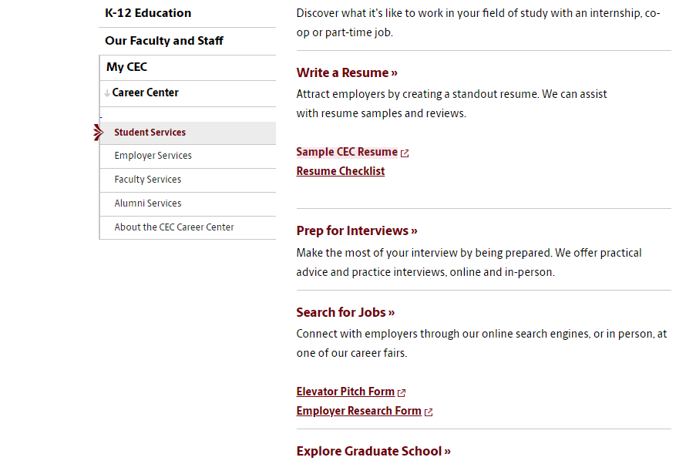
Career fair toolkit
My CEC - Career Center - Student Services
http://cec.sc.edu/careercenter
Notes:
In addition to OPPA, we have two locations on campus. Our main Career Center is located in Thomas Cooper Library on the 5th floor. We also have a satellite office in the College of Engineering & Computing, for students enrolled in that college.

Slide 16


How to Research employers
Handshake
Career Fair + App
Notes:
The other resource we highly, highly recommend you utilize to conduct research on employers is The Career Fair Plus App. This app is free and can be downloaded from the App Store or Google Play depending on which device you have. Our Career Fairs are moving towards a more sustainable look and will be solely relying on this app instead of printed versions of the information. The Career Fair Plus App will be your #1 day-of resource for identifying employers in attendance, the positions they’re hiring for and the majors they’ll accept, and, most importantly, where they’re located within the convention center so you can strategize who you speak with first.

Slide 17
Researching Employers
Review the list of employers attending the fair
  Handshake
  Fairs app
Visit employer web sites
Narrow your focus and prioritize the number of employers you want to connect with
Before the Fair

Slide 18

Suit Up!
Before the Fair

Slide 19

The Importance of Networking
80% of job vacancies: never advertised
The overall time needed to
find a job can be drastically
reduced.
  4-6 months if networking
  6-9 months if not networking
Learn about occupations, employers, and industries of interest
START EARLY!
Notes:
Therefore, it’s important to follow up appropriately!

Slide 20

Prepare your Pitch
Elevator Pitch:
Marketing message for
your professional self
Your qualifications
+ Your interests/goals
+ Why this organization
= Your Pitch
30-60 seconds
Practice, practice, practice!
Notes:
Articulate who you are, where you’ve been, and where you want to go
*The image is hyperlinked to an elevator pitch video.

Slide 21
Practice Time you have until the Sand Runs out!
1 minute
End
Notes:
This ‘sand timer’ will start on a mouse click anywhere on the slide. The ‘sand’ will drain from the top section to the lower section and when completed will show the word ‘End’.
To change the timings of this timer, you need to enter the animation settings, and change the timings for the Isosceles Triangles. There will be 2 that need changing (to the same amount) – one animates the top triangle emptying, whilst the other animates the bottom triangle filling.
When you change the timings these have to entered as a number of seconds.

Slide 22
Prepare to Make a Good Impression
Bring 20+ copies of well-written, critiqued resume
Practice your elevator pitch until it sounds natural
Develop a list of questions for employers based on your research
Prepare a “Career Fair Employer Log” to use for note-taking during the fair
Before the Fair
Notes:
Know how to relate your past work, academic and out-of-class experiences, to the career field.
Prepare a career log in advance to document career fair information (i.e., To whom have you given a resume?, Are they scheduled to return to USC ?, etc.)

Slide 23

Come visit us!
College of Engineering & Computing Career Center
Swearingen 3A57 | 803-777-1949
Drop-Ins: Monday-Friday, 1-4pm, SWGN 3D19
Appointments: Sign up on Handshake, SWGN 3A57

Slide 24

1st-YEAR CAREER READY BUCKET LIST
Activate Handshake & complete your profile
(sc.joinhandshake.com)
Take career assessments then meet with
your career coach to discuss career paths
Get involved in organizations or activities
to build your resume & make connections
Come to Drop-in (Mon-Fri, 1-4pm) for help building your resume
Attend a career-related event (like attending
a career fair to introduce yourself to employers)

Slide 25

Thank you!
Questions?

